Slide 1
Governing Board Annual Training

Slide 2
Annual Training including:
Finance Training for Governing Boards with Spencer Styles of Charter Impact
Brown Act and Political Reform Act Training by Jennifer McQuarrie

Slide 3
Let’s Talk!
Topics of discussion:
Board Goals
Board Evaluation Process
Additional Training Requests

Slide 4
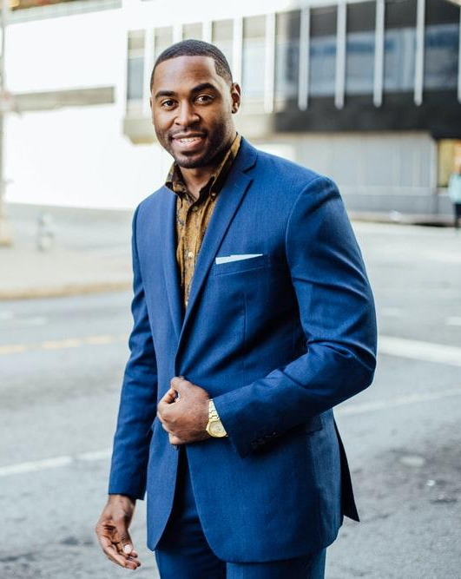
What else would you like to discuss?

