Slide 1
Executive Director’s Report
May 2022

Slide 2
Lake View Agenda
01
02
03
04
Enrollment
Vista Ordering
Anti-Bias Training
Return Date for Teachers

Slide 3
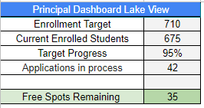
Enrollment Update
A special thank you to our amazing Sequoia Grove Enrollment Team!!!

Slide 4
New Ordering System Launched for Pre-Ordering!
A great big thank you to Stephanie and Ryan for helping with the build and implementation!

Slide 5
Notes:
Allie

Slide 6
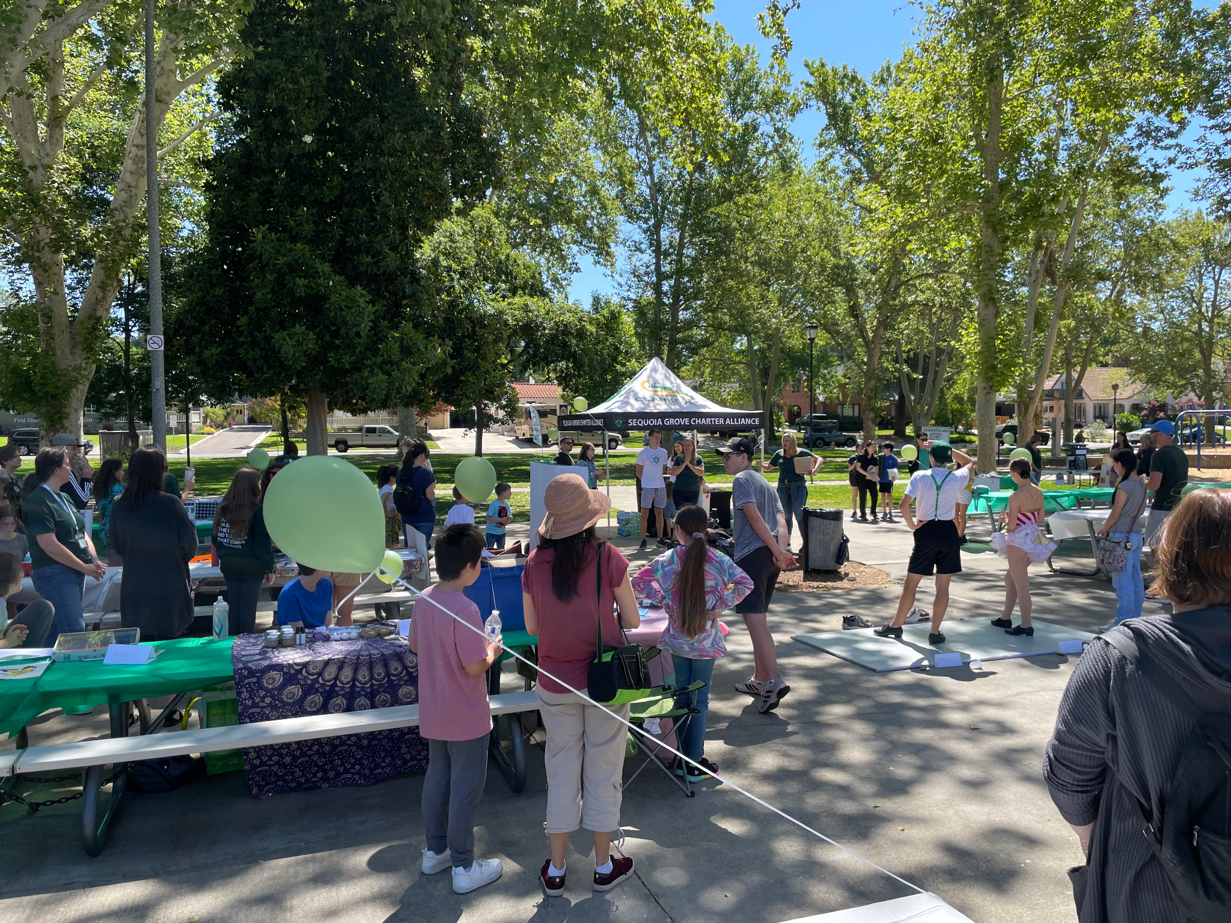
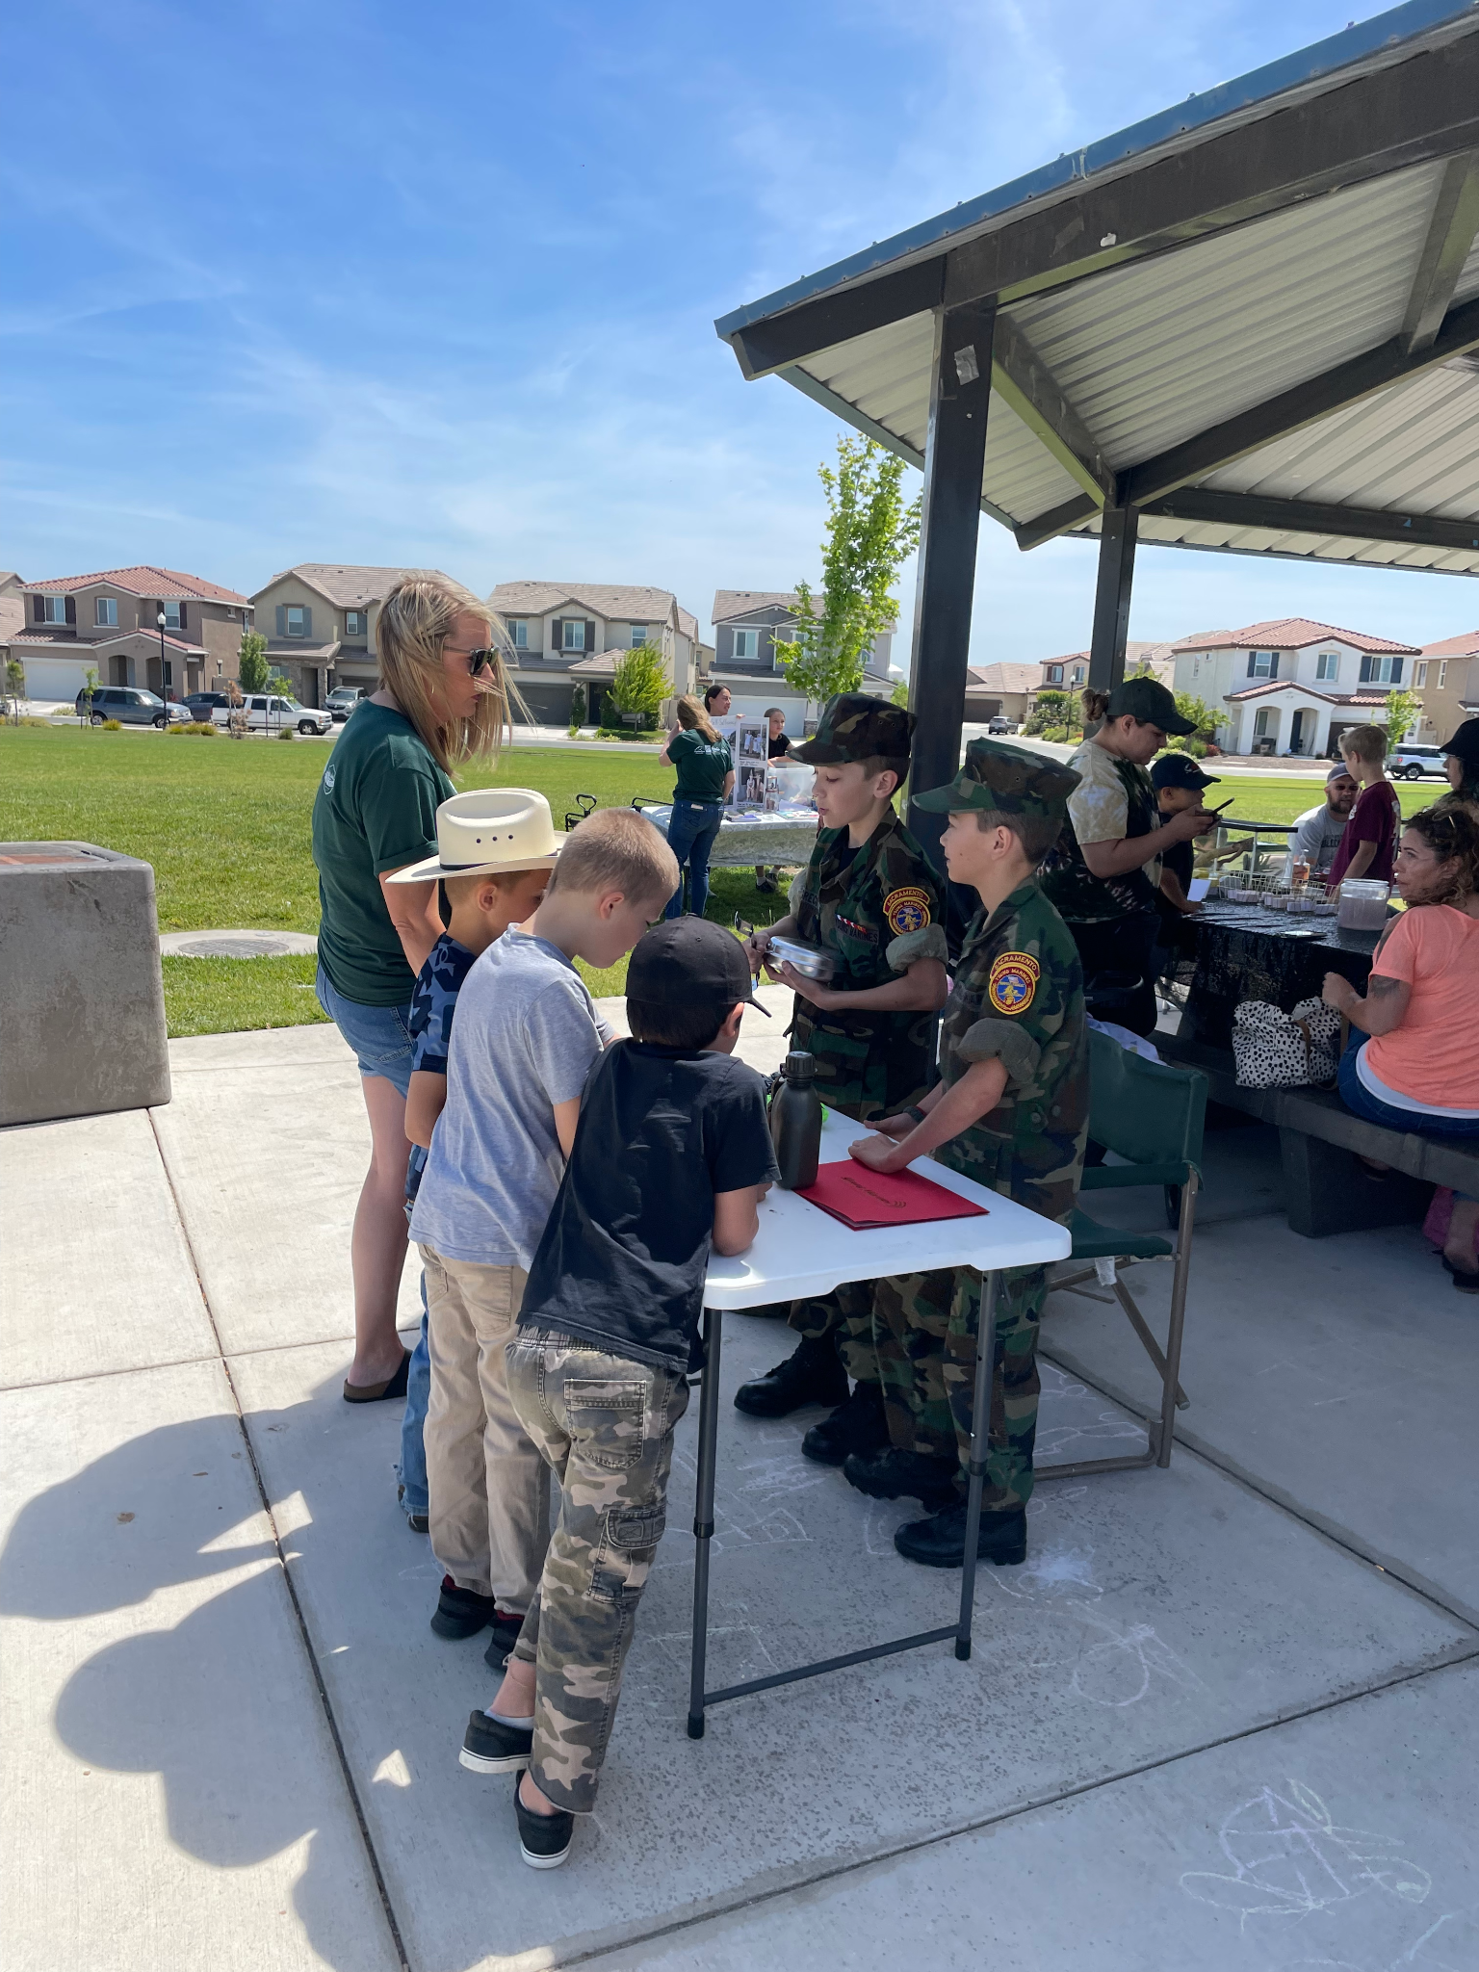
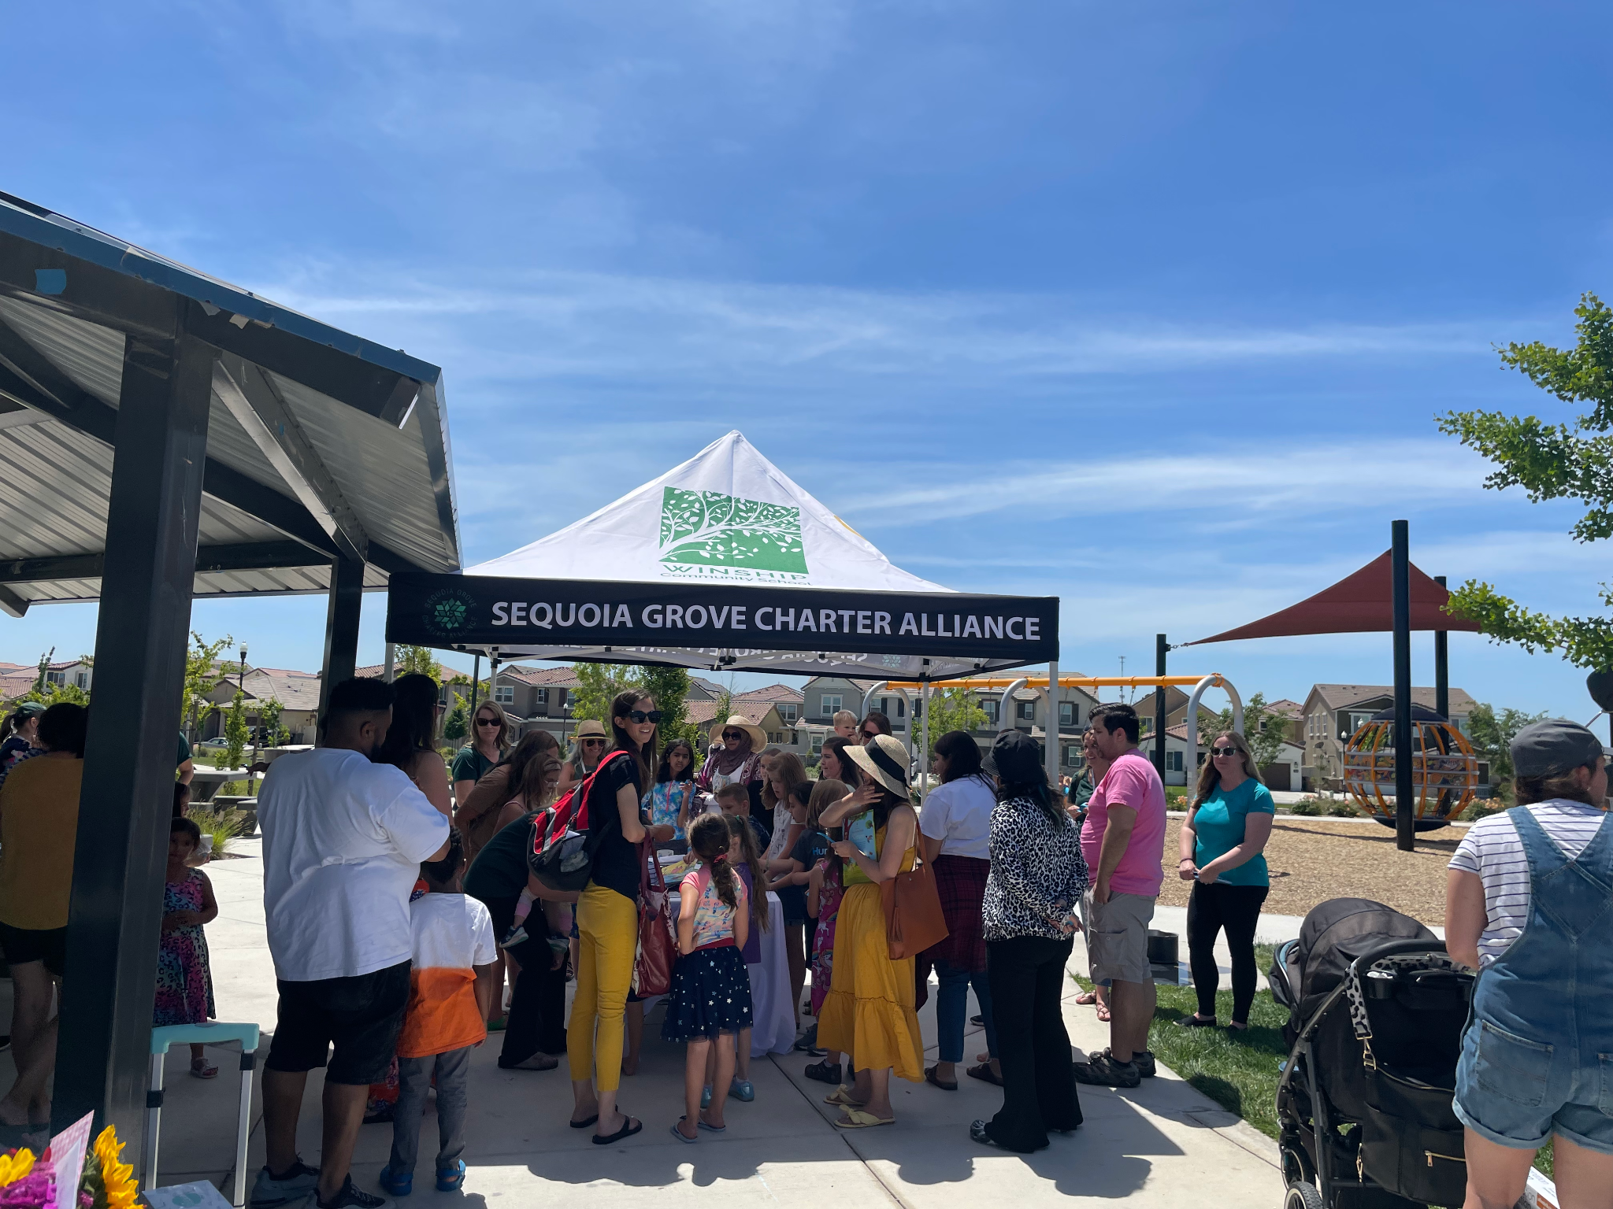
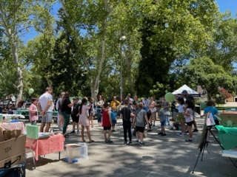
Student Showcase Success!
Our students are so talented!
Notes:
Allie

Slide 7
2022-2023 Diversity, Equity, & Inclusion PD
Back to School Professional Development:
Schoolwide Professional Development will include a virtual presentation and small group breakout sessions
with presenter and facilitator, Dr. Shree Walker, as she addresses the topic of Meeting the Needs of Diverse Learners.
Meeting the Needs of Diverse Learners will expose educators to their conscious and unconscious biases
related to diverse learners, provide tools to adjust automatic patterns of thinking, causing a mindset shift and
ultimately empowering educators to first seek to understand, separate facts from feelings and
cultivate high expectations and positive relationship with diverse learners.
Notes:
Allie

Slide 8
Ongoing Professional Development Opportunities throughout the school year will include:
Online Learning Modules available in the Professional Development Google Classroom
Facilitated Small Group Discussions within Instructional Teams
Diversity, Inclusion, and Growth Book Club Opportunities
SEL Wellness Sessions
DEI Training Resources to be Reviewed for possible implementation:
Transforming Education: SEL Educator Toolkit
Epoch Education: DEL Online Trainings
Franklin Covey: Unconscious Bias: Understanding Bias to Unleash Potential

Slide 9
We made it to the end of our first year as Sequoia Grove.
It has been quite a journey and we look forward to continuing to serve our homeschool families well in the future.
Thank you to all of our school staff, the CSO staff and our boards for making this year a success.
Teachers will return August 1

Slide 10
Thank you so much
For all you do to encourage, inspire, motivate and guide your teams! The work you do is amazing! You are much appreciated.

