Slide 1
Executive Director’s Report
March 2022

Slide 2
Agenda
Enrollment
CAASPP Testing
HSVA Presentation
System Update for 22-23
High School & HSVA

Slide 3
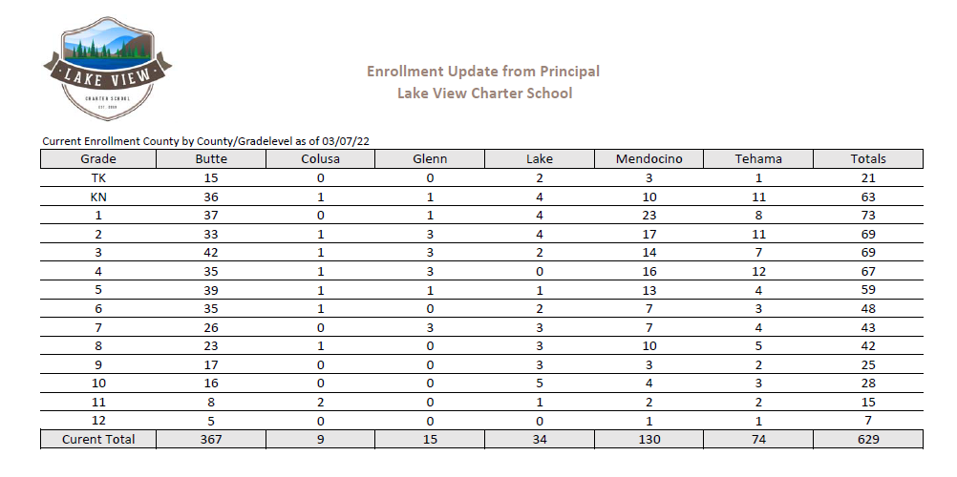

Slide 4
CAASPP Testing
Testing window is March 7 - May 13
CAASPP includes ELA & Math (gr. 3-8 & 11)
CAST Science Test (gr. 5, 8 and once in HS)
CAA (California Alternative Assessment)
Hybrid administration
Approximately 12% wish to test in-person
Remainder wish to test remotely
95% participation rate is critical!
Photo by Syed Hussaini on Unsplash
Notes:
Our testing window opened on March 7th and will run through May 13th. We will test 3-8 and 11th graders in Math and ELA, as well as 5, 8, and HS students for the CAST Science test.
We were able to incorporate teacher’s feedback from the administration of the Interim tests, and as a result have been able to accommodate hybrid testing! Of the approximately 2500 students that we are testing, only 12% wished to test in-person. The rest have opted for virtual testing. Those virtual sessions will be staffed with tech support and proctors to assist families and our teachers with any computer-related issues they may have. And as a bonus have significantly reduced the amount of proctoring hours required by teachers.
We Thrive at 95! Due to changes in the way the Dashboard calculations work (penalized for every student below 95% participation, as opposed to a point deduction for every percent below 95 not tested) the participation rate is more important than ever, as those deductions count towards our academic indicators as well, and can reduce our Distance From Standard Scores.

Slide 5
Our Messaging to Families:

Slide 6
Looking Ahead….
3/14
4/4
4/6
5/2-23
5/24
5/31
Open Enrollment Begins
Intent to Return sent to all current families
Open Enrollment Closes
Intent to Return is due
Ordering cutoff using current year’s funds
Spring Showcases
8th grade Virtual Promotion
4pm
In-Person HS Graduation @ Memorial Auditorium 4pm

Slide 7
NEW- Vista Ordering System for the 2022-2023 School Year!

Slide 8
Spring Showcases
What it is?
Extended Park Day
Outdoor Open House
TK-12th Grades
Where & When?
6 Different Parks / Locations throughout the month of May
(Lending Library Van schedule)
Student Station
Students Bring Own Table or Blanket
Ideas:
Art, LEGO, Science Experiment, Sewing Project, Report, Crafts, Talent
Notes:
What is it: Families Bring Own Table or Blanket
Student or Family Table
Talent: Pre-record performance, play instrument at station, perform magic trick, Science Demo, Famous Person/Book Character dress up

Slide 9
Spring Showcase Dates/Locations
Ukiah
Folsom
Butte/Chico
Roseville
Elk Grove
Tahoe
*May 2nd
12:00pm - 2:00pm
Todd Grove Park
*May 23rd
11:00am - 1:00pm
Wildwood Park
May 20th
10:00am - 12:00pm
Nisenan Park
*May 16th
10:00am - 1:00pm
Royer Park
*May 18th
11:00am - 1:00pm
Kammerer Park
*May 11th
1:00pm - 3:00pm
Bijou Park

Slide 10
Transition to High School Series
This is a two part series for all 8th graders and new students looking to to join BOTH NIGHTS for a 2 part series.
The high school team will be in attendance and ready to answer questions

Slide 11
HSVA Mission
The mission of HSVA is to provide standards-based, a-g instruction to independent study high school students by a CA single-subject credentialed teacher. HSVA provides opportunities for students to learn synchronously and asynchronously in a safe, online learning environment.

Slide 12
HSVA Model
Stacking hands with the whole learning team to ensure student success

Slide 13
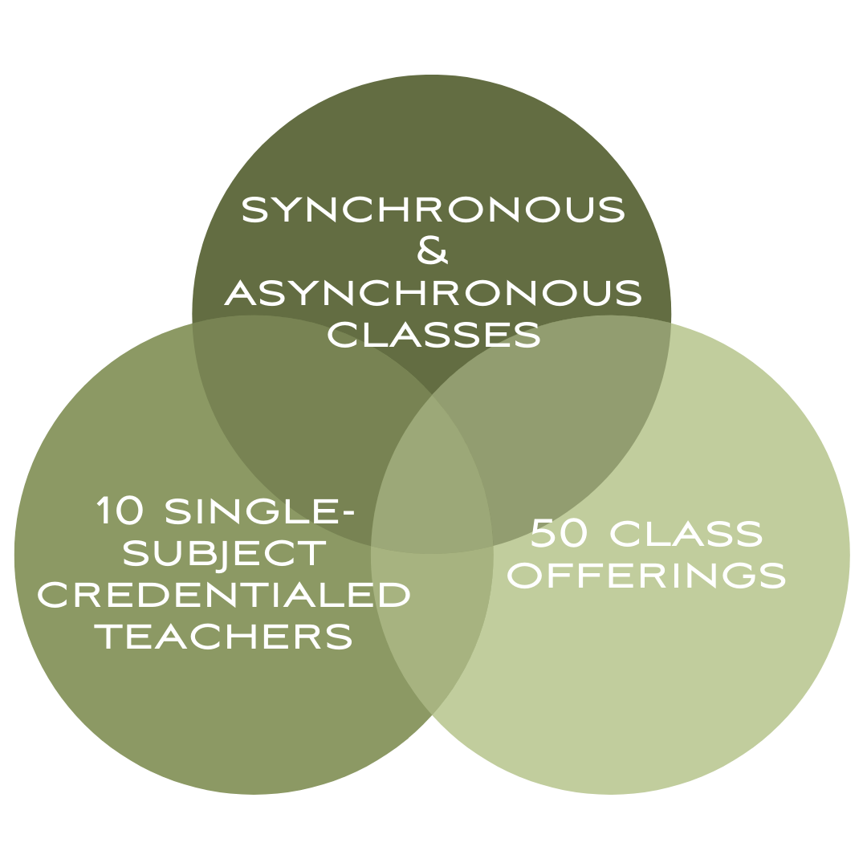
HSVA Model

Slide 14
High School & HSVA Enrollment
School | Total Enrollment | # High School Students | % of students in High School | HSVA Students | % of HS students in HSVA | % of students overall in HSVA
Clarksville | 1624 | 282 | 17% | 100 | 35% | 6%
Feather River | 1830 | 384 | 21% | 178 | 46% | 10%
Lake View | 629 | 75 | 12% | 19 | 25% | 3%
Total | 4083 | 741 | 18% | 297 | 40% | 7%

Slide 15
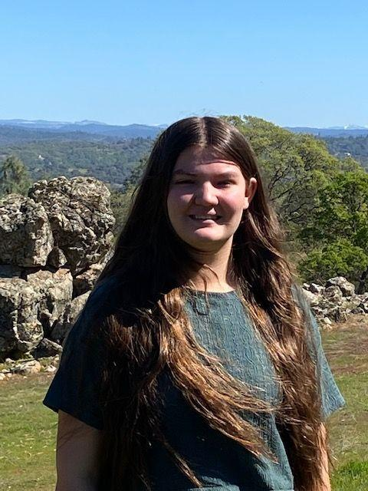
Student Spotlight
Claresa Miglore - Lake View
10th grade
7th year as a homeschool student
2nd year with our family of schools
4 HSVA-Live! classes
2nd year with HSVA
HSVA Academic Decathlon Team

Slide 16
Thank You
We appreciate all you do to support our schools!

