Slide 1
Executive Director’s Report
January 2022

Slide 2
Agenda
Enrollment
Covid Updates
Staff Development
Semester 2
Planning for 2022-23

Slide 3
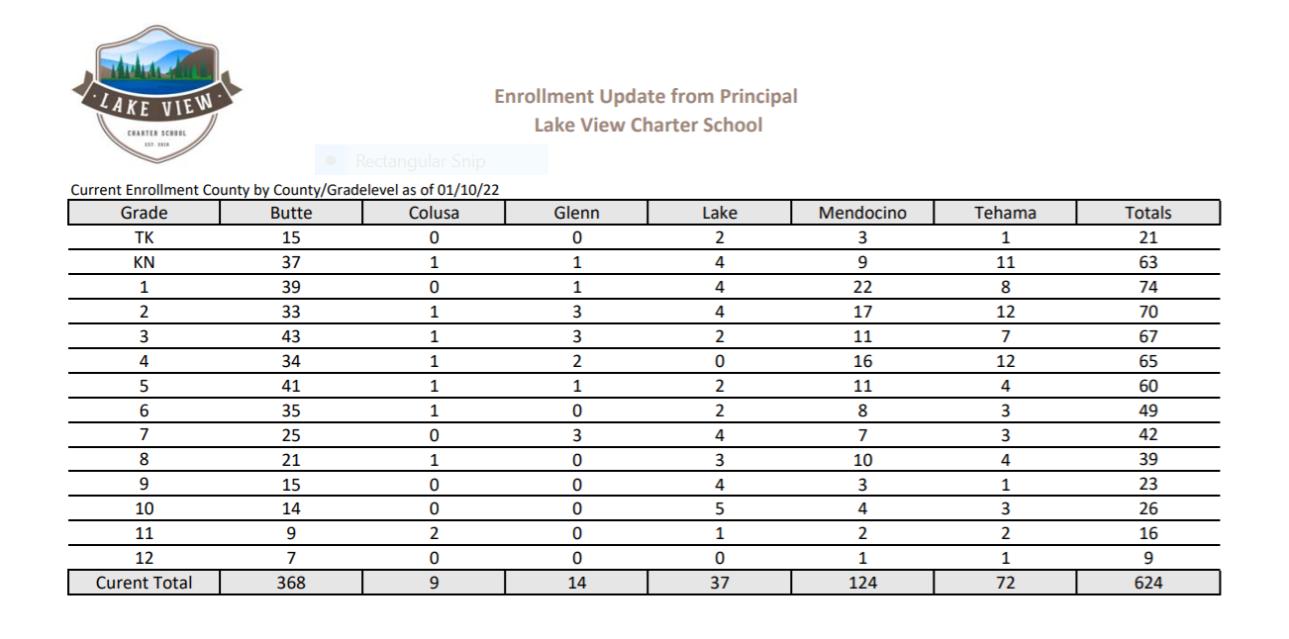

Slide 4
Covid Updates
Survey sent to staff for at-home tests for second semester
Tests are being distributed from 3 locations and mailed
Each county has different reporting requirements, so it has been a challenge keeping up with each
Several staff have had positive cases since returning from winter break
ITA’s are working with their teams to cover for teachers who are out ill and SGCA are doing the same to cover for their staff
Special ‘Thank You’s’ to Shelli Ninke & Drew Kimzey from SGCA for their help on notification and reporting processes and to Director, Darcy Belleza for her constant support and communication of policies to staff

Slide 5
Staff Development
Friday, January 28th for all staff
Virtual format
Conference style - teachers select the sessions they wish to attend
Sessions led by ITAs & Teachers
Opening with an Inspirational Speaker & Life Coach Paula Taylor

Slide 6
Semester 2 Has Begun!
January 11 marked the beginning of semester 2!
Winter testing window opened
Start of LP5
HSVA & JHVA new classes starting
New session of Clubs and Adventure Academy Classes starting
Teachers completing report cards & closing out Semester 1

Slide 7
Planning for the 2022-23 School Year
Our staff is beginning to plan for the upcoming school year in the following ways:
School Calendar
Budget Planning
Staffing
Enrollment Goals & Timeline
Organizational Structure
Intent to Return process for Staff & Families

Slide 8
Thank you for all
you do to support our schools!
Do you have any questions?

