Slide 1
Executive Director Report
November 2021

Slide 2
Agenda
Enrollment Update
Board Member Recruitment
New System
Programs Update

Slide 3
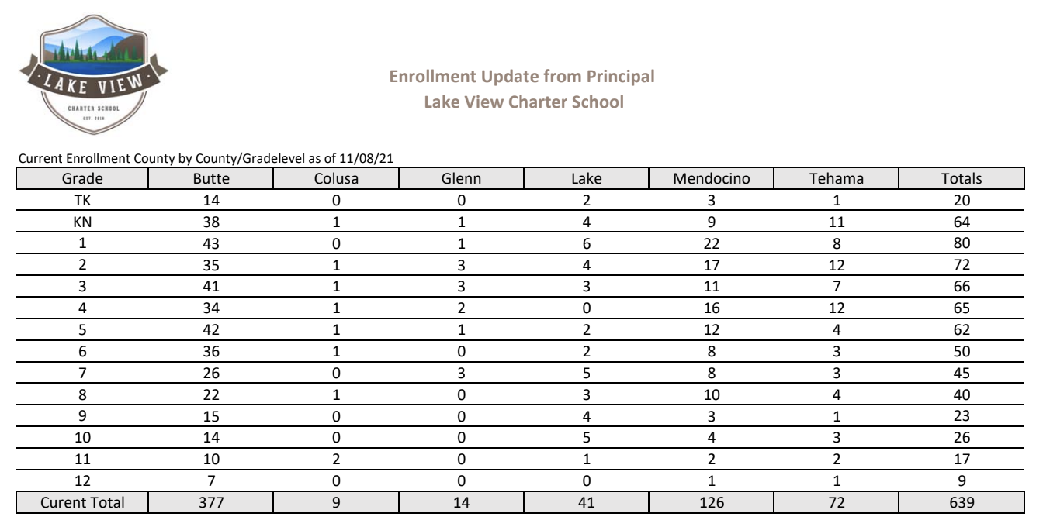
Enrollment Report

Slide 4
Exciting News! Coming Soon!
NEW: Field Trips, Classes & Events System

Slide 5
Programs Update
Adventure Academy
Junior High Virtual Academy
Growing Options & Participation
German, Math Options, Holidays around the World, etc....
Registration for Spring opens 12/1
Current students have option to roll over
Clubs
High School Virtual
Academy
Session 3 Clubs starting November 15
Photography, Fitness, Blackout Poetry, Spanish, etc…..
Registration for Spring opens 12/6
Section A rolls over to Section B

Slide 6
Your dedication to our school is appreciated!
Thank you!

