Slide 1
Executive Director’s Report
September 2020
JenJene
Julie Haycock

Slide 2
Falling into place...
Projects:
Finished Learning Continuity Plans
Finalizing annual audit requests
WASC final accreditation
Looking ahead:
Strategic Planning

Slide 3
Fall Happenings
Email migration to school-specific emails
Email
STAR 360 Launch
360
Community Connections started
CC
Proof of Residency collected from families
POR
EWS system launch - payroll, time off requests, staff attendance
Professional Development with online vendors
EWS
PD

Slide 4
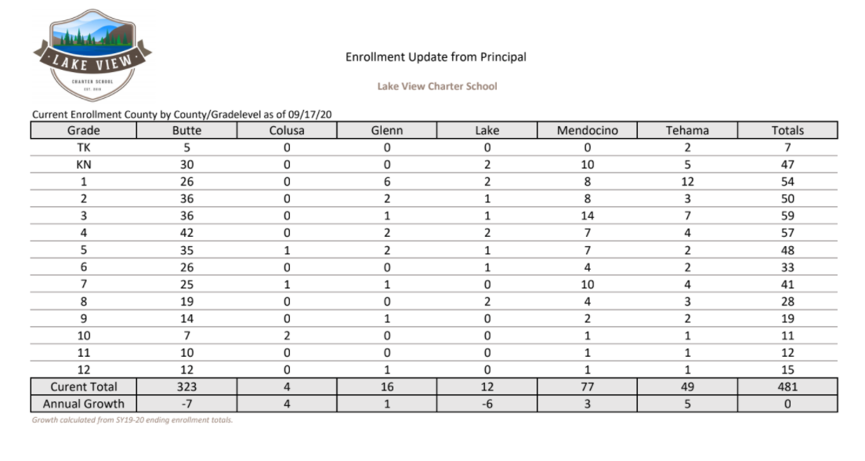
Enrollment Report
.

Slide 5
Thank you!

