Slide 1
Together We Thrive
GGA Community Engagement
Committee
May 23, 2023
www.girlsglobalacademy.org
@GIRLSGLOBALDC

Slide 2
2023 - 2024 Recruiting update
We have applications from 18 different middle schools and 2 offers to pay tuition
This year 120 students have ranked GGA in their top 3 compared to 69 the year before
82 students matched to GGA
Sent 110 offers to prospective students
86 completed all enrollment paperwork
Grade Level | SY23-24 Applications | SY22-23 Application
9th | 255 | 162
10th | 71 | 29
11th | 40 | 17
12th | 9 | N/A
Total | 366 | 208
Matched | 82 | 54
Notes:
28 matched offers from the 110 still pending
33 waitlist offers still pending
9 Waitlists students in 12th
14 waitlist students in 9th
12 waitlist students in 10th
4 waitlist students in 11th grade
Enrollment is 86 = 51 new and 35 returning

Slide 3
Recruiting Success
Commitment to recruiting and retention
Despite the disadvantage of not having access to 30+ DCPS Middle Schools, we exceeded our application numbers from last year
Continue to build reputation in the charter school landscape for families
Middle school in person presentations
Our students and our building tours
Brochures in Community Centers
Virtual Open House
GGA Building Group Tours - Middle Schools
Family Engagement Day
Social Media

Slide 4
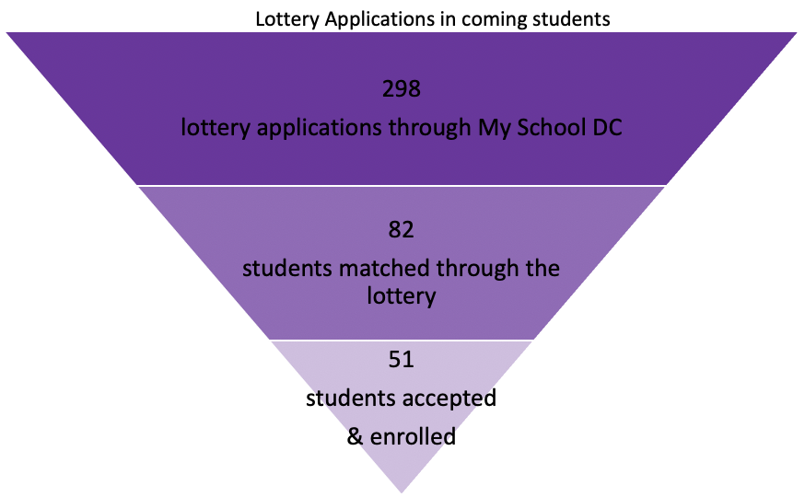
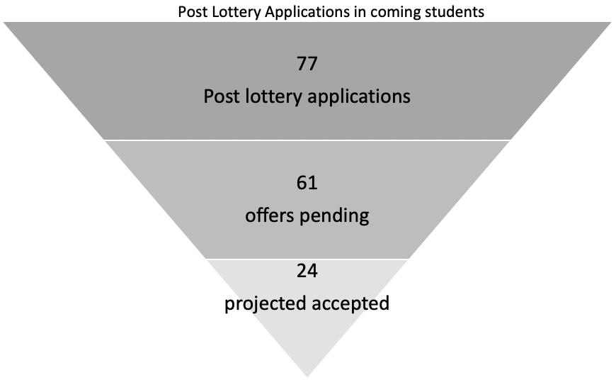
Path to 211 Enrolled: Applications Overview
As of May 19

Slide 5
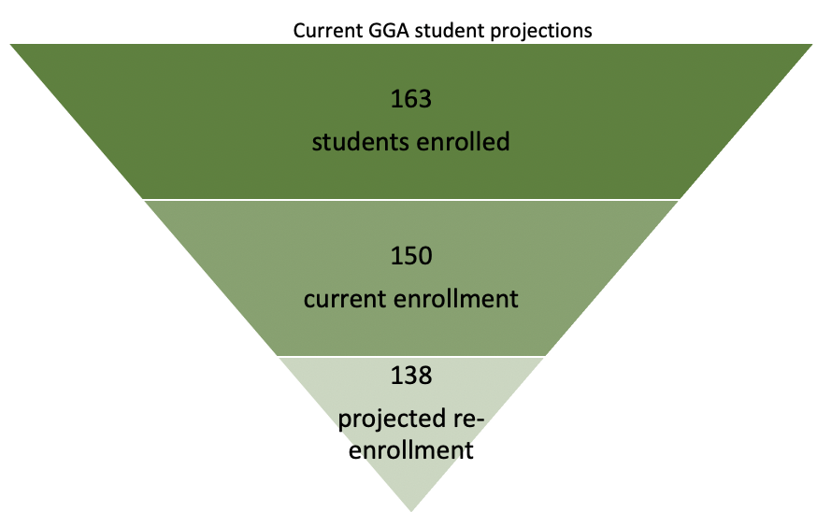
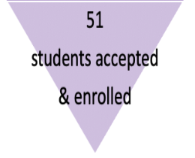
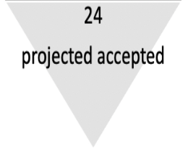
Path to 211 enrolled
+
+

Slide 6
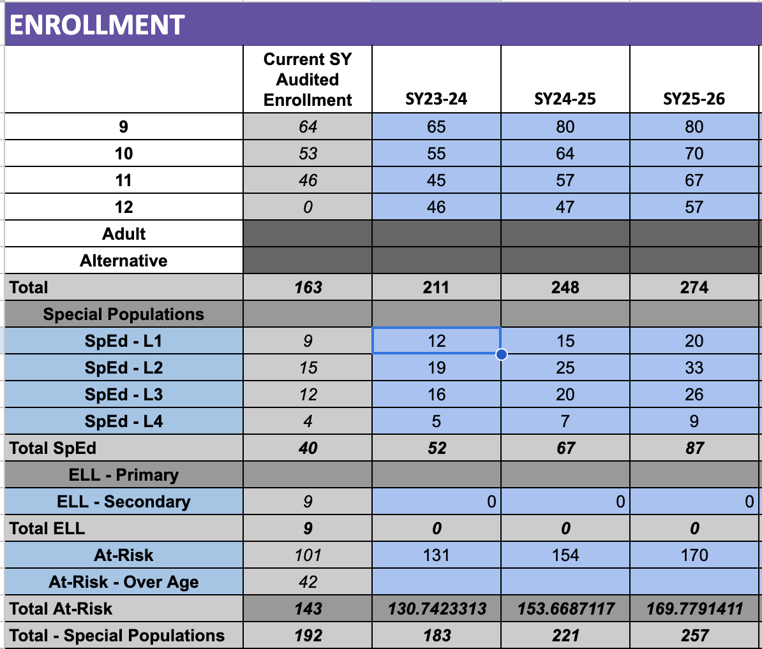
3 year Enrollment Projection

Slide 7
Fundraising Pipeline Update
2022-2023 Goals based on Fundraising Strategy
Strategy | FY2023 Budget | Raised to Date | Difference
Individual Giving | $20,000 | $18,591 | -$1,409
Corporate Giving | $0 | $0 | $0
Events | $3,500 | $7,950 | $4,450
Foundation Grants | $160,000 | $328,000 | $168,000
Totals | $183,500 | $354,541 | $171,041
2023-2024 Pending
Donor | Potential Amount
4 Grants | $94,360
2 Grants last 2024 | $620,000
Totals | $714,360
Next Steps:
Submitted a request for proposals for fundraising support
Projected vendor selection in June

Slide 8
Community Engagement Committee Next Steps
We Believe Partnerships with the community are intentional and valued
Write the Student Experience vision statement
Identify the categories of Partnerships
Creation of an evaluation criteria for partnerships
Identify that type of experiences for students
Pathways
Pillars

