Slide 1
FY23 Budget
Overview of SY 22-23 Budget:
Priorities
Key assumptions – enrollment, revenue & expenses
Things to know
Projections for rest of School Year (SY) 22-23
Vote on budget adjustment

Slide 2
Top Budget Priorities
Strong School Culture
Academic Engagement and Rigor
Supporting Staff Capacity
Vibrant Opportunities and Experiences - giving students the full high school experience
Facility buildout financed and sustainable
FY 23
Notes:
Our theory is If we invest in people we will have improved student performance, build capacity of the staff, and attract and retain individuals that are vested in our mission.
We have identified five priorities that will guide our budget decisions. Sustainability over time and empowered in the work
Strong School Culture
All stakeholders feel a strong sense of belonging
Students feel physically and mentally safe safety
Intentional student retention efforts
Thoughtful family engagement
Academic Engagement and Rigor
IB is full supported
Instructional coaching fosters strong instructional practices
Building the GGA brand
Supporting Staff Capacity
Teams feel supported
Leveraging our current staff’s strengths and talents
Intentional staff retention efforts
Vibrant Opportunities and Experiences - giving students the full high school experience
Field Trips
Programs with partnerships
Athletics
Enrichments
Facility buildout financed and sustainable

Slide 3
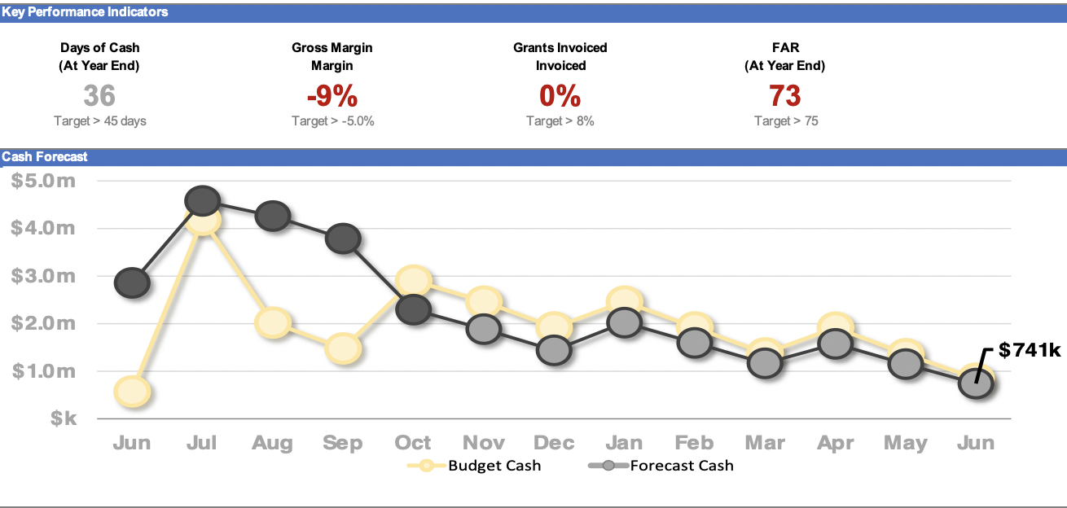
Budget for SY 22-23

Slide 4
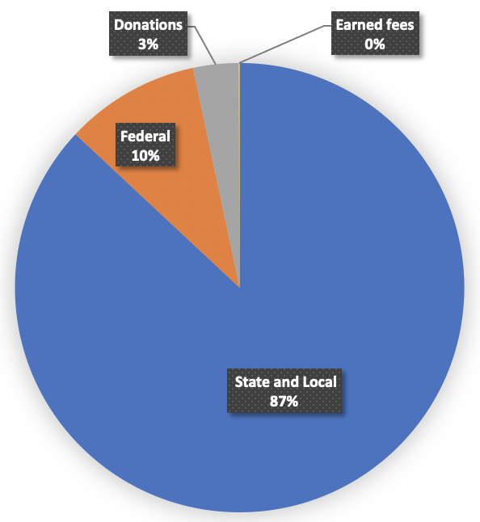
Budget: Key Revenue Variables
Revenue is tied almost entirely to enrollment
5.9% per pupil allocation increase in SY22-23
Per pupil facility allotment increase from $3,408 to $3,513 per student
Reduction in COVID federal funding
Notes:
Revenue
Revenues have decreased overall from budget by $1.16M as a result of our under enrollment, but we have seen a month over month increase of $86k as a result of $32k in additional ESY funding for the summer, $44k in unbudgeted COVID PCR reimbursements and a $9k increase in our SOAR allocation from our original budget. We are continuing to look for ways to increase our revenue and hope to have good news on the funder front soon.

Slide 5
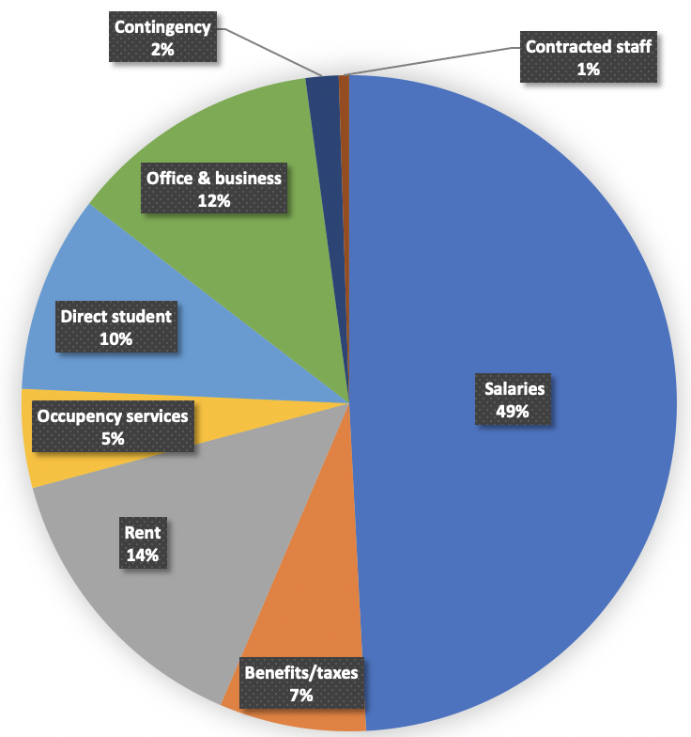
Budget: Key Expense Variables
56% of expenses are salaries and benefits
19% of expenses are rent payments and building maintenance
10% of direct student expense include a funded and sustainable IBCP program

Slide 6
Goals for FY23 Budget
Meet the PCSB expectation of 30 days of cash on hand by June 2023
Have a zero operating income by June 2023
Academic program fully funded and maintain low student to teacher ratio
Pay minimum base rent obligation
Facility improvements are financed outside the annual budget

Slide 7
Things to Know
GGA student enrollment is below the 236 enrollment projection
A 10% variance of enrollement triggers a re-budget for approval
Planned in advance for our enrollment shortfall of 73 students
GGA is operating on a 161 student revenue
Current on all rent and payments
Adjusted expenses including staffing to account for the reduced revenue
Projected ceiling of -$289,192 operating income
Conservative financial management from fiscal year 21-22 allowed us to be in a good financial position to withstand the enrollment shortfall in SY 22-23

Slide 8
Board Approved Budget June vote
Budget for November vote
37 days of cash on hand; below our ideal target of 45 days of cash on hand
Operating Income $3,730
Per pupil facility allotment to cover $829,068 base rent
36 days of cash on hand; below our ideal target of 45 days of cash on hand
Operating Income -$289,192
Approve budget with current summary of key information

Slide 9
Path to a Zero Operating Income
Operating income ceiling delta of $289,192
Revist adjustment in January 2023
Salaries | $23,424
Leased staff | $30,000
Contingency | $95,000
Total expense reduction | $148,424
Revenue increase per pupil | $30,310
Total Operating Income reduction | $178,424

Slide 10
A look ahead
Girls Global Academy board votes to approve the GGA budget as presented
Girls Global Academy to meet with Calvary to discuss the rent schedule and enrollment trends
Pursuing foundation grants to increase revenue

Slide 11
Facilities Update
November - Begin to pay 1% interest only on $2M loan
November 29th – HVAC measurements
December 3rd - HVAC installation
December - MCN Build complete outstanding items on punchlist

Slide 12
Facilities Looking Ahead: Phase 4 Scope
Phase 4 Scope (SY23-24):
4 more classes - paint and flooring
Maker-space (grant funded)
Gym padding, floor and lighting
ADA entry doors
Security camera system

