Slide 1
Academic Excellence
October, 2018

Slide 2
Spring 2018
SBAC Results

Slide 3
Overview
Population | Proficient and Above - 2017 | Net Change | Proficient and Above - 2018
All School - ELA | 58% | -5% | 53%
All School - Math | 48% | 0% | 48%
Class of 2022 - ELA | 60% | 1% | 61%
Class of 2022 - Math | 51% | 1% | 52%
Class of 2023 - ELA | 47% | 6% | 53%
Class of 2023 - Math | 34% | 14% | 48%
Class of 2024 - ELA | N/A | N/A | 44%
Class of 2024 - Math | N/A | N/A | 42%

Slide 4
SY 18.19 EBIA Student Population Profile

Slide 5
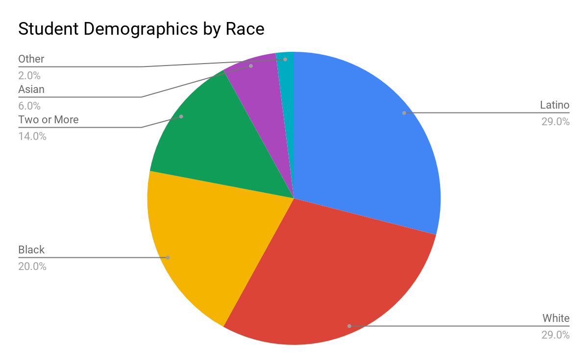
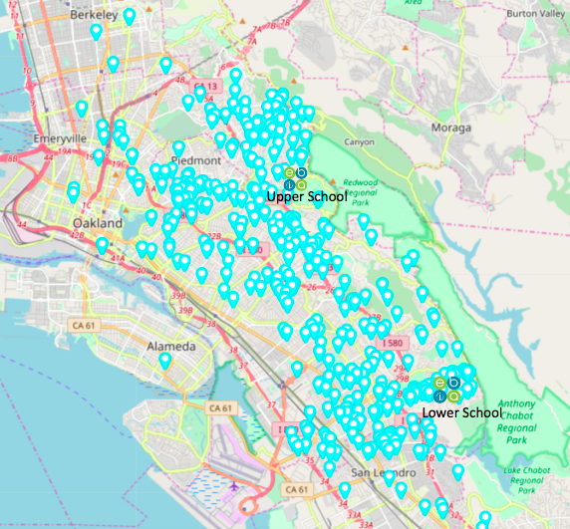
Student Profile
Students with Disabilities - 17%, EL - 5%, FRL - 25%
Notes:
Versus OUSD - https://drive.google.com/file/d/18vKVTDbTxKOTlnQGSZmITyiuNI-1Am_R/view
A comprehensive collective bargaining agreement (CBA).
A strong compensation and benefits package outpacing neighboring districts.
Over 15 days of professional development across the schoolyear.
Daily team meeting structure to ensure collaboration and alignment.
Comprehensive coaching model with ongoing feedback and support.

Slide 6
Fall Baseline Data

Slide 7
Fall Baseline Data
Population | Projected Math Proficiency Rate | Projected ELA Proficiency Rate
Grade 6 - Class of 2025 | 45% | 61%
Grade 7 - Class of 2024 | 43% | 56%
Grade 8 - Class of 2023 | 31% | 56%
Grade 9 - Class of 2022 | 27% | 46%
Grade 10 - Class of 2021 | 45% | 62%
Grade 11 - Class of 2020 | 36% | 51%

Slide 8
SY 19.20 Student Recruitment Kick-Off

Slide 9
Renewal Petition Update

Slide 10
Renewal Petition Update
Submitted on September 26th, 2018
Presentation before the OUSD board scheduled for October 17th, 2018
2:00 - 5:00pm
KDOL TV Studio, B-237 (Committee Room),
Met West High School Entrance, 314 East 10th Street, Oakland.
Board and community engagement ongoing

Slide 11
Intersession Update

Slide 12
Intersession Update
Lower School
Advisory PLP prep during mornings
Rotational Program Model
Partners: Low ropes, Music, Dance, Acting, Biking, Engineering
Upper School
Advisory PLP prep during mornings
Week long program selection
Partners: Video, Music, Sound Engineering, Entrepreneurship, College/Career Readiness
Independent study and internships available

