Slide 1
Unaudited Actuals FY 2016-17
EBIA, August 2017
East Bay Innovation Academy 3400 MALCOLM AVE, OAKLAND, CA 94605 www.eastbayia.org

Slide 2
$57K operating income in FY 16-17
Fund balance at $498K (10% of expenses)
East Bay Innovation Academy 3400 MALCOLM AVE, OAKLAND, CA 94605 www.eastbayia.org

Slide 3
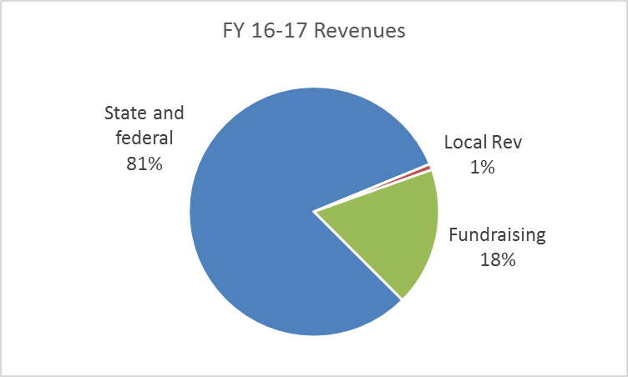
Revenue Highlights
FY 16-17 revenues: $4.7M
State and federal rev driven largely by ADA (406.5)
Special Education rev: $457K
Local rev includes Oakland Measure N ($12K)
Fundraising rev ($838K) includes $646K private donations
East Bay Innovation Academy 3400 MALCOLM AVE, OAKLAND, CA 94605 www.eastbayia.org

Slide 4
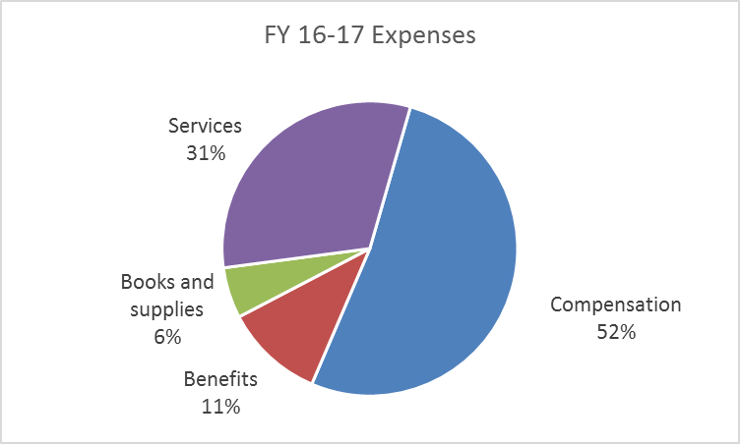
Expense Highlights
FY 16-17 expenses: $4.64M
Compensation and benefits ($3M)
Special education ($765K)
After School Quest ($35K)
Intersession services ($103K)
Food services ($64K)
East Bay Innovation Academy 3400 MALCOLM AVE, OAKLAND, CA 94605 www.eastbayia.org

