Slide 1
EBIA CoVitality Administration
Presentation to the Board
Wednesday January 18th, 2017

Slide 2
Objectives of Today’s Presentation
2
Why Is Social Emotional Learning Important?
EBIA: The Greater Context
CoVitality Administration at EBIA
EBIA CoVitality Results and Analysis
Questions/Discussion

Slide 3
Why is Social Emotional Learning Important?

Slide 4
Social Emotional Learning
4
SEL is the process of helping students develop the skills to manage their emotions, resolve conflict nonviolently, and make responsible decisions.
Students are more successful in school and daily life when they:
Know and can manage themselves
Understand the perspectives of others and relate effectively with them
Make sound choices about personal and social decisions
In the long run, greater social and emotional competence can increase the likelihood of:
high school graduation
readiness for postsecondary education
career success
positive family and work relationships
better mental health
reduced criminal behavior
engaged citizenship

Slide 5
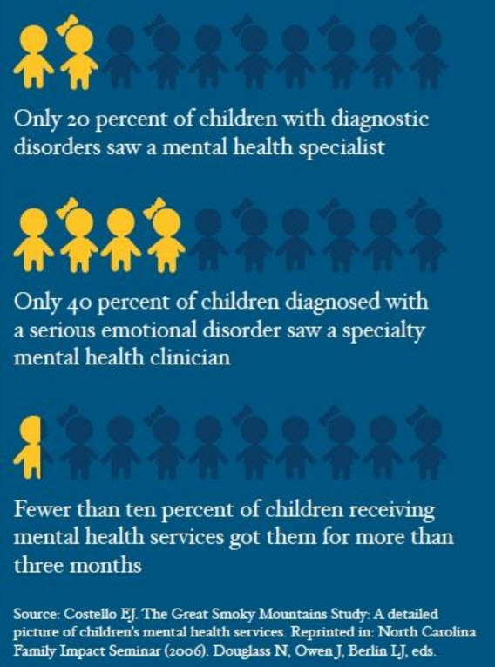
EBIA’s Motivations
4
Preemptively identify students with few social emotional skills
Need to teach students social emotional skills (perseverance, self awareness, etc.)
Positive mental health = positive academic success

Slide 6
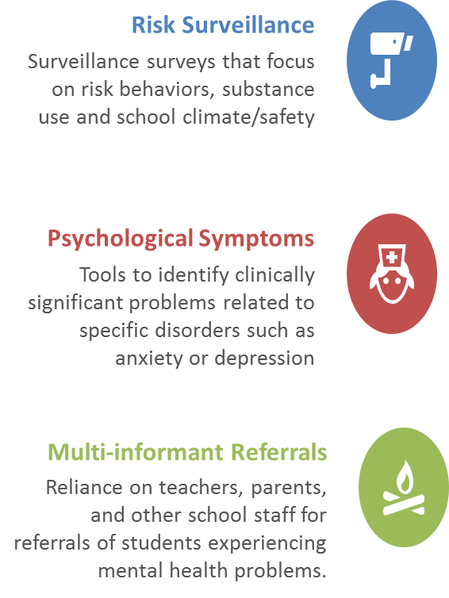
How do schools typically assess social-emotional health?
Notes:
Traditional approaches are deficit-based in that they tend to focus on problem behaviors, psychopathology, or getting noticed by parents and teachers

Slide 7
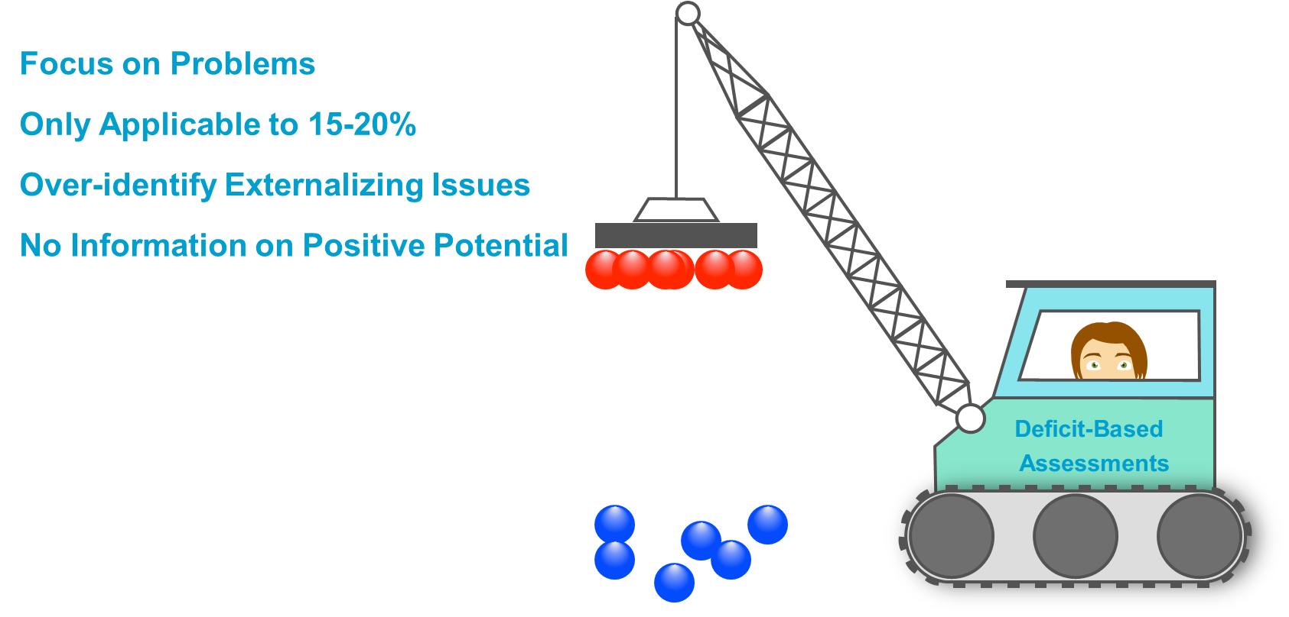
Typically……

Slide 8
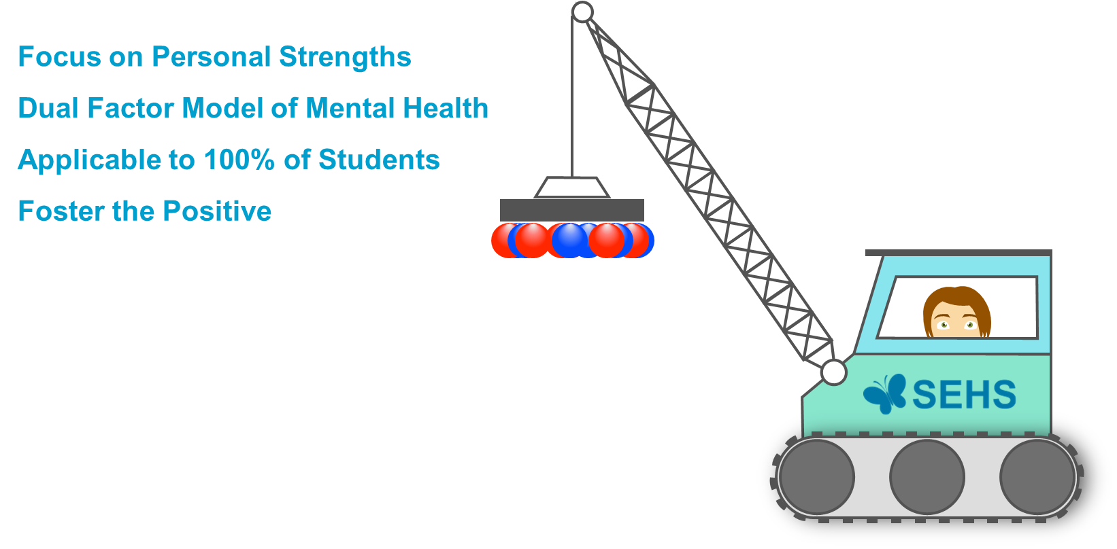
CoVitatiliy……

Slide 9
Alignment with CoVitatiliy

Slide 10
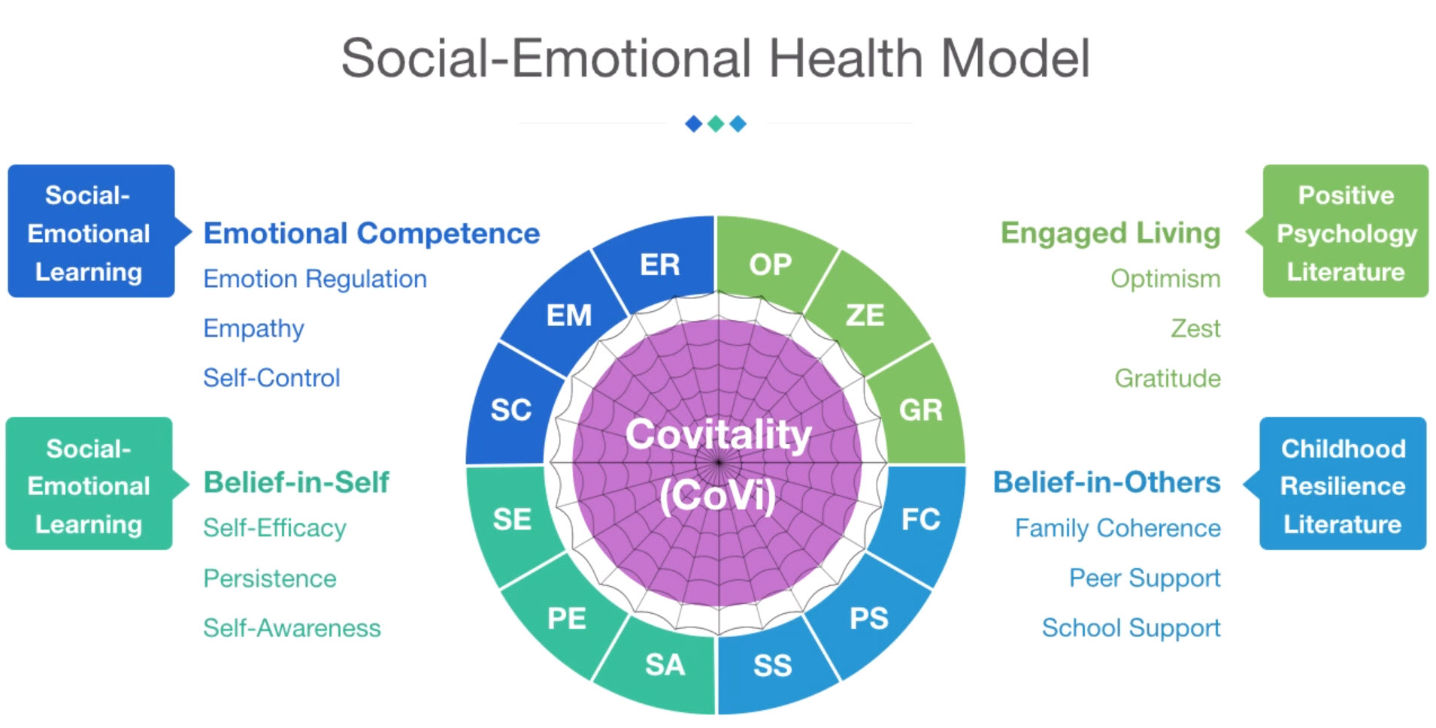
The CoVitality Model
10

Slide 11
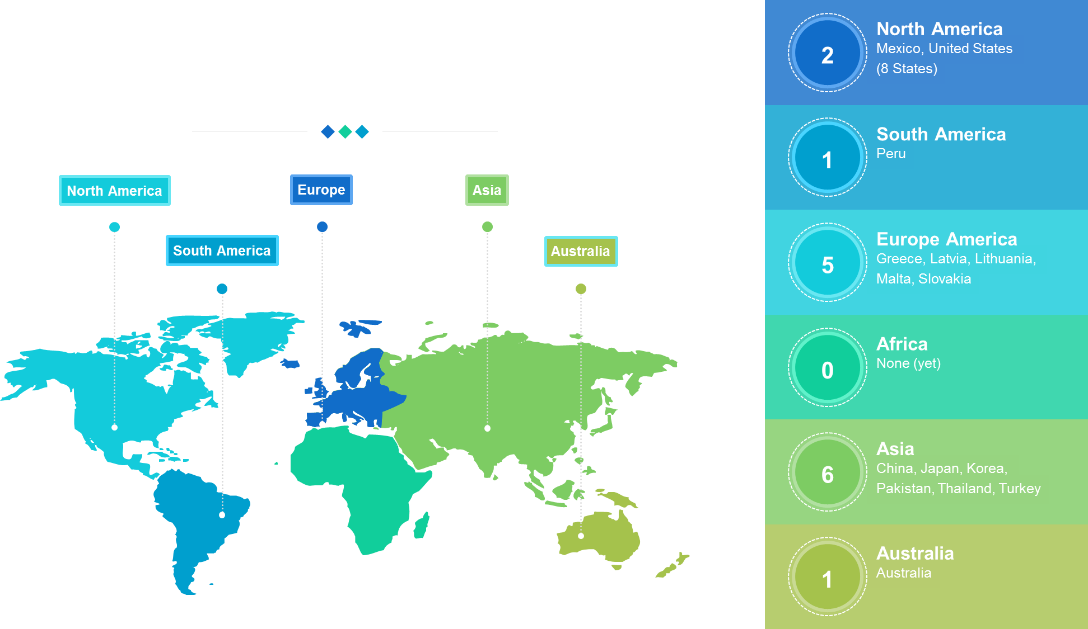
Extensive Usage

Slide 12
A Quick Recap on CoVitality
12
What is CoVitality?
CoVitality is the co-occurrence of positive psychological traits
Short 36 Item Survey that uses four research backed social emotional domains to measure overall CoVitality
Positive, Strength-Based Approach
Typical risk-based assessments only identify 12-15% of students with problems, but provide no info about how well students are doing. CoVitality provides actionable information for all students.
CoVitality is strengths-based and assesses youth’s personal and social assets
The CoVitality Survey can directly identify areas of needed intervention at school or student level (e.g. empathy, school support)
Robust Research Support
Developed over past 5 years at one of the most highly regarded research institutions in the world (University of California Santa Barbara)
Grounded in the latest theories of positive youth development
Cited and featured in 20+ publications
Validated on 1,000s of students
Model replicated internationally

Slide 13
CoVitality Administration at EBIA

Slide 14
3 Step Administration Process
Provide Students with Survey Link
Monitor Survey Completion in App
Generate Reports in Real Time
1
2
3

Slide 15
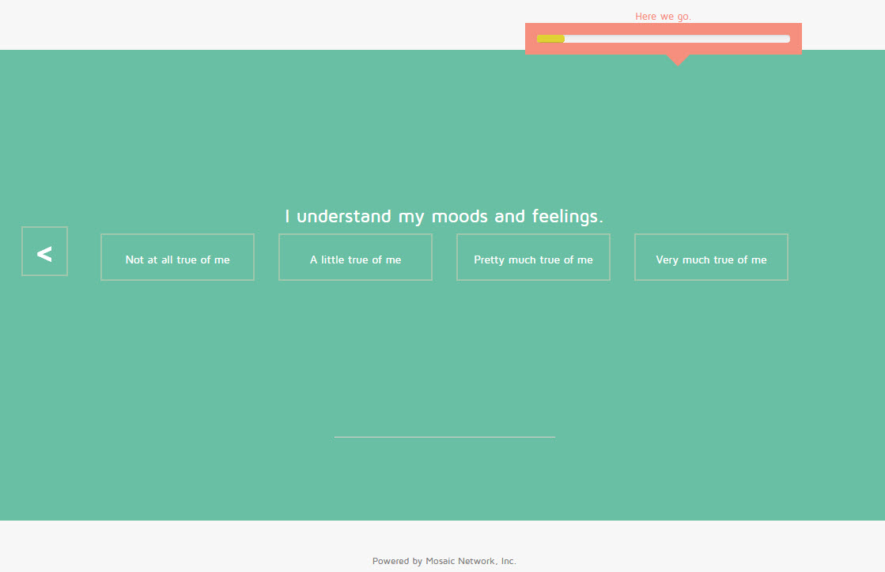
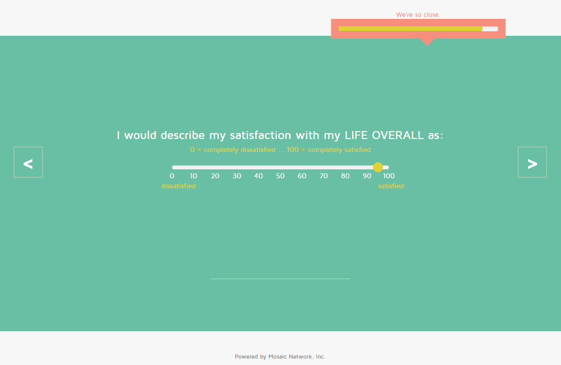
CoVitality Online Survey
15

Slide 16
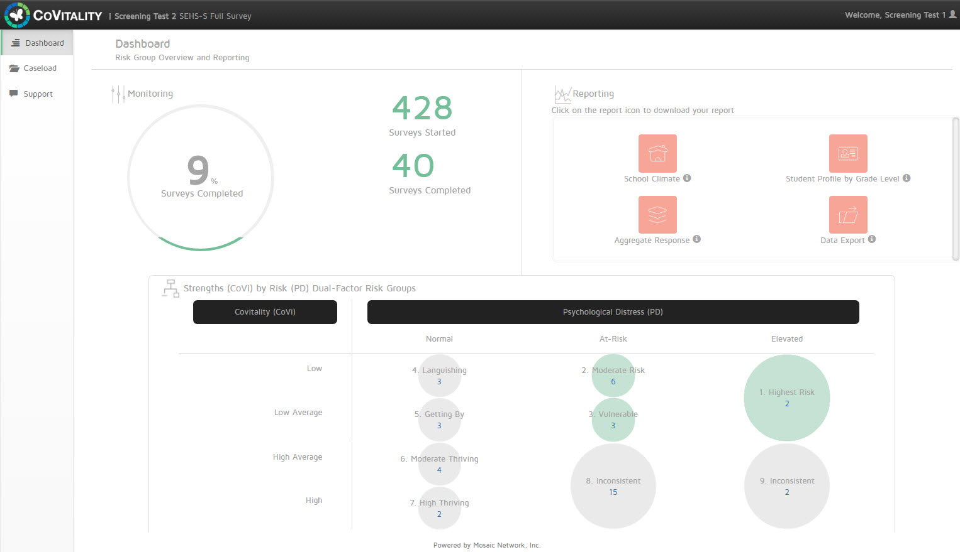
CoVitality App: Dashboard
16

Slide 17
CoVitality Results

Slide 18
Survey Results General Overview
Completed Surveys:
378 students completed all of parts of the survey
Grade Level Breakdown:
Grade 6: 116 (30.7%)
Grade 7: 110 (29.1%)
Grade 8: 108 (28.6%)
Grade 9: 44 (11.6%)
Gender Breakdown:
There was more females (224 (59.3%) than males (154 (40.7%) that completed the survey.
Ethnicity Breakdown:
Latino/a/Hispanic (18.3%)
Asian (9.3%)
Black/African American (16.4%)
Native Hawaiian/Alaskan Native (0.5%)
White (34.1%)
Identified with Two or More Groups (21.4%)

Slide 19
Aggregate Item by Item Analysis
A significant number of students in Grades 6-8 indicated that they don’t have a friend their age who they can talk to about their problems.

Slide 20
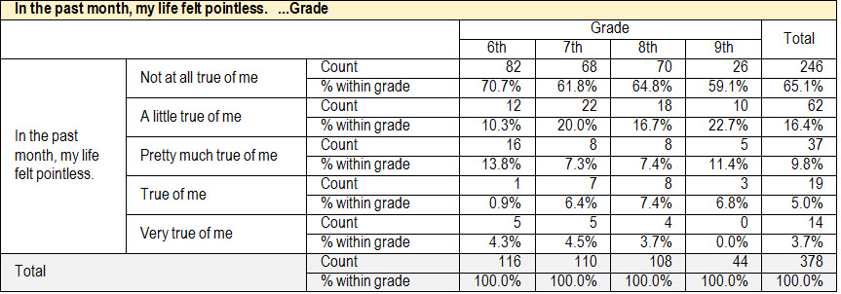
Aggregate Item by Item Analysis
The majority of the students felt their live had meaning and was not pointless.

Slide 21
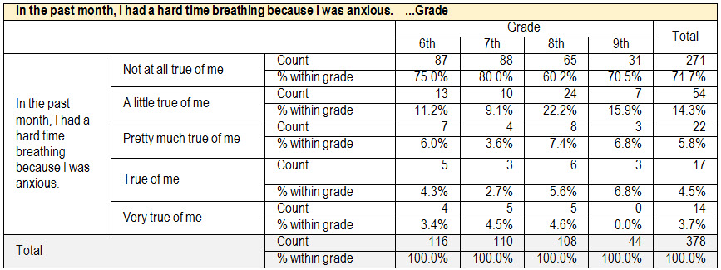
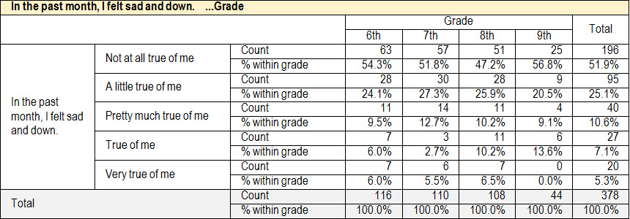
Aggregate Item by Item Analysis
Most all of the students indicated they were not anxious or sad in the past month.

Slide 22
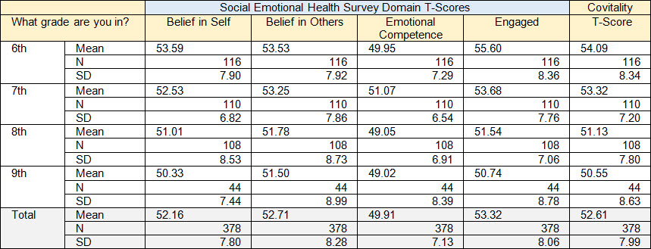
Aggregate SEHS Analysis
The means across all CoVitality Domains and Overall CoVitality Scores are quite consistent across all grades

Slide 23
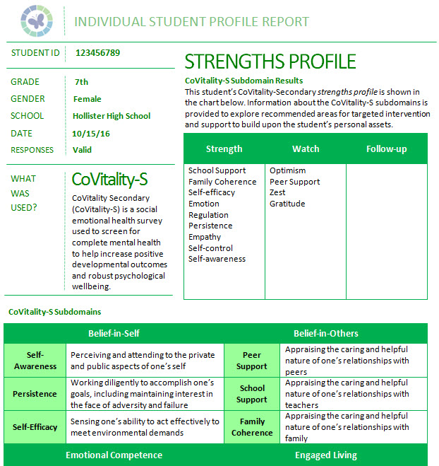
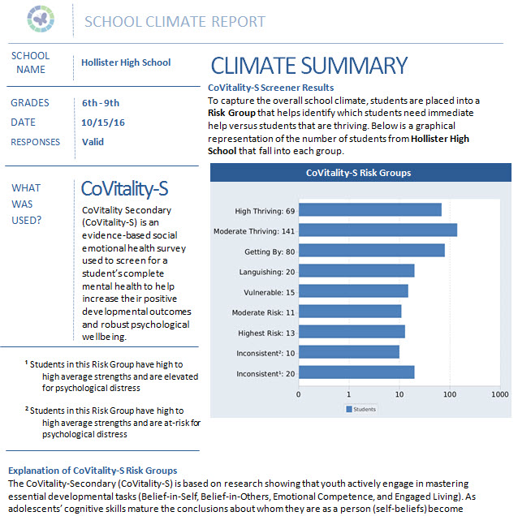
CoVitality App: Reports
23

Slide 24
How to Use CoVitality Results
24
Identify gaps and deficits, then work to close these gaps. Then once these SEL skill sets are improved, it will correlate to stronger academic achievement at EBIA
Through the information provided in this administration, deficit gaps can be closed at a school or class wide level using the aggregate results and/or at an individual student level using the individual results.

Slide 25
CoVitality Results

Slide 26
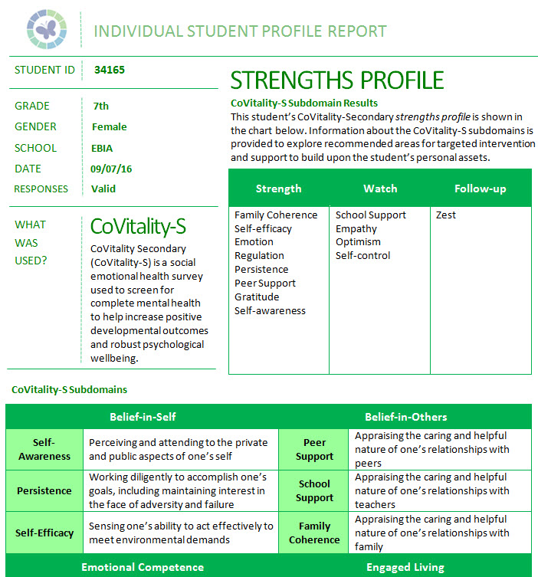
CoVitality App: Reports
26

Slide 27
East Bay Innovation Academy Counting Student Domain Strengths
Belief in Self
Belief in Others
Emotional Competence
Engaged Living
Number of students
(48)
(48)
(69)
(72)
(141)
Notes:
This chart shows the percent of students with 0-4 domain strengths (Belief in Self + Belief in Others + Emotional Competence + Engaged Living = 0-4 strengths). A domain is counted as a strength for a student when the average of their responses across all 9 items is at least 3 of the 4-point scale (each domain is represented by 9 questions/items in the CoVitality Survey).

Slide 28
I would describe my LIFE Overall as:
0 = completely … 100 completely satisfied
100 = Completely Satisfied
Values of 70-90 are in the typical range
0 = Completely Dissatisfied
Notes:
The number of personal strengths is very strongly associated with students overall level of life satisfaction. In general, EBIA students reported positive levels of overall life satisfaction.

Slide 29
“I am happy to be at this school”
* SEHS Domains
Belief in Self
Belief in Others
Emotional Competence
Engaged Living
Notes:
The number of personal strengths is very strongly associated with students self-reported feelings of being happy and content at school. For EBIA, only 27% of the students with 0 personal strengths also reported felling happy at school.

Slide 30
Belong at School
“I feel like I am a part of this school.”
Notes:
Students with 0-1 strengths were a little more likely to respond that they did not feel like a part of EBIA. However, not feeling like a part of EBIA was reported at much lower frequencies than at other schools.

Slide 31
Feel safe at school
“I feel safe in my school”
Notes:
The students report feeling safe at school. Students with 0-1 strengths were a little more likely to respond that they felt unsafe. However, feeling unsafe at EBIA is much lower than other schools.

Slide 32
Students overall level of school connections
School Connectedness Items
I feel close to people at this school
I am happy to be at this school
I feel like I am a part of this school
The teachers at this school treat students fairly
I feel safe at this school
Strongly Agree
Agree
Neither Agree or Disagree
Disagree
Strongly Disagree
Notes:
Students feelings of engagement and connectedness was higher for students with 2-4 strengths

Slide 33
I felt unimportant in the past month…
* SEHS Domains
Belief in Self
Belief in Others
Emotional Competence
Engaged Living
Notes:
The number of personal strengths is very strongly associated with students’ responses to the question: “In the past month, I felt unimportant.” In general, however, EBIA students did not feel “unimportant.”

Slide 34
Past Month Emotional Distress
Average item response
Very true of me
True of me
Pretty much true of me
A little true of me
Not at all true of me
Notes:
Students with zero self-reported strengths reported experiencing more emotional distress in the past month. However, the EBIA students on a whole reported a low level of emotional distress.

Slide 35
Percent of students with strengths for each of the
SEHS-S subscales
Notes:
This graph shows the percentage of EBIA students who had a strength in each of the 12 CoVitality subscales. For example, 91% of the EBA students had Gratitude as a “strength” (having Gratitude as a strength means the average response for the three Gratitude items was at least 3 on the 4-point response scale).

Slide 36
E. Fact Sheets

