Slide 1
Academic Excellence
EBIA Team Updates, November 2016
East Bay Innovation Academy 3400 MALCOLM AVE, OAKLAND, CA 94605 www.eastbayia.org

Slide 2
First Trimester
East Bay Innovation Academy 3400 MALCOLM AVE, OAKLAND, CA 94605 www.eastbayia.org

Slide 3
Schoolwide Goals and Priorities
Instruction
To create classrooms that model rigorous, in-depth learning experiences and emphasize collaboration and peer support.
Culture and Climate
To create a school culture and climate where all students can authentically state that they and their peers live the innovator norms and understand their connection to college and career readiness.
East Bay Innovation Academy 3400 MALCOLM AVE, OAKLAND, CA 94605 www.eastbayia.org

Slide 4
First Trimester Academic Report
East Bay Innovation Academy 3400 MALCOLM AVE, OAKLAND, CA 94605 www.eastbayia.org

Slide 5
First Trimester Academic Report
Lower School Highlights
Strong reading growth across 7th grade
Increased use of Achieve300 program (above paced usage)
Average Lexile level increase for students is 20% above projected
Roll out of integrated Algebra I in 8th grade
15% of 8th graders currently participating in Algebra I program
Authentic presentations of learning
First Trimester Presentation of Learning
First Trimester “Projects and Pastries”
Authentic audience present at in-class presentations
Lower School Second Trimester Targets
Increased literacy support in history and science courses
Targeted intervention in 6th grade math course
East Bay Innovation Academy 3400 MALCOLM AVE, OAKLAND, CA 94605 www.eastbayia.org

Slide 6
First Trimester Academic Report
Upper School Highlights
High proficiency rate on AP benchmark assessments
40% of students with Environmental Science performance at 3 and above
Increased math growth in second half of the trimester
Integration of project-based learning across courses
Student presentation of authentic research
Student presentation of final projects across courses
Upper School Second Trimester Targets
Increased personalization of instruction across courses
Targeted literacy intervention for high needs students
East Bay Innovation Academy 3400 MALCOLM AVE, OAKLAND, CA 94605 www.eastbayia.org

Slide 7
First Trimester School Culture and Climate
East Bay Innovation Academy 3400 MALCOLM AVE, OAKLAND, CA 94605 www.eastbayia.org

Slide 8
First Trimester School Culture and Climate
Lower School Highlights
Integration of collaboration strategies in group projects
Increased student pride in school community
Lower School Second Trimester Targets
Decrease litter throughout building and outdoor area
Support stronger peer intervention and de-escalation skills
East Bay Innovation Academy 3400 MALCOLM AVE, OAKLAND, CA 94605 www.eastbayia.org

Slide 9
First Trimester School Culture and Climate
Upper School Highlights
Establishment of student leadership practice
Student connection to and comfort with staff
Upper School Second Trimester Targets
Personalized response plans for high needs students
Making physical space a reflection of school culture and values
East Bay Innovation Academy 3400 MALCOLM AVE, OAKLAND, CA 94605 www.eastbayia.org

Slide 10
EBIA 2016 Fall Intersession Report Out
East Bay Innovation Academy 3400 MALCOLM AVE, OAKLAND, CA 94605 www.eastbayia.org

Slide 11
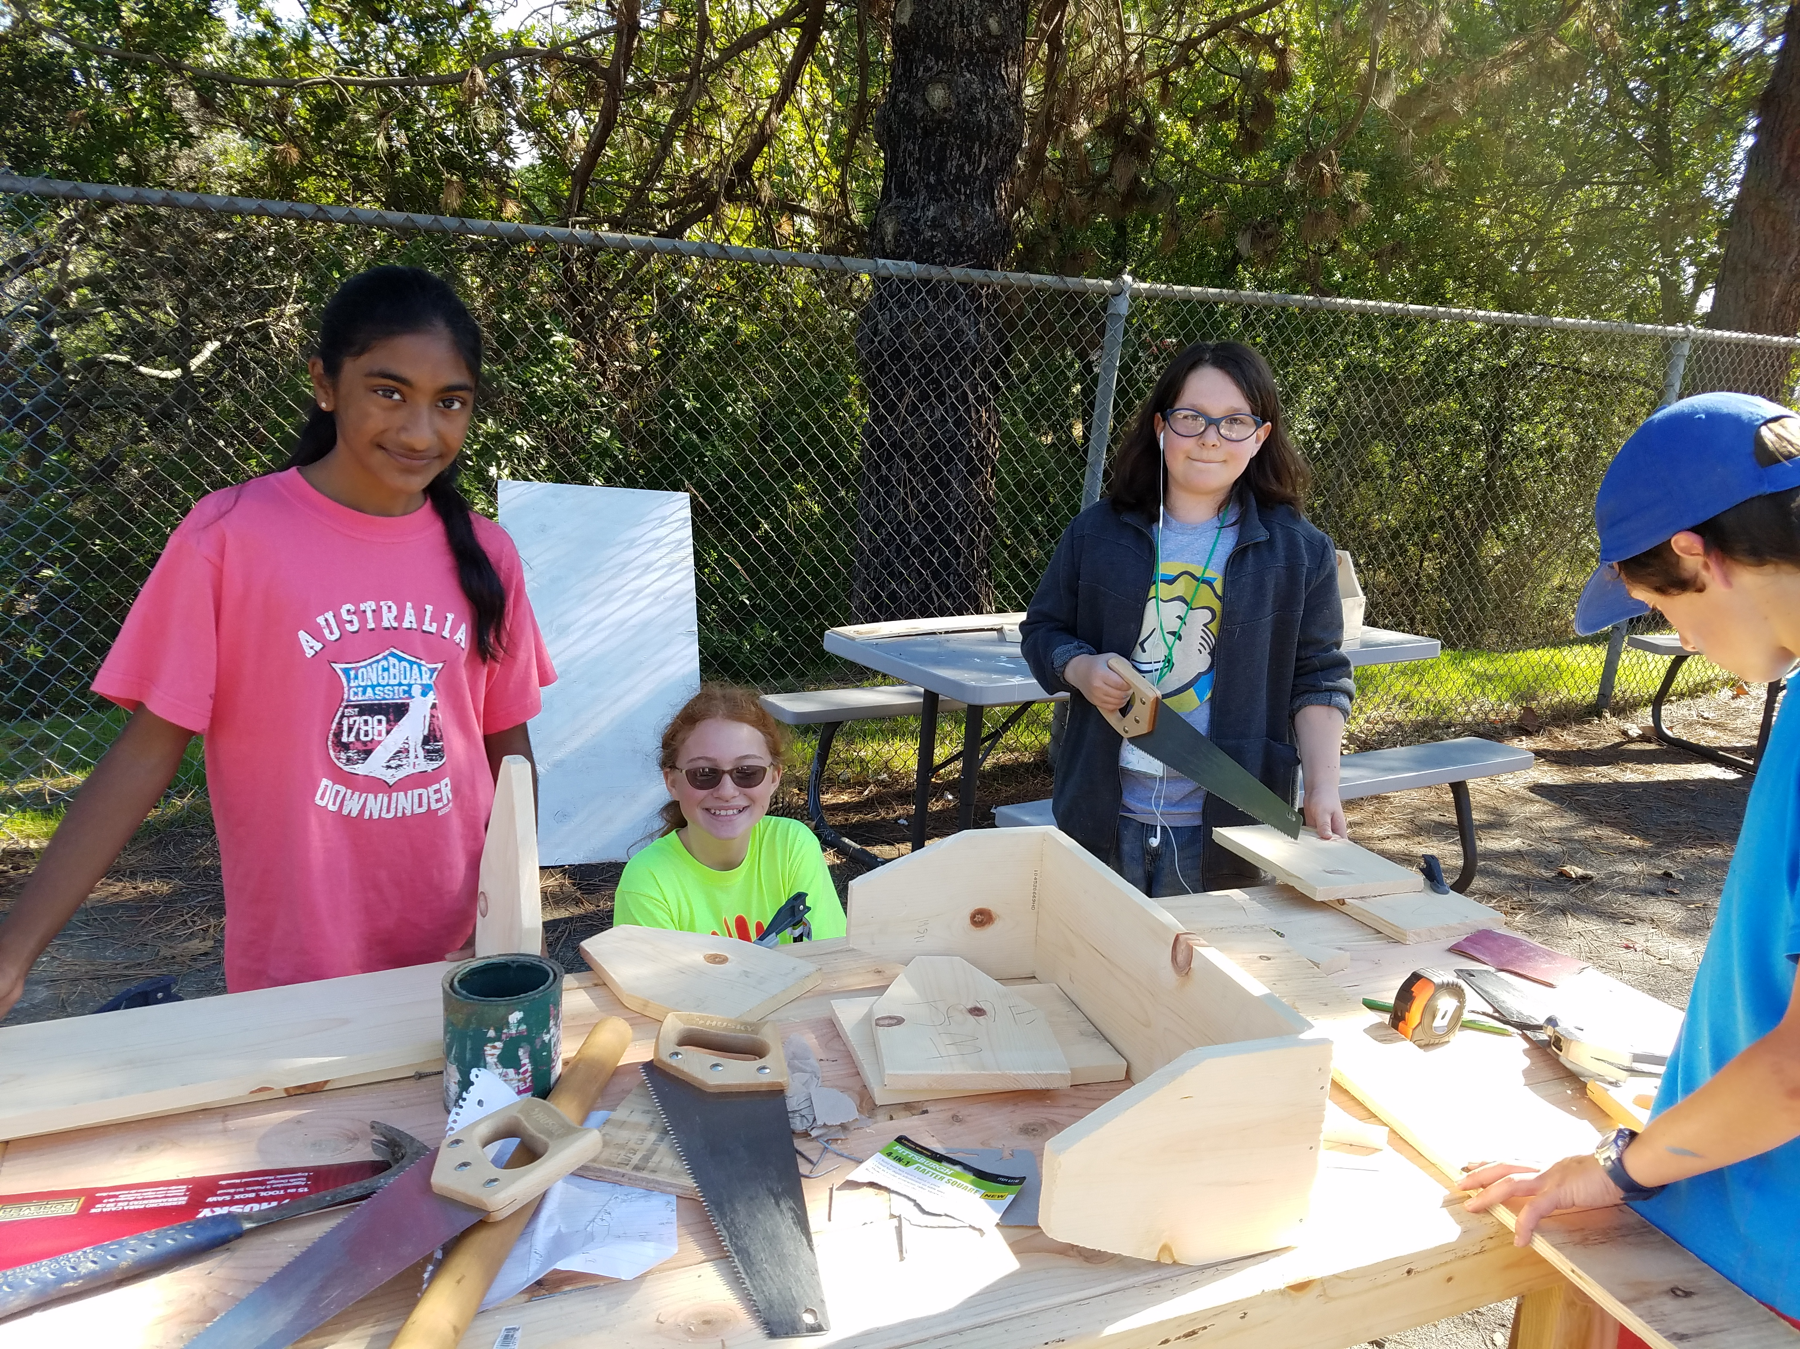
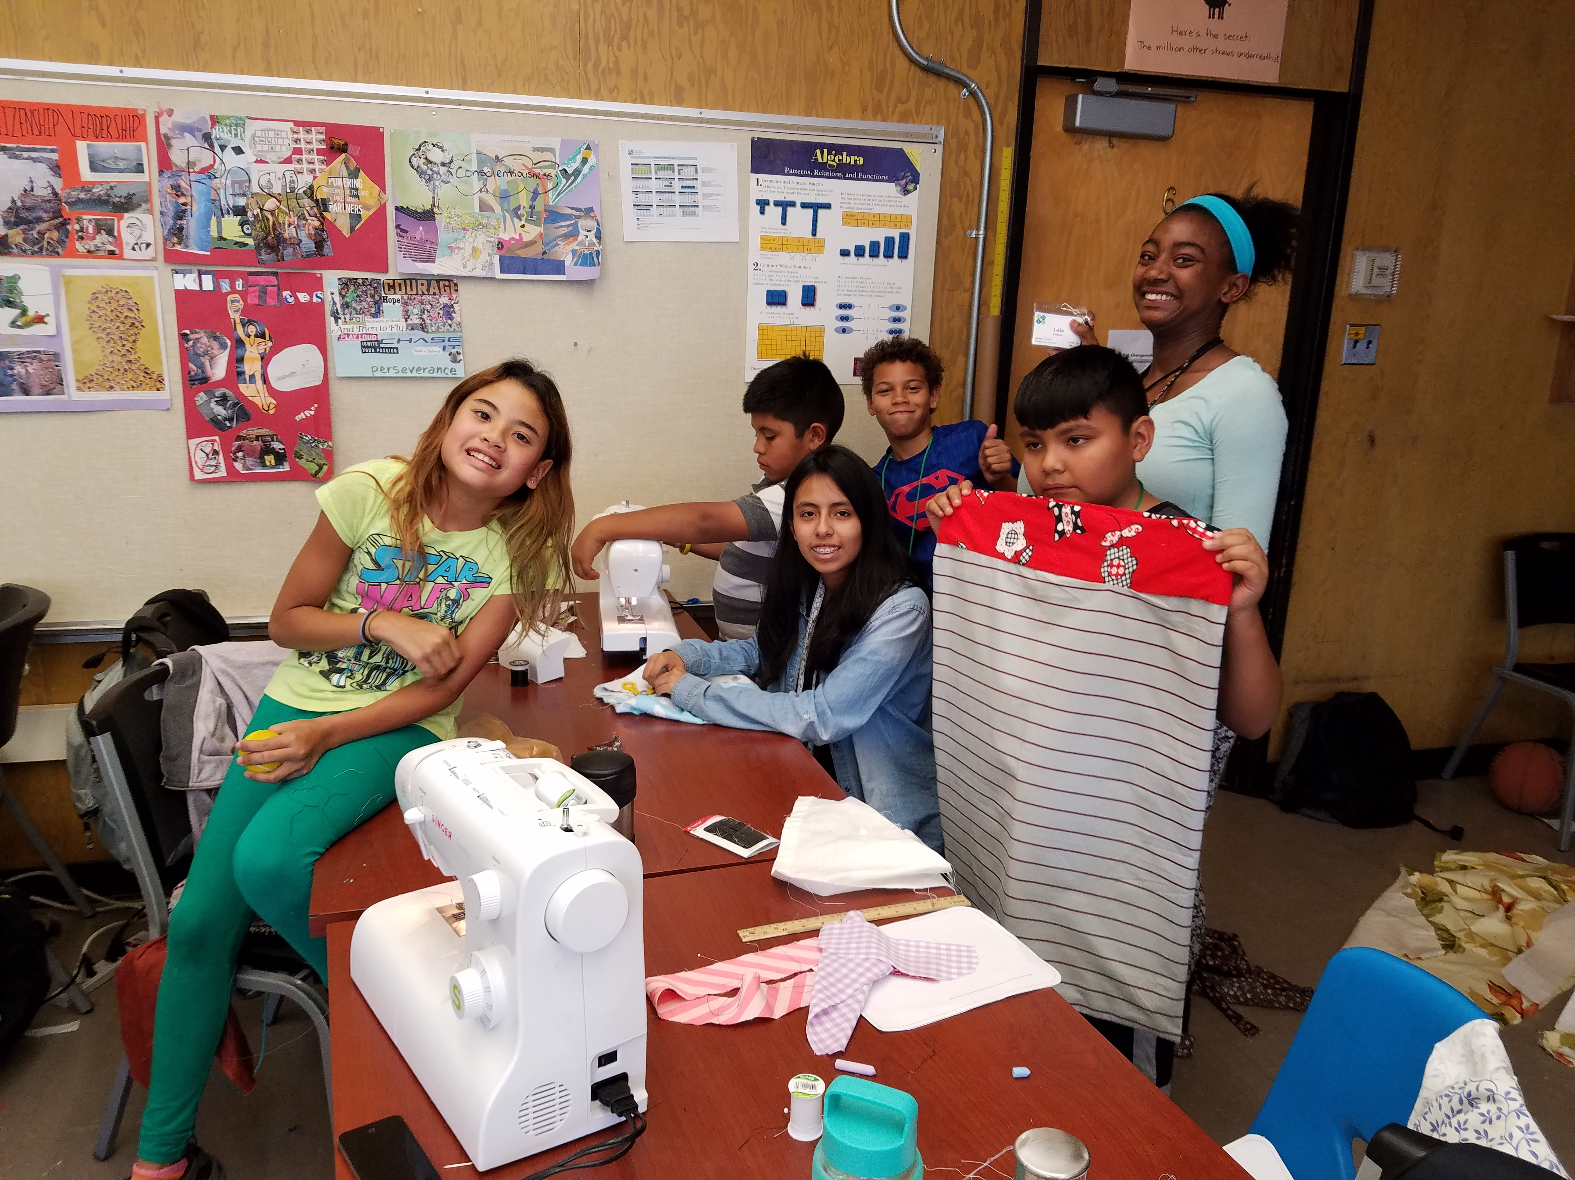
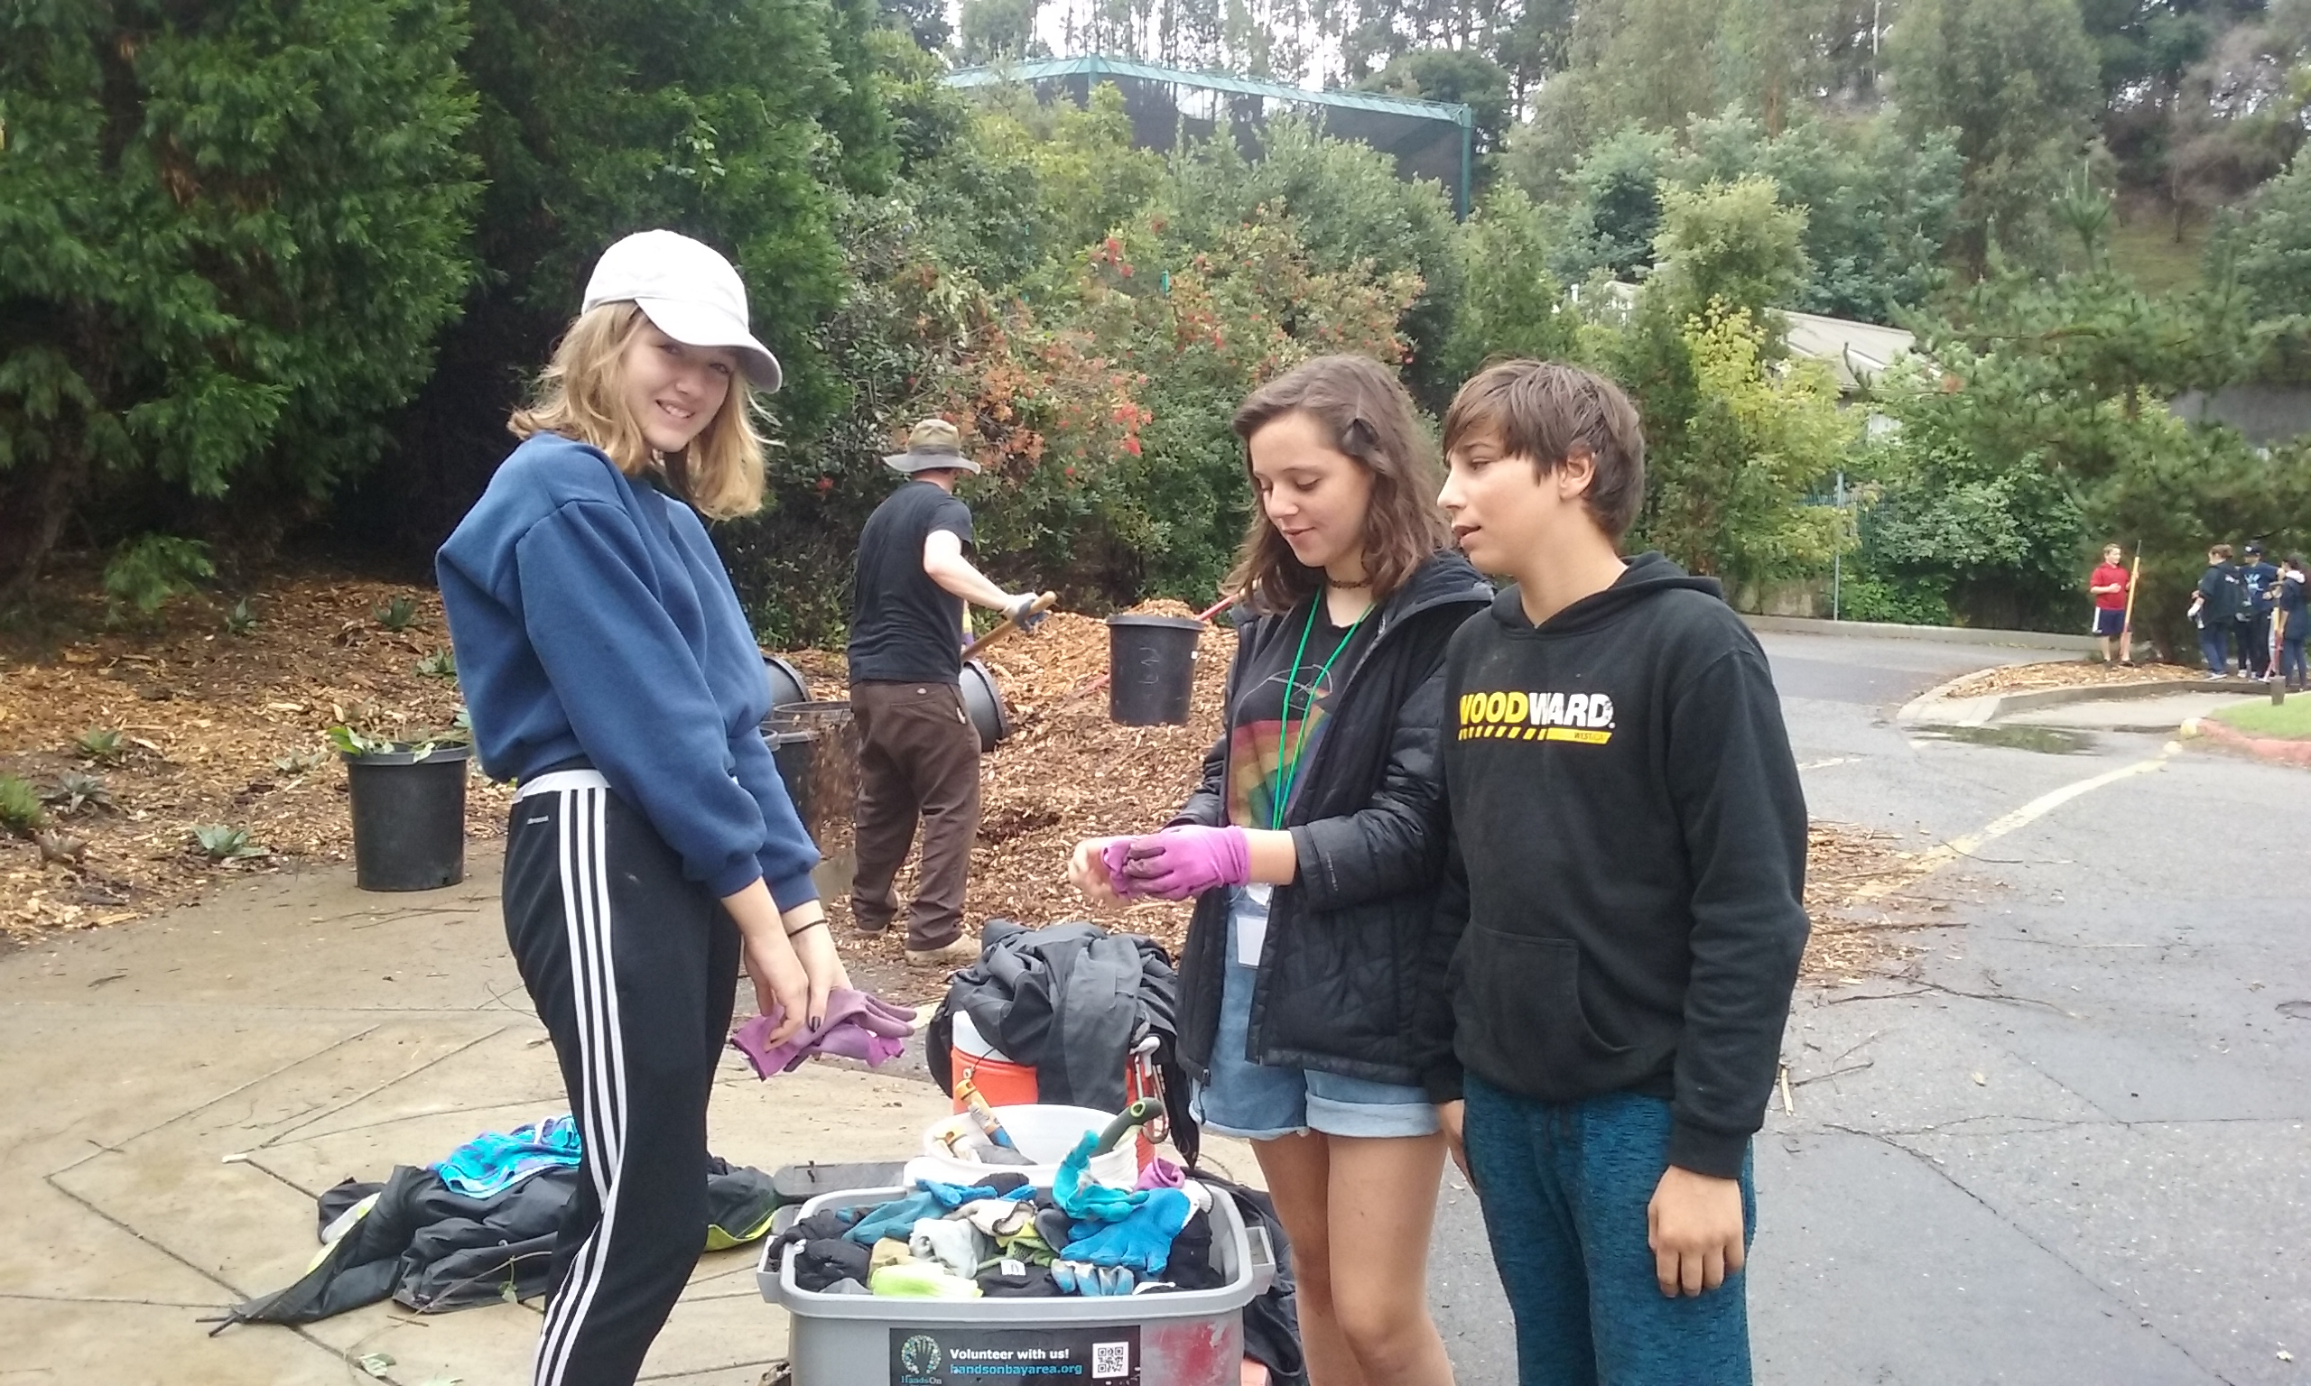
Intersession Report Out
Overview of Programs
Engagement with over 20 partner organizations and businesses throughout the Bay Area
Over 12,000 hours of community service completed across grades 6-9
High rate of student satisfaction with placement and experience
High rate of parent volunteer satisfaction with placement and experience
East Bay Innovation Academy 3400 MALCOLM AVE, OAKLAND, CA 94605 www.eastbayia.org

