Slide 1
East Bay Innovation Academy
2023-24 1st Interim Update
Only add “City, State” if appropriate – may not make sense for regular monthly presentations
Bryce Fleming & Jessika Welcome
December 6, 2023

Slide 2
Financial Summary
Operating loss reduced to $118K, fund balance and cash remain strong
Revenue
Expenses
Expenses increased by $24k
Fund balance projected to end at $1.89M (22% of exp.)
Financial Health
Cash balance increased to $1.55M (66 DCOH)
Increase in enrollment and unduplicated count increased LCFF revenue by $89k
Other state revenue decreased by $50k from adjustments to one-time funding
Increase in substitutes of $82k partially offset by $51k decrease in comp and benefits
Other budget changes netted a $6k savings
Fundraising increased by $80k from private donation

Slide 3
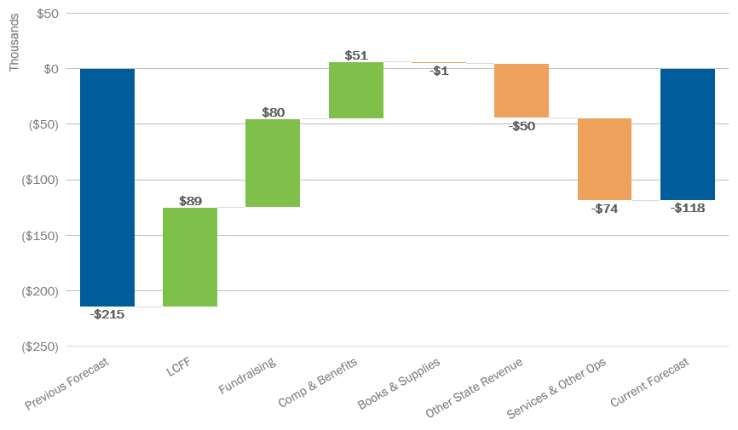
2023-24 Forecast Update
Excel Workbook:
Waterfall
October forecast reflects an improvement of $97k from prior month

Slide 4
2023-24 First Interim Budget
Projected decrease of $195K from approved budget in June 2023
Notes:
Current ADE is 260, budget 339
Revenue Decrease:
State revenue decrease because ADE was lower than previously estimated
Federal revenue increase: CSP Carry over
Expenses Increase:
Professional and Tech Services: Projecting to have more long-term substitute teachers due to lack of current full-time teachers
CSP Funded – Infinite Campus, Data Insight Partners, etc
Property Services
Repairs and Maintenance – CSP carryover – likely to shift elsewhere
Debt Services and Misc
Estimated CAM fees
Property taxes

Slide 5
2023-24 First Interim MYP
Operating income in out years, revisions likely before 2nd interim (March)
Notes:
Current ADE is 260, budget 339
Revenue Decrease:
State revenue decrease because ADE was lower than previously estimated
Federal revenue increase: CSP Carry over
Expenses Increase:
Professional and Tech Services: Projecting to have more long-term substitute teachers due to lack of current full-time teachers
CSP Funded – Infinite Campus, Data Insight Partners, etc
Property Services
Repairs and Maintenance – CSP carryover – likely to shift elsewhere
Debt Services and Misc
Estimated CAM fees
Property taxes

Slide 6
2023-24 Cash Flow by Month
Cash balance of $1.55M in October, continuing to increase in the spring

