Slide 1
Academic Update
February 2015 Board Meeting Devin Krugman
East Bay Innovation Academy 3400 MALCOLM AVE, OAKLAND, CA 94605 www.eastbayia.org

Slide 2
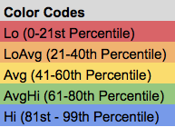
First Half MAP Growth
Statistical Overview
Average 6 month growth score is 2-3 RIT points (Statistical error range is an average +/- 2 to 3 points)
Number represent mean RIT score for given population on given assessment
AVG represents average growth score for given population across all assessments
General Trends
Large gains across 6th grade (with one year of growth in math)
7th grade fall mean scores overall in higher percentiles, with less growth demonstrated
Gender discrepancies in math/science and reading/language
Next Steps
Comparative analysis by race, IEP/504, EL and FRL
East Bay Innovation Academy 3400 MALCOLM AVE, OAKLAND, CA 94605 www.eastbayia.org

Slide 3
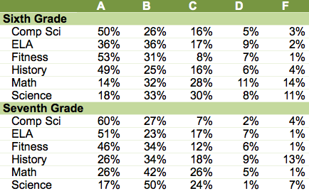
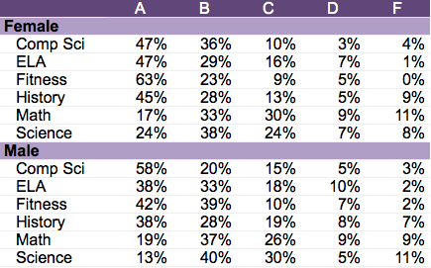
First Half Grade Progress
Breakdown by Grade
Initial Observations
6th grade pass rate outliers in math and science
7th grade pass rate outlier in history
Somewhat consistent pass rates by gender
Spring academic updates – Wednesday schedule, revision policy, accelerated math
Comparative analysis in March by race, IEP/504, EL and FRL
Breakdown by Gender

Slide 4
Closer Look: History Department
February 2015 Board Meeting Paul Meyer and Glenn Katzman
East Bay Innovation Academy 3400 MALCOLM AVE, OAKLAND, CA 94605 www.eastbayia.org

Slide 5
Grade 6 Overview
Course Question: How do communities survive and thrive?
Capstone: Trace how E.B.I.A. has survived and thrived this past year → what should we do differently moving forward?
Core Skills: Reading, Writing, Summarizing, Image Analysis, Metacognition,
Pedagogy: Less teacher-focused and more student-directed; brief lecture followed by teacher support; group projects with some student choice
MAP Data Focus: Informational Text, Writing: Plan, Organize, Develop, Revise, Research
Instructional Resources:
T.C.I. History Alive!: Lesson samples and documents
1997 Standards and Common Core Standards: Justification and Reasoning
S.H.E.G.: Developed by Stanford; graduate students, RAs, teachers, etc.
ELA: Close collaboration with ELA in terms of planning, MAP data, etc.
Devin Krugman: Frequent check-ins on scope and sequence with a veteran teacher

