Slide 1
JOSE ANTONIO AGUIRRE
Selected Public Art Projects
with Community Participation

Slide 2
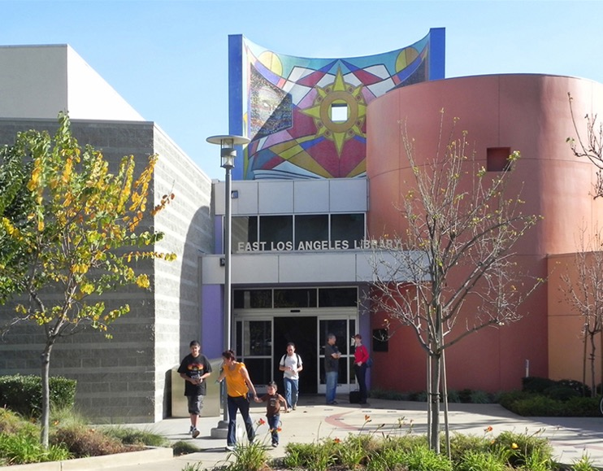
East Los Angeles County Public Library

Slide 3
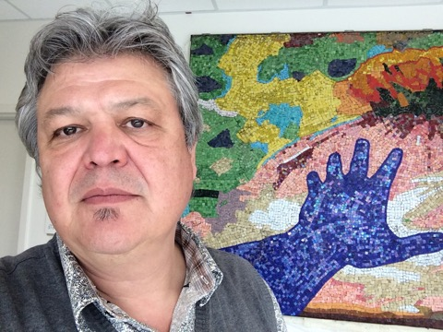
Jose Antonio Aguirre is recognized as a bi-national artist, who was born and raised in Mexico City and immigrated to the United States in 1976. During the 1980s, Jose achieved a B.F.A. from the Art Institute of Chicago and then an M.F.A. from the California Institute of the Arts in 1990. Jose Antonio has continued to live and work in Los Angeles, developing a national and international art career. He has actively participated in solo and group exhibitions, but he is particularly recognized for his public art.

Slide 4
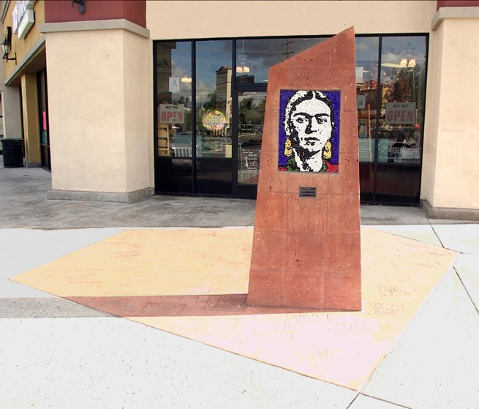
PASEO DE LOS MAESTROS /FRIDA KAHLO
Paseo Sepulveda Shopping Center, North Hills, Los Angeles, CA

Slide 5
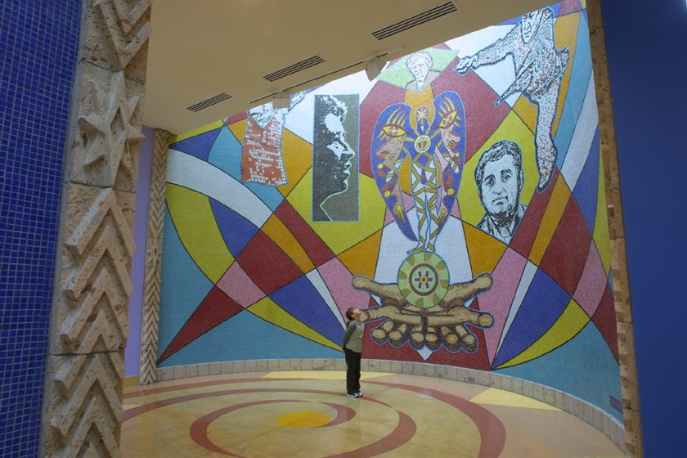
Our Legacy Forever Presente… / Arrival
East Los Angeles County Public Library

Slide 6
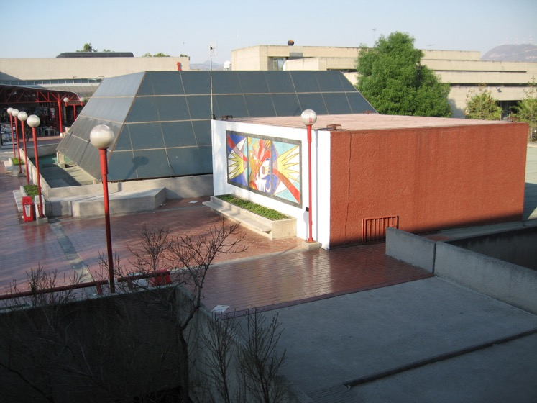
DUALIDAD/DUALITY
Universidad Autónoma Metropolitana Azcapotzalco
Mexico City

Slide 7
Public Art with community participation
The artist intention, is to involve the local community (ages 8 -90) recruited from schools, community organizations, churches, libraries and senior centers, in the feedback and making of a permanent public art work, participating mostly in the production of Byzantine and/or Venetian Glass mosaic elements.
This process will be implemented through a series of lectures, hands-on workshops to be scheduled as needed. Their participation, brings pride and ownership for future generations.

Slide 8
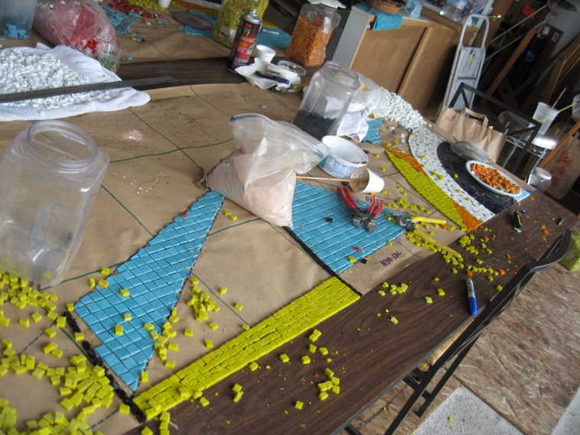

Slide 9
Wey yano’ one’ (Here we are-Aquí estamos)
McKinley School – Pasadena, California
750 Student (Grades K-8th), teachers and parents participation in the production of a Venetian mosaic mural (110’ W x 4’ H)
installed at the the original school yard retaining wall.
This project was recipient of the Bravo award.
2006

Slide 10
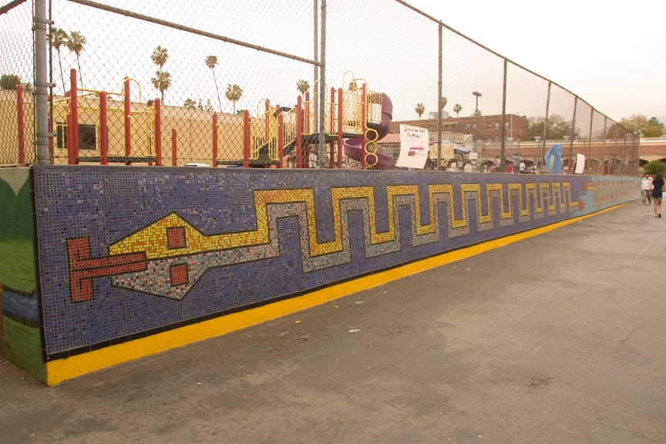

Slide 11
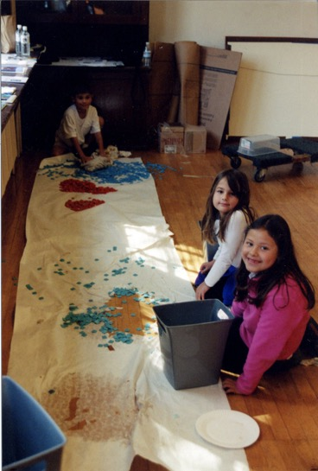
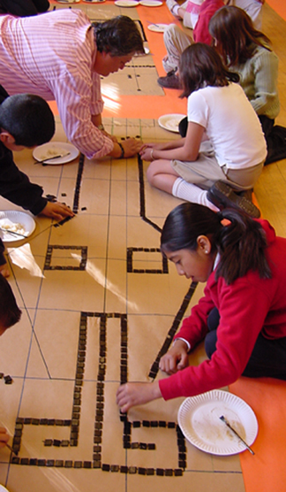

Slide 12
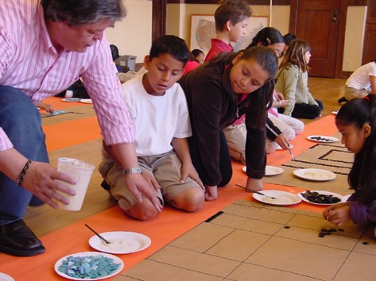
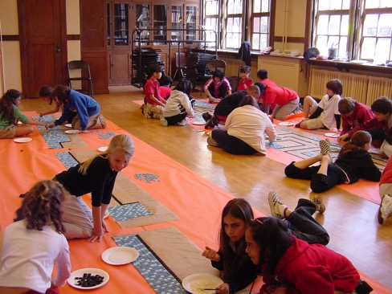

Slide 13
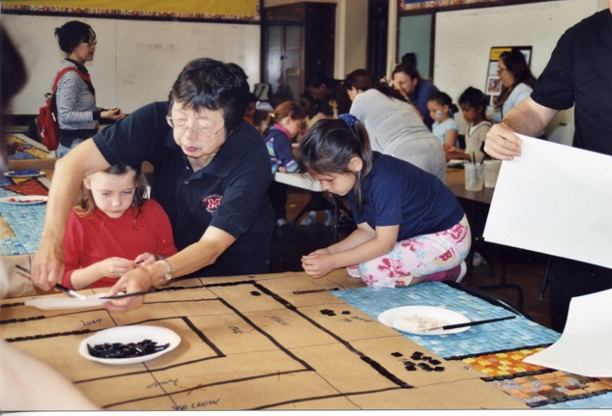
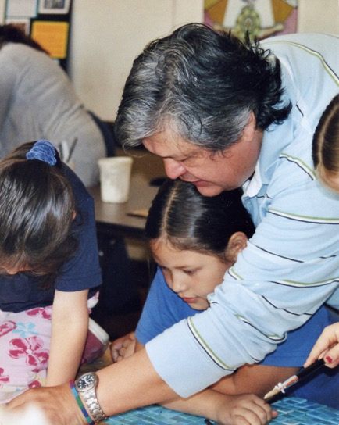

Slide 14
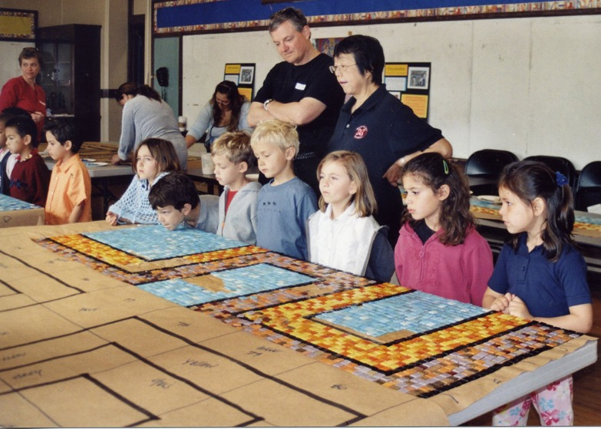

Slide 15
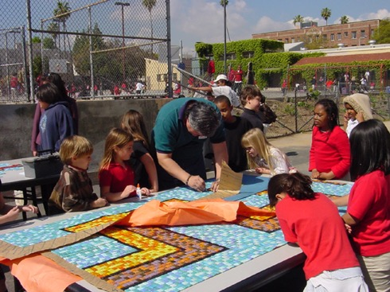
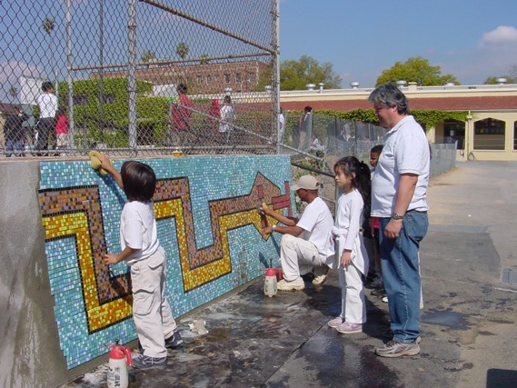

Slide 16
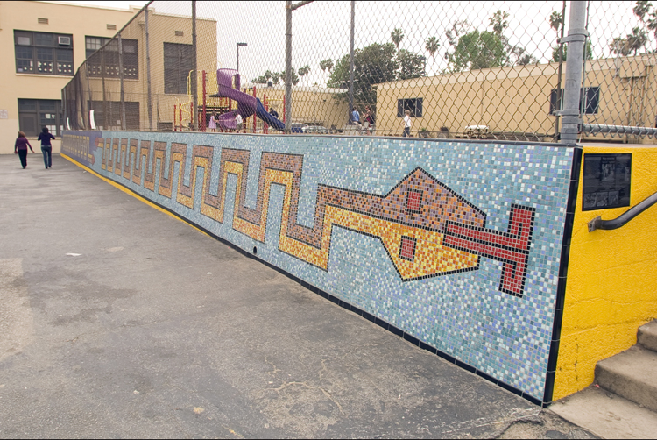

Slide 17
Our Shinning Stars
Lancaster Animal Shelter
Children, teens, adults and seniors from Agua Dulce and Lancaster communities; students of the Glass workshop at Universidad Autónoma Metropolitana, Azcapotzalco campus in Mexico City; participated in the production of seven medallions Byzantine and Venetian glass mosaic elements installed in the main corridor at the entrance of the shelter.
2010

Slide 18
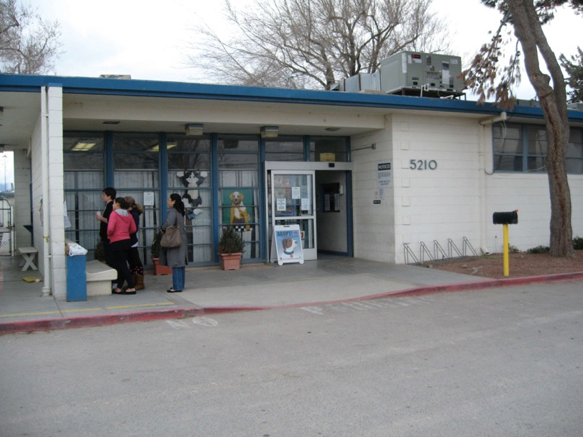

Slide 19
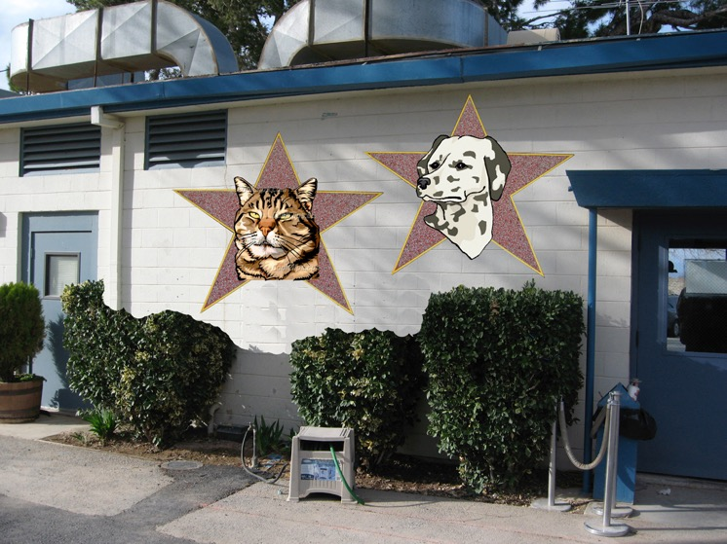

Slide 20
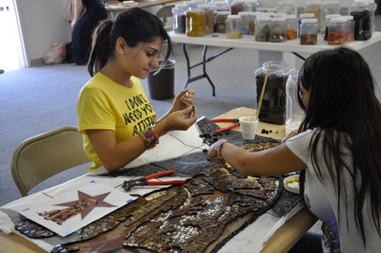
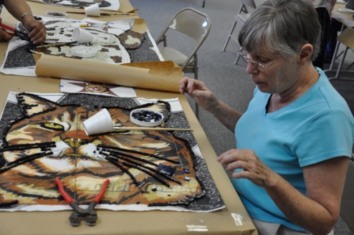

Slide 21
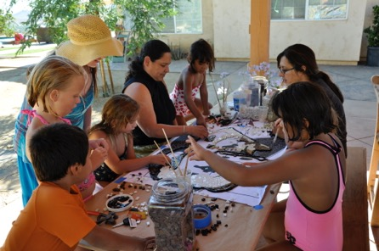
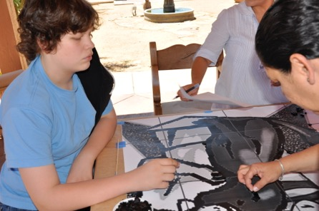
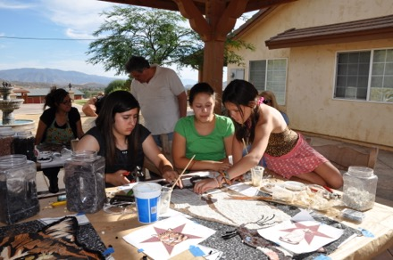
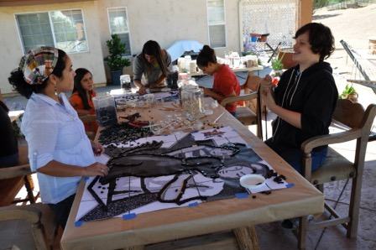

Slide 22
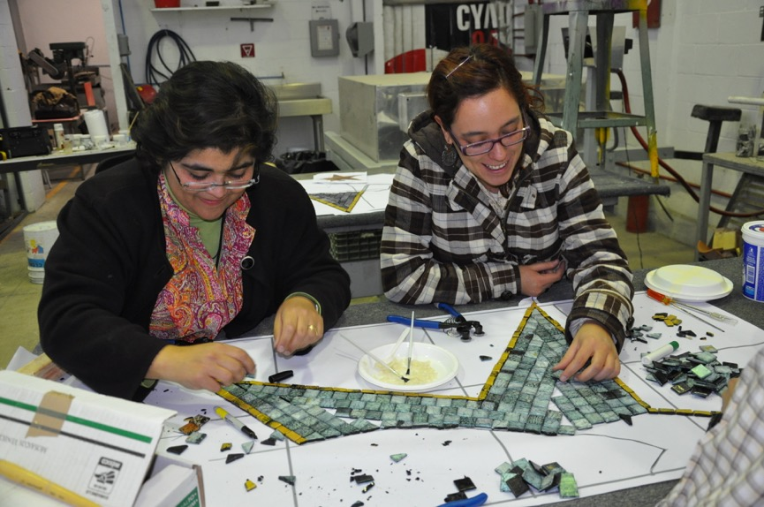

Slide 23
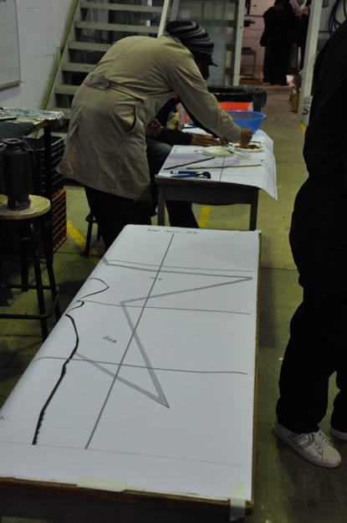
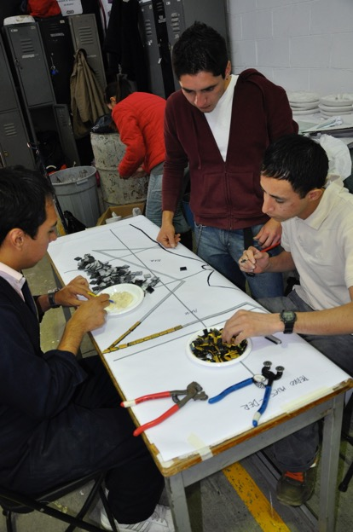

Slide 24
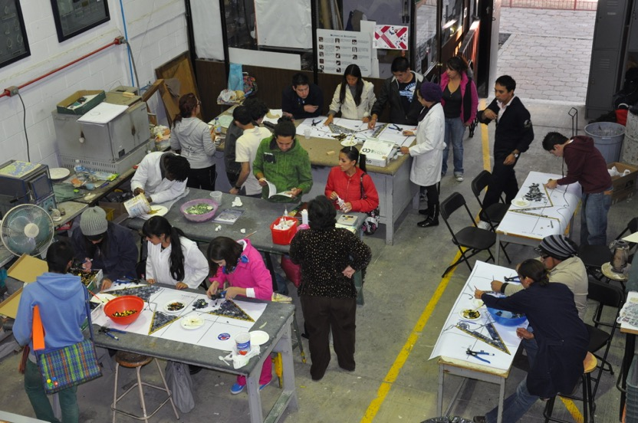

Slide 25
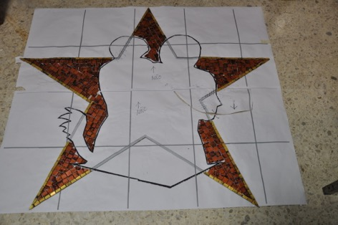
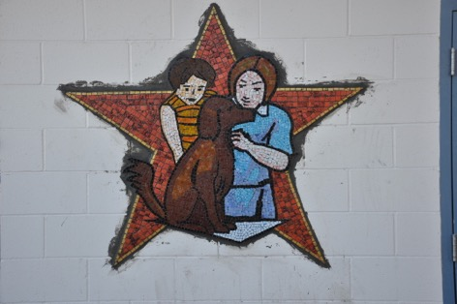

Slide 26
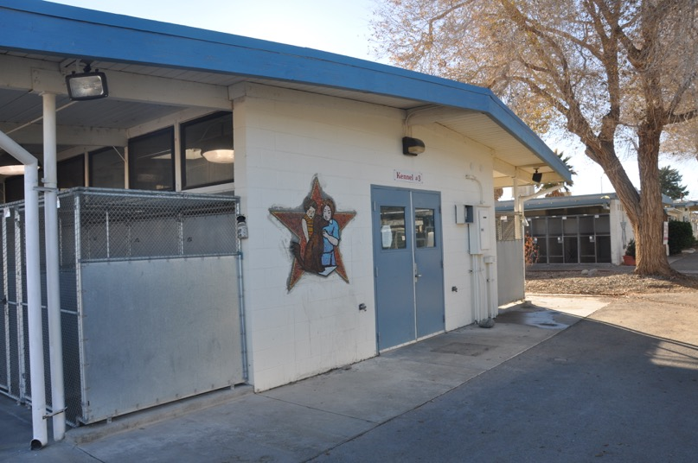

Slide 27
A Luminaries Journey
Valley Boulevard Grade Separation / El Sereno
A series of nine standing sculptures, placed along a 1/4mile green areas of East Valley Boulevard next to Cal-State Los Angeles. Designed project to include students from Universidad Autonoma Metropolitana-Azcapotzalco in Mexico City in the production of all mosaic and fussed glass elements.
2011

Slide 28
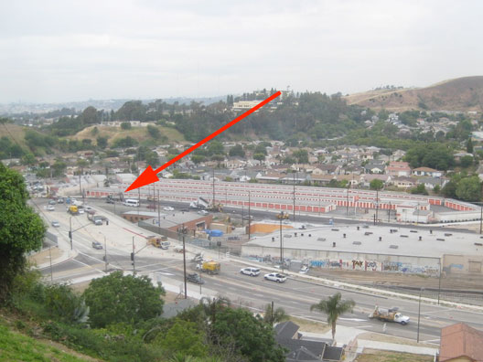

Slide 29
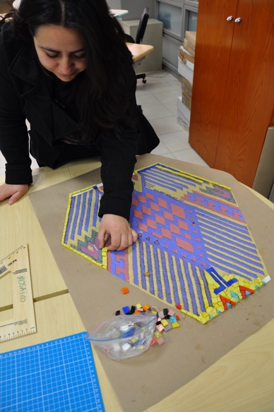
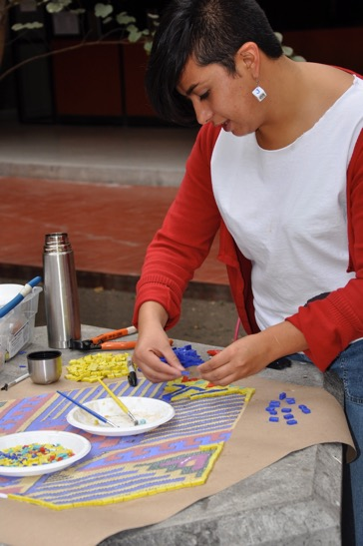

Slide 30
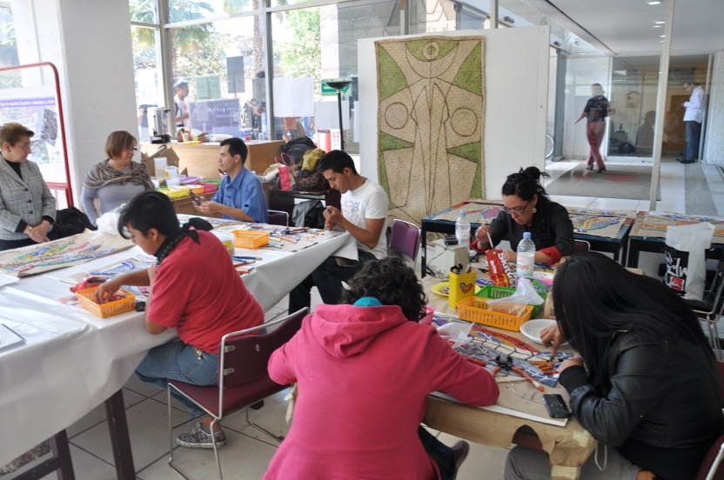

Slide 31
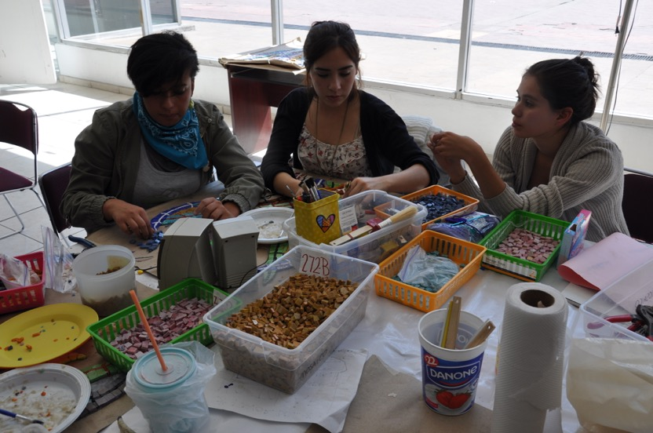

Slide 32
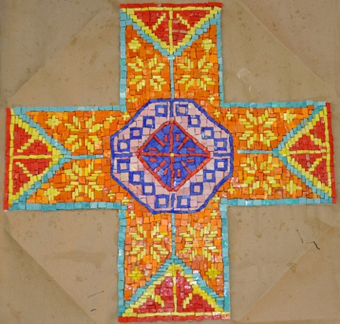
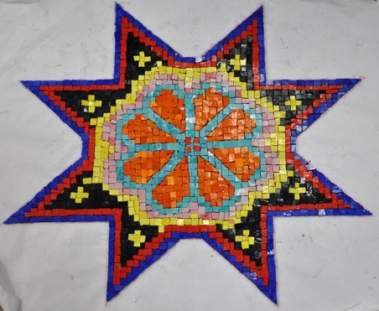

Slide 33
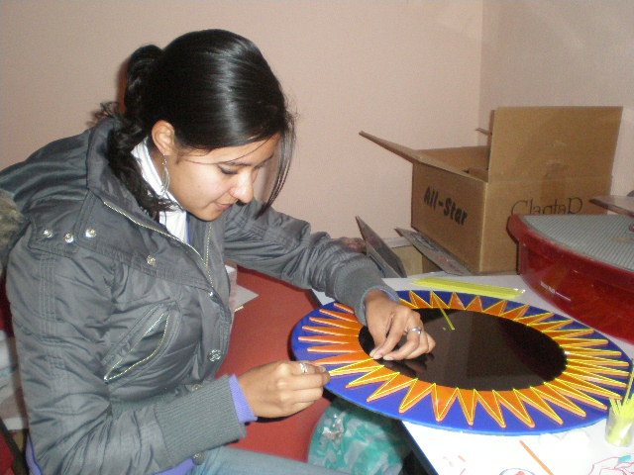

Slide 34
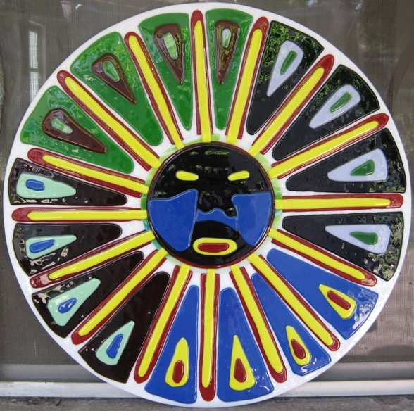

Slide 35
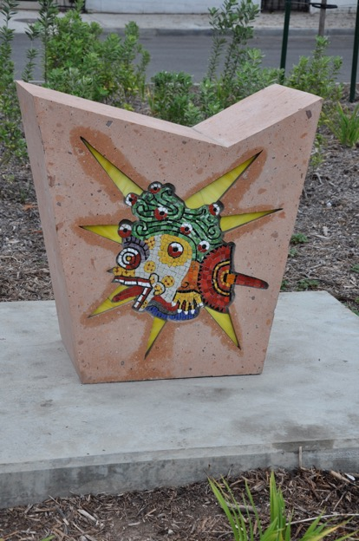
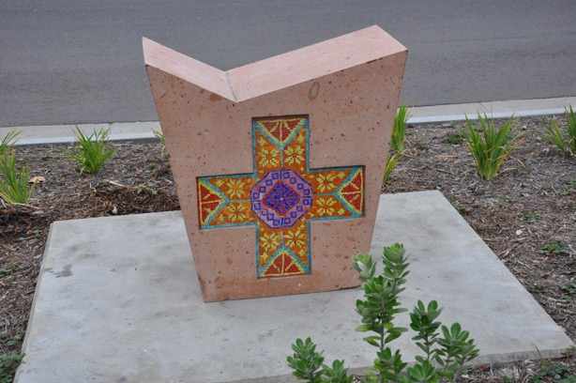

Slide 36
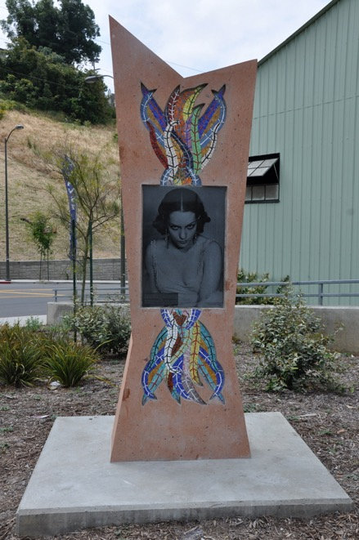
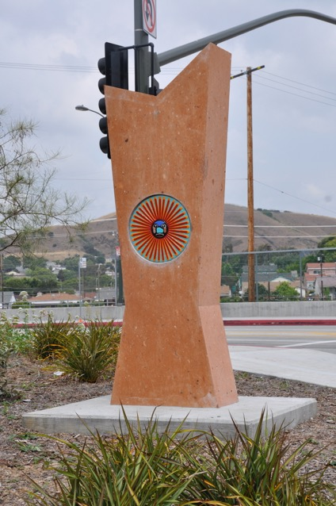

Slide 37
A Passage Through Memory
Azusa Downtown Station / Gold Line Foothill Extension
Students from the Arts program at Azusa Pacific University, participated in the production of glass mosaic elements,
installed at the base of the canopy columns located
at the station platforms.
2014/15

Slide 38
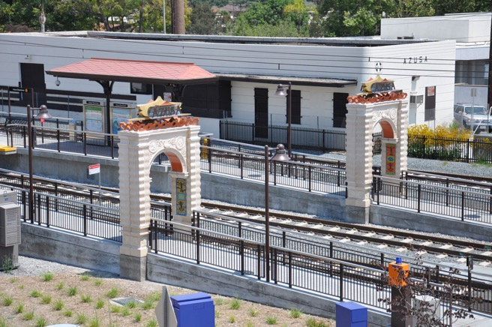
Jose Antonio Aguirre developed a concept for the station that will serve as both a historic landmark and a gateway for the City of Azusa. The station's architectural and artistic design elements are to reflect an integration of motifs and pictographs drawn from the cultural traditions of the Native American Tongva-Gabrielino tribe and the architectural forms of the early California Spanish-Colonial Mission style. The fusion of the two histories will capture the cultural significance of the local area reflected in the civic identity of the City of Azusa.

Slide 39
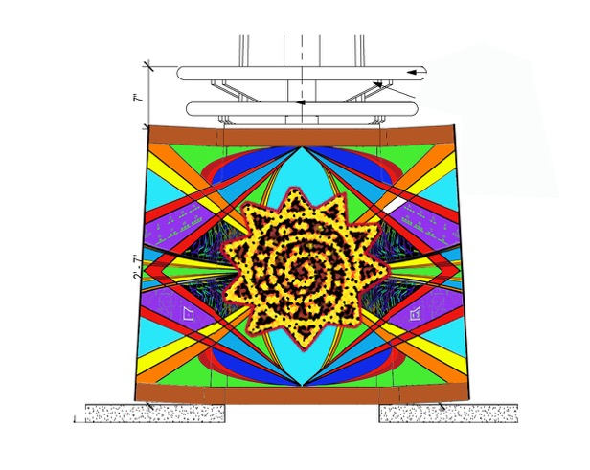
A unique art element to this station is the inclusion of hand-made glass mosaic compositions that are inspired by basket weavings from the local tribes of the San Gabriel Valley region. The artist seeks to include the public in the design developmental stages and final creation of the custom mosaics that will be installed on the canopy column bases of both platforms.

Slide 40
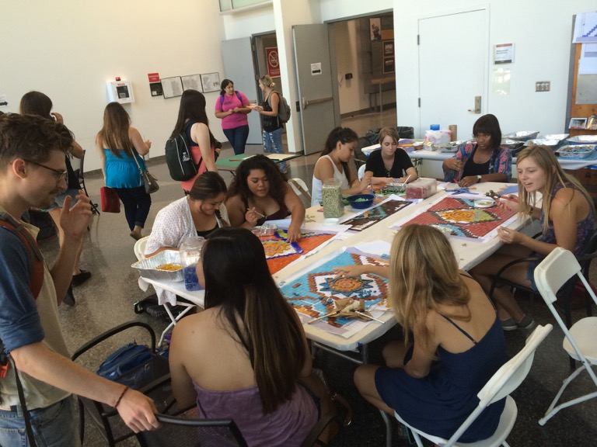

Slide 41
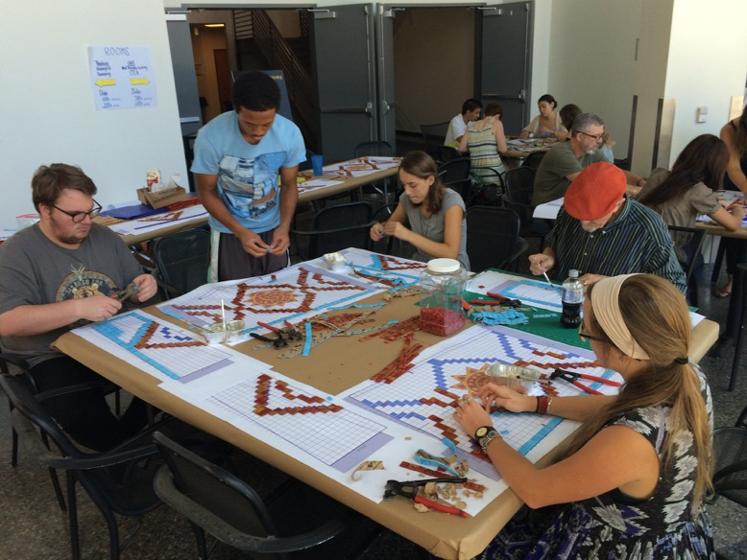

Slide 42
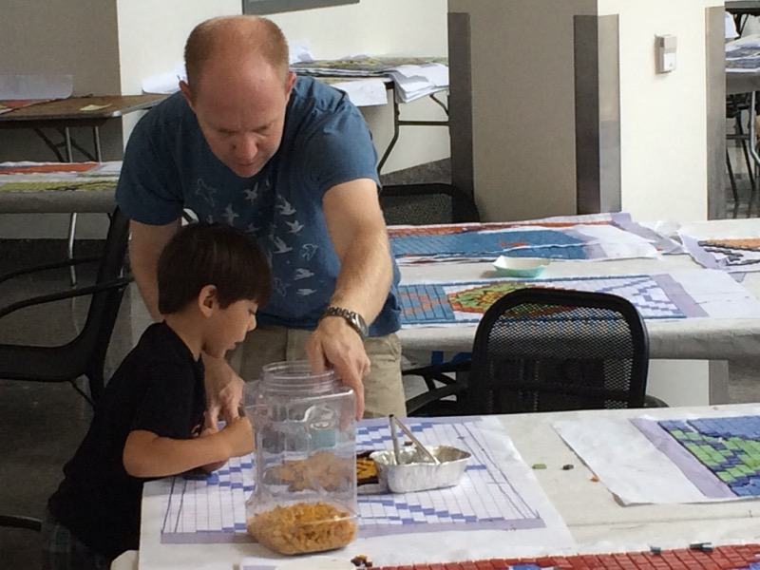

Slide 45
ESCENCIA ANÁHUAC
Mosaic mural produced with students (1 - 6th grades),
teachers, staff and parents at Colegio Anáhuac, an elementary school in Colima City, Mexico, involving 550 people

Slide 46
Design was composed integrating ideas
developed by students in their art class
Final design is reproduced into
a full scale reversed drawing

Slide 47
During the process of producing of full scale drawings, students participated discussing the
image relationship and narrative at they same time that the witnessed the process of
enlarging the design to full scale.

Slide 48
First step was for the student to outline the design in mosaic

Slide 49
Students setting one piece of mosaic at the time on to brown/butcher paper, using a
non-toxic state of the art glue based on a 3000 year old recipe.

Slide 50
Families involved with their children in the production of mosaic.

Slide 51
Completed large mosaic sections, ready for installation

Slide 52
Finished mosaic is cut into smaller numbered sections

Slide 53
Detailing finished cut sections to be ready for installation

Slide 54
Wall is prepared with a coat of mortar and sections are installed
face back into the surface

Slide 55
After mosaic sets into mortar, paper is wet to be peeled off mosaic

Slide 56
Paper is wet and removed until it uncovers the mosaic

Slide 57
Esencia Anáhuac
Finished mosaic after clean up and grouting

Slide 58
JOSE ANTONIO AGUIRRE
Public Art
Studio 626.584.1699
jaalarte@earthlink.net

