Slide 1
NWEA/Dibels MOY results
Jan 2024

Slide 2
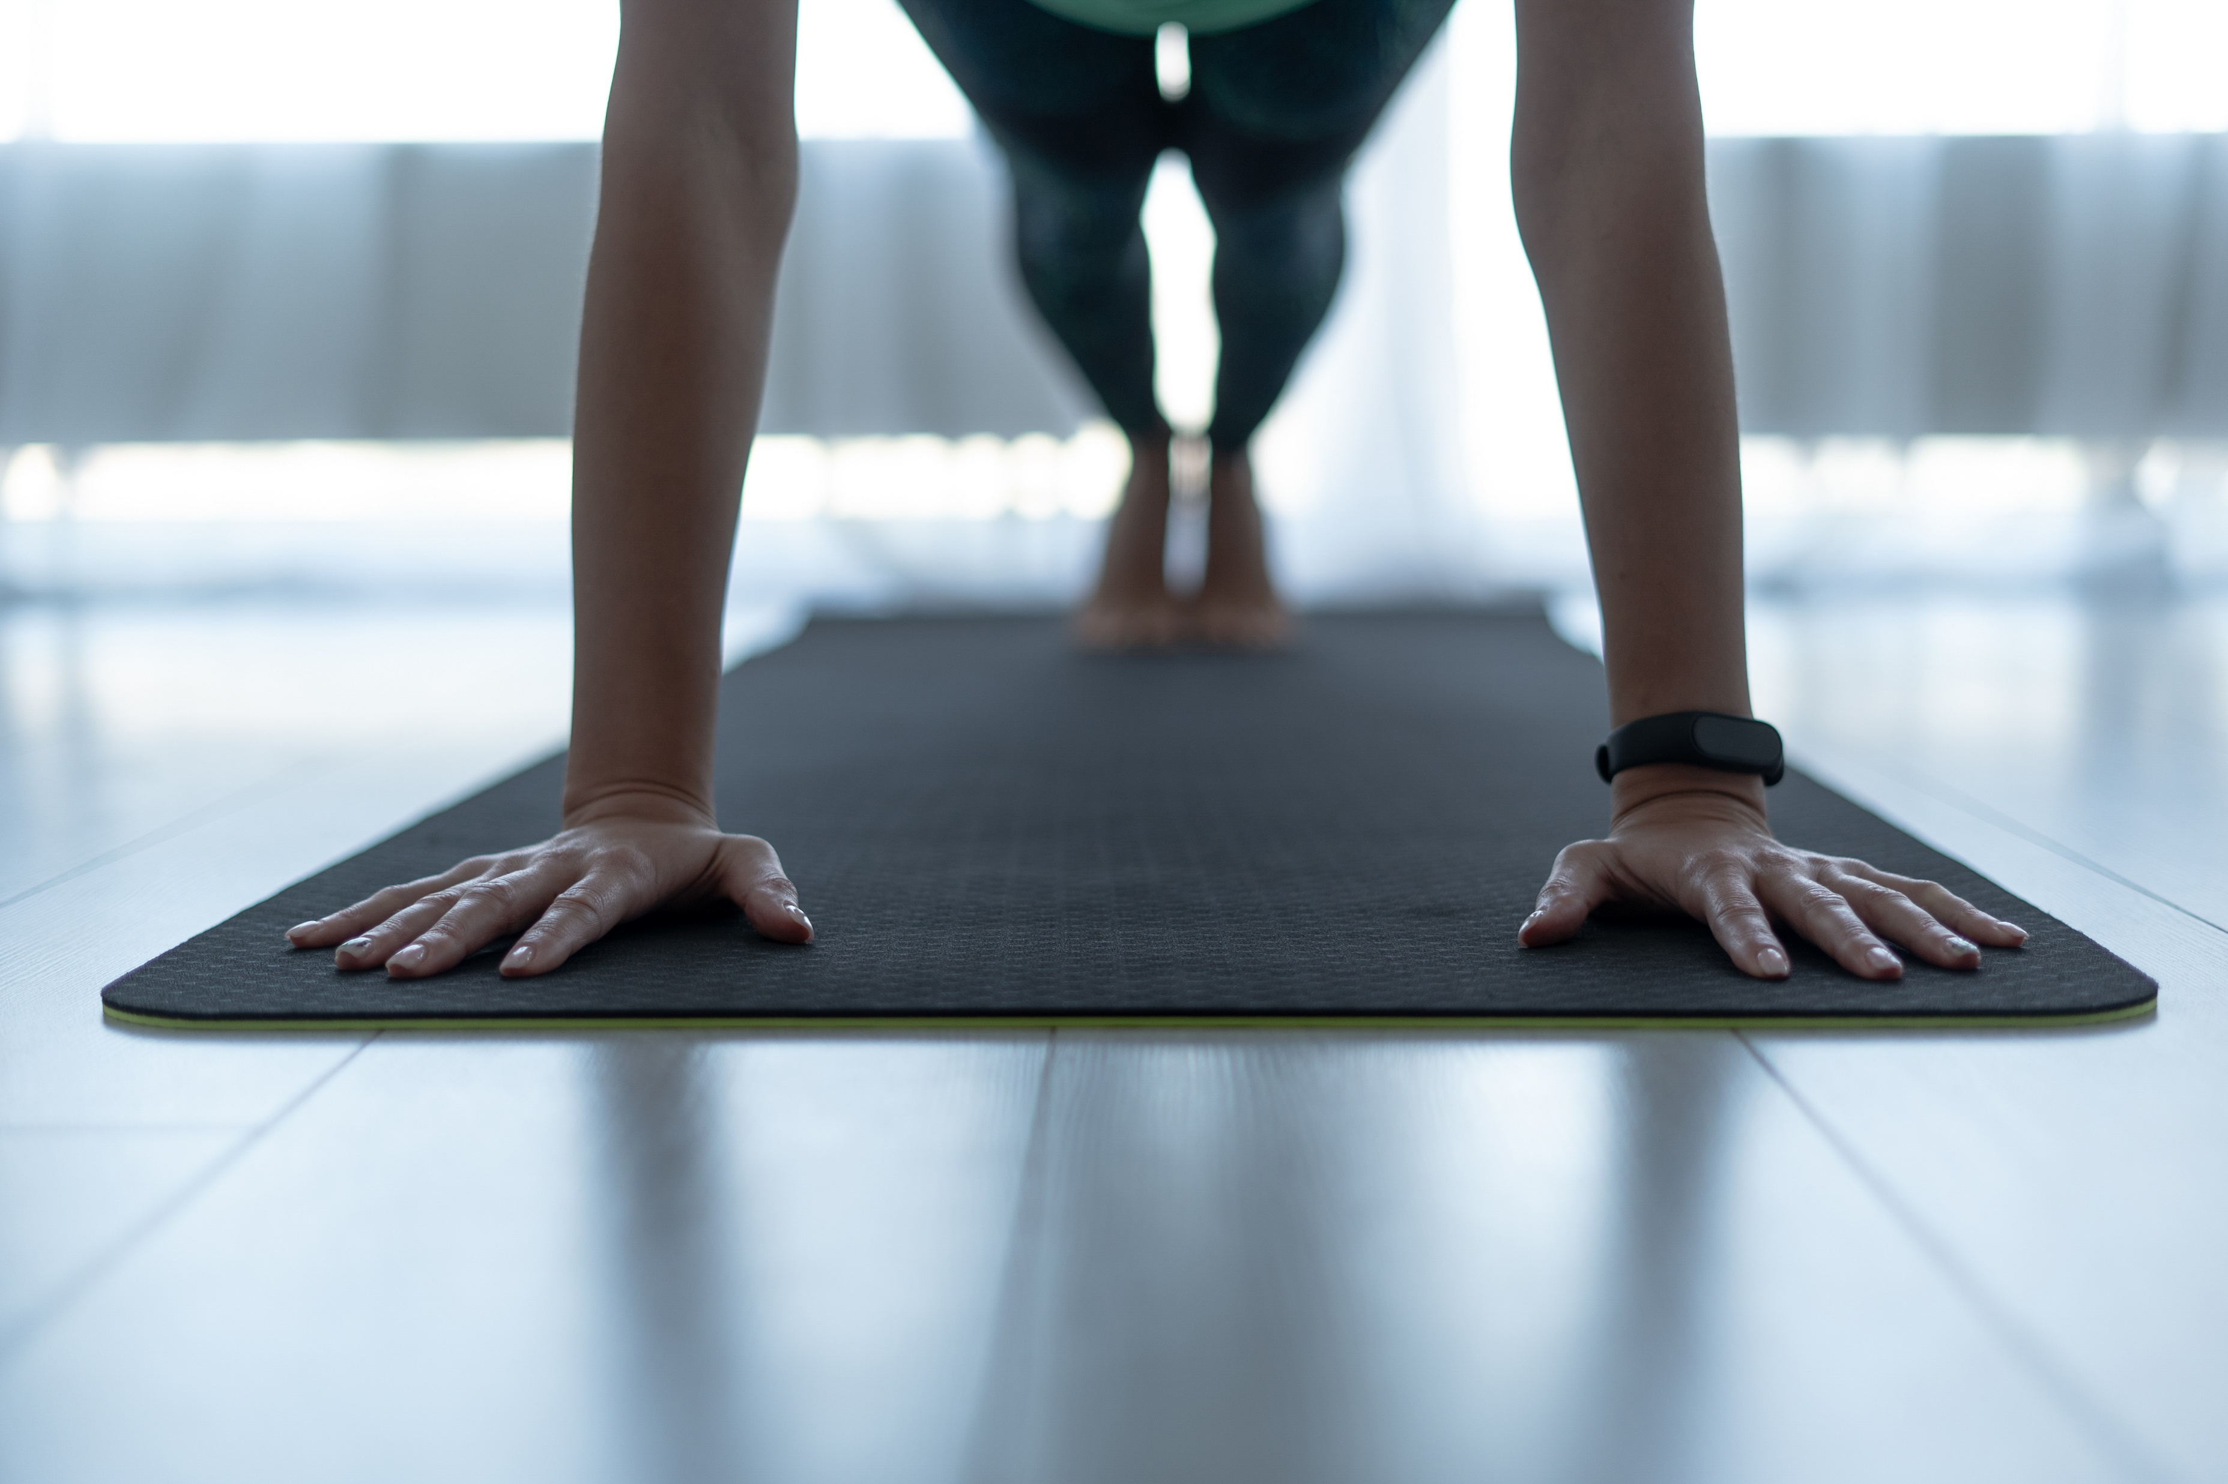
Table Talk (4 min.)

Slide 3
If we were a football team halfway into the season, how likely would we be going to the playoffs?
Pair and share (2 min.)

Slide 4
2023-2024 MOY NWEA Data

Slide 5
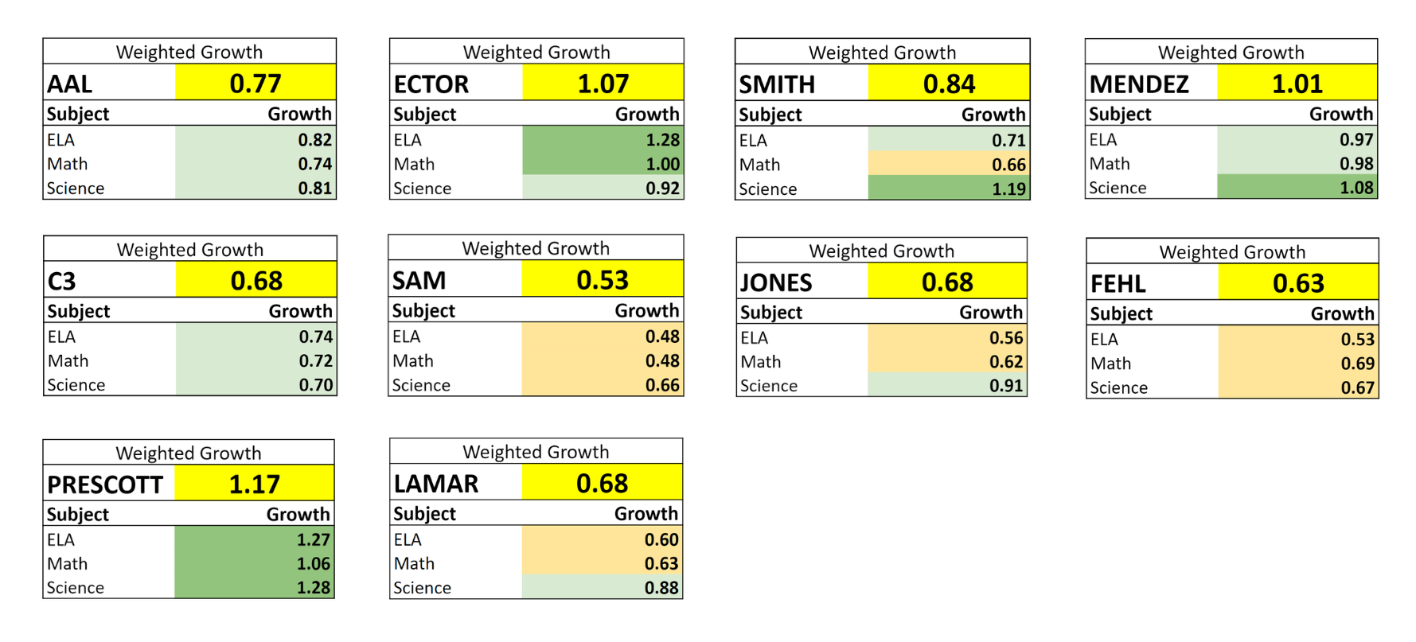
MOY NWEA Growth: from August to December 2023

Slide 6
Dibels MOY Composite scores

Slide 7
Dibles Data-Third Future Schools | Grade Level | BOY-Below Benchmark | BOY Benchmark | MOY Below Benchmark | MOY Benchmark | Difference
AAL | Kinder | 76% | 24% | 61% | 39% | 15%
 | 1st | 62% | 38% | 60% | 40% | 2%
Coperni 3 | Kinder | 74% | 26% | 39% | 41% | 15%
 | 1st | 39% | 61% | 10% | 80% | 19%
Sam Houston | Kinder | 28% | 72% | 19% | 81% | 9%
 | 1st | 14% | 86% | 31% | 69% | -17%
Lamar | Kinder | 76% | 24% | 53% | 47% | 23%
 | 1st | 76% | 24% | 73% | 27% | 3%
Jones Clark | Kinder | 52% | 48% | 72% | 28% | -20%
 | 1st | 63% | 45% | 85% | 15% | -13%
Fehl-Price | Kinder | 62% | 38% | 71% | 29% | -9%
 | 1st | 75% | 25% | 65% | 35% | 6%
Prescott | Kinder | 75% | 25% | 40% | 60% | 35%
 | 1st | 77% | 23% | 85% | 15% | -8%

Slide 8
Table Talk (4 min.)
Consider your or your school’s NWEA/Dibels scores. What could you have done differently to improve outcomes for students?

Slide 9
Fluid Multiple Response Strategies
Teaching L’s and S1’s
Owning the LCD work
Team Center work
Short writing responses

Slide 10
Fluid Multiple Response Strategies
Ensuring all students know or respond before moving on
Which MRS to use
White boards vs pair and share
MRS vs check for understanding
Insisting on engagement
Writing strong responses
Identifying partners
Room arranged for pair and share
Use of timers for the right amount of time
Students copying info

Slide 11
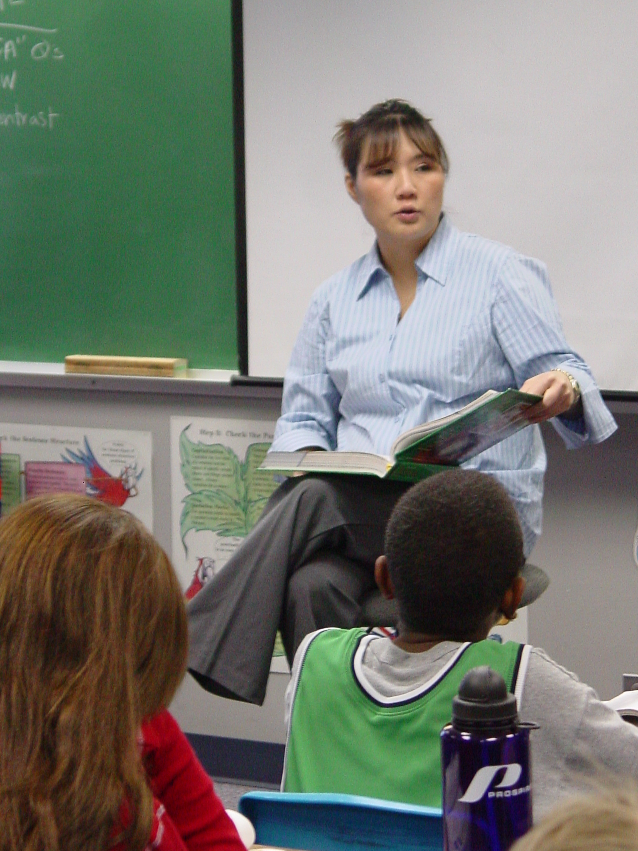
Teaching L’s and S1’s
Direct instruction or guided instruction
Use MRS strategies and scaffolding
No copying
Insist on engagement
Get started right away
Approx. 40% to 50% of students
Use visuals
Keep the pace up

Slide 12
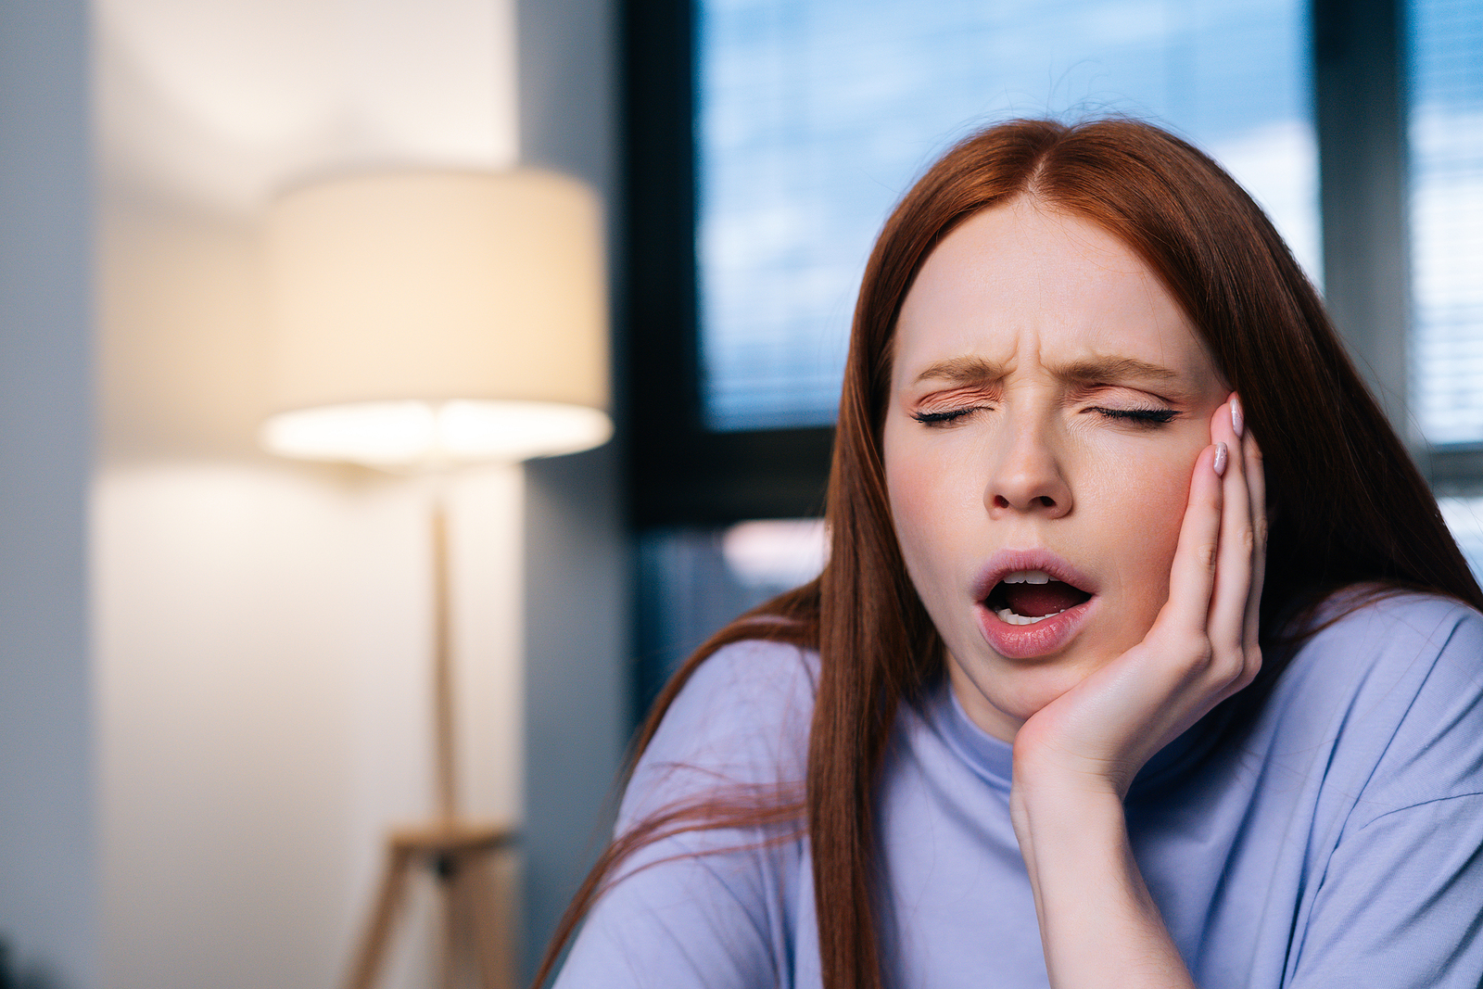
Owning the LCD work
He warned us about going to a concert on a school night . . .
Pair and Share (3 min.)

Slide 13
Team Center work
Pushing the S2s and As
Accuracy and Completion
Annotation
Ensuring work is getting done with Quality
Disciplined Team Center

Slide 14
Short writing responses
All students
Writing legibly
Complete sentences
Quick response versus Short Constructed Response
Writing to a rubric

Slide 15
Reading Instruction/Intervention
Use Data for Grouping
Follow CKLA
Maximize time
Set Composite Goals for each student

Slide 16
Table Talk (3 min.)
What are you going to do differently for the second semester?

Slide 17
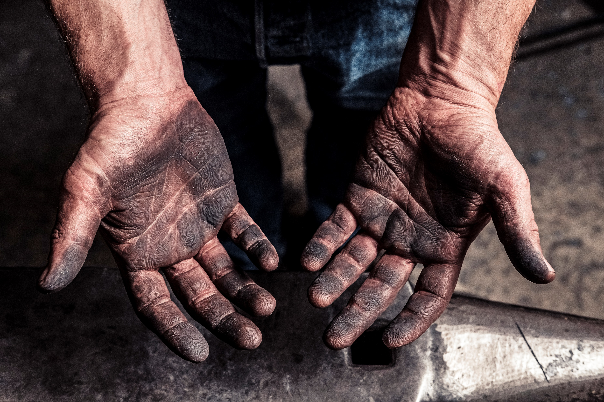
Do you have what it takes?
Do you want to do what it takes?

Slide 18
“Stop researching every aspect of it and debating the pros and cons of it…start doing it”
Jocko Willink

