Slide 1
2023-2024
What’s Happening at Brevard Academy?
We have had a great month at BA!

Slide 2
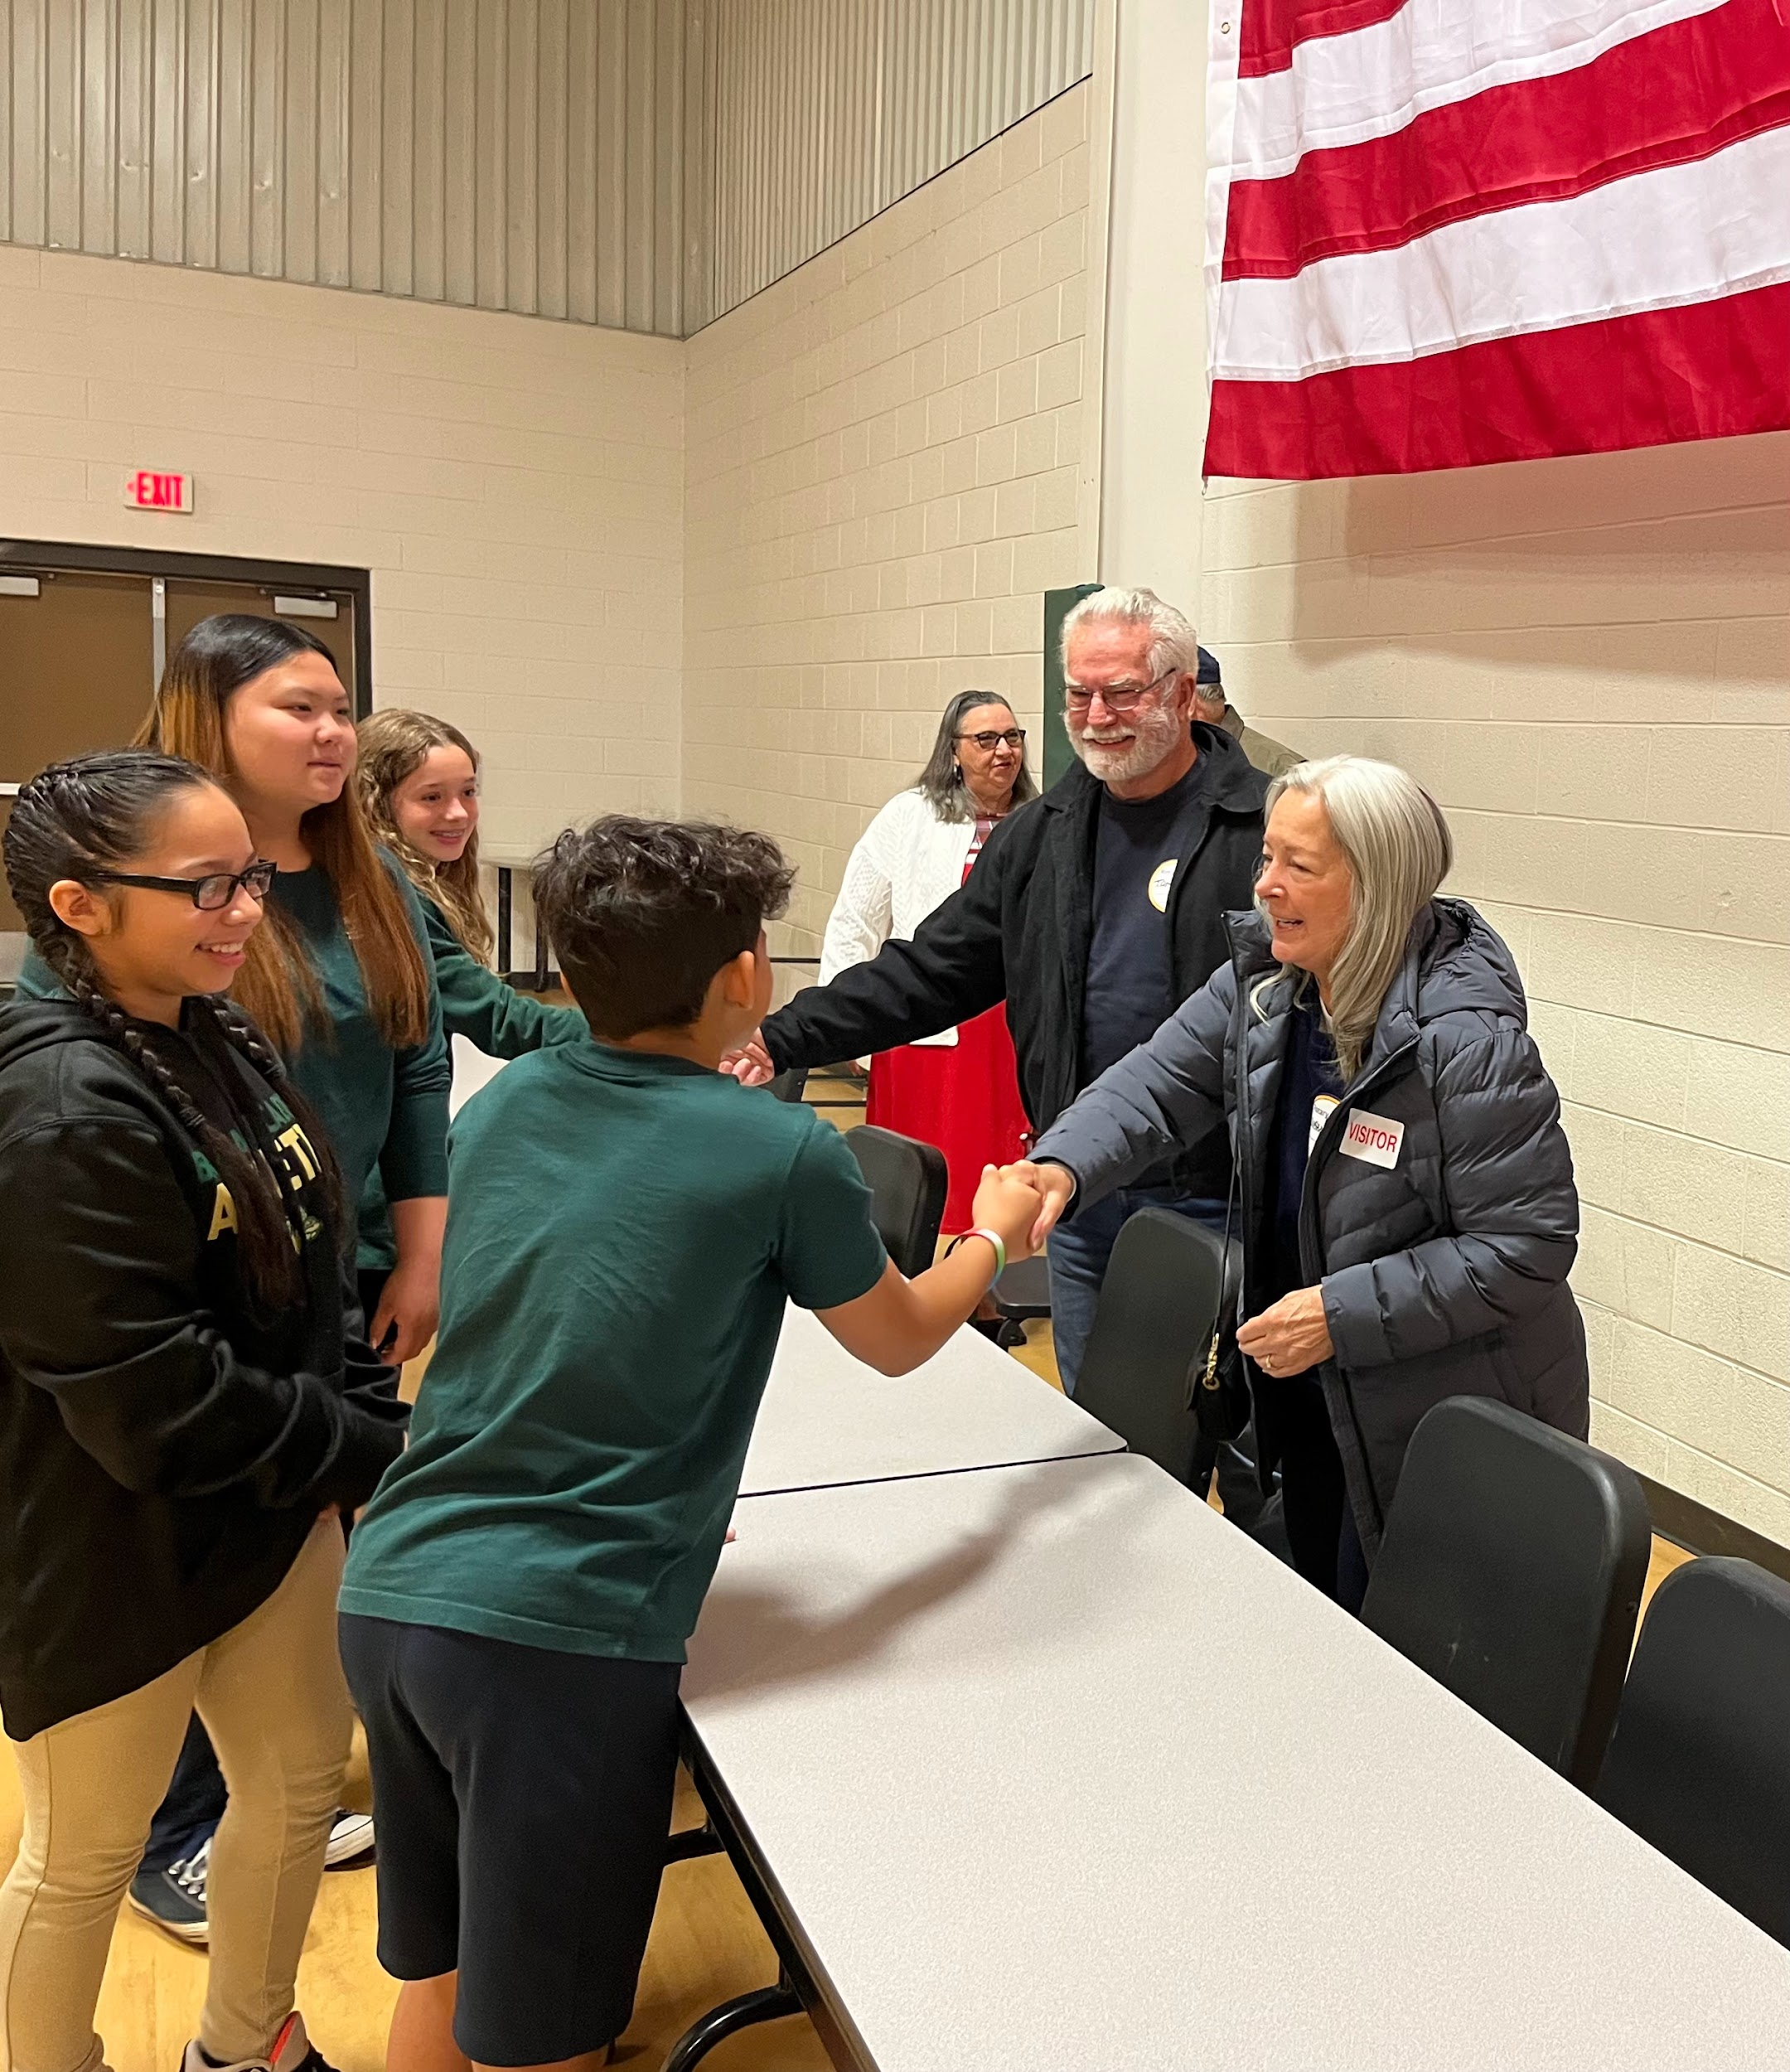
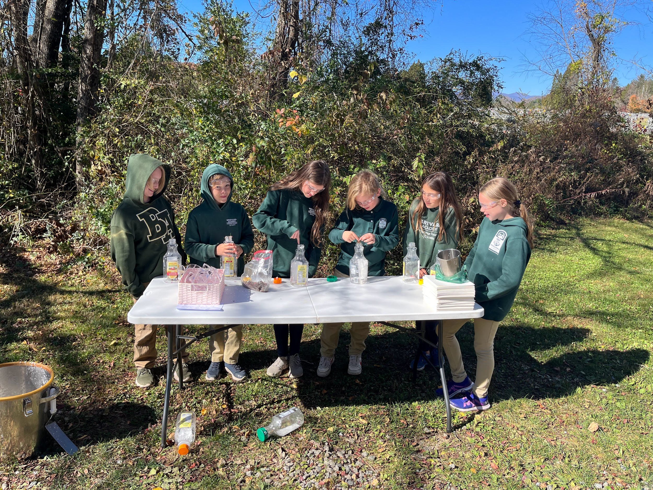
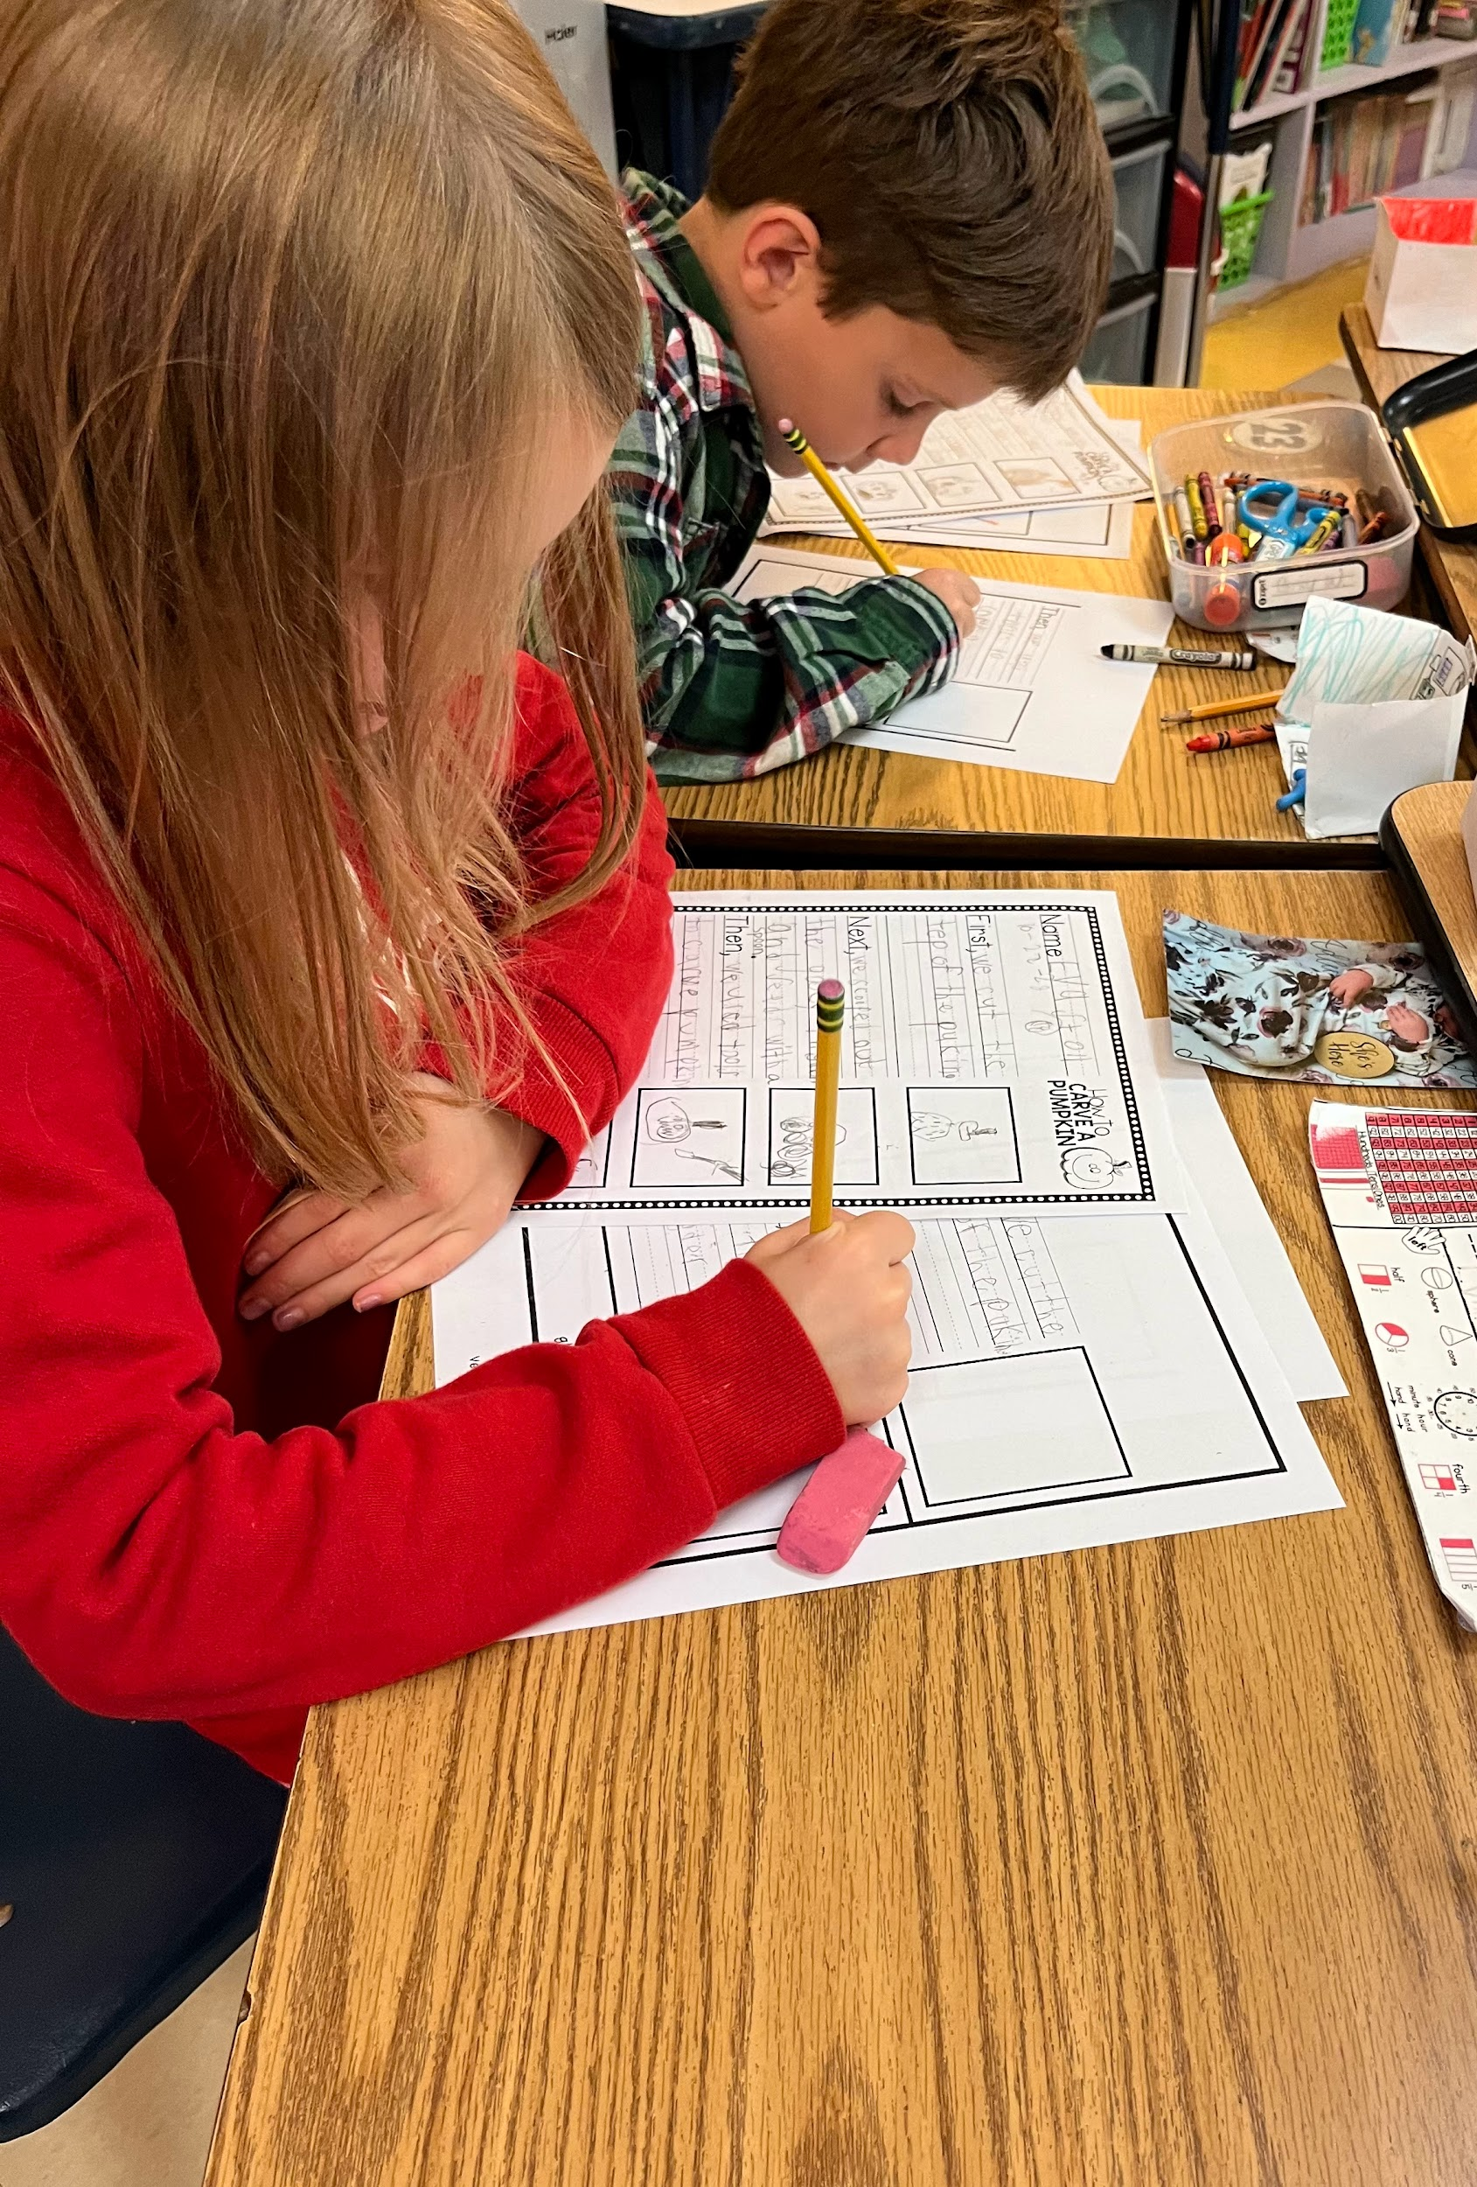
Our Mission
The Mission of Brevard Academy is to prepare its students to achieve academic excellence through the Core Knowledge Sequence. Through a partnership involving students, teachers, and parents the school strives to create citizens with strong moral character and active intellectual inquiry.

Slide 3
Our Vision
Brevard Academy: A Challenge Foundation Academy (BA-CFA) a K-8 public charter school develops and encourages motivated, intellectually curious students who are skilled in critical thinking, individual expression and problem solving. From their diverse backgrounds, students accept our challenge to pursue personal and academic excellence. Through this pursuit, they become confident members of their community who lead by serving others.
We believe teachers should respect and value the gifts of each student, foster a love of learning and curiosity, and be committed to the success of each student.
We believe students should believe in the potential of each person, including themselves to learn and think globally and embrace the ideals of tolerance and fairness
More Information
We believe school should be a setting that inspires high academic achievement and provide a socially, emotionally, and physically enriching environment

Slide 4
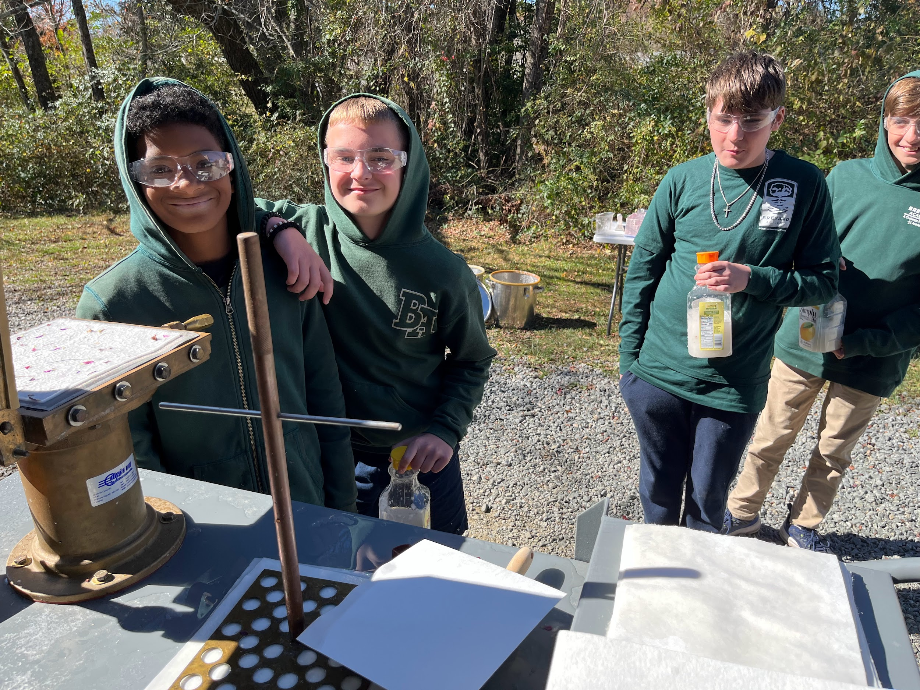
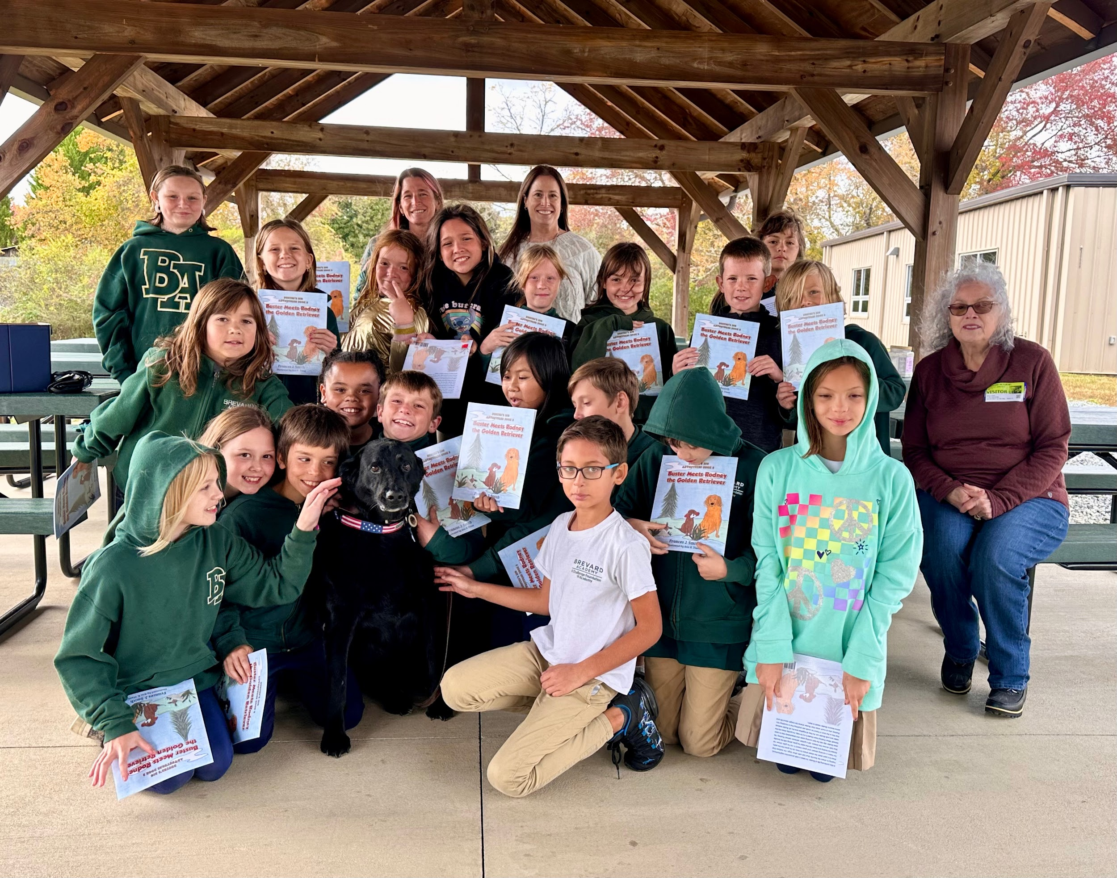

Slide 5
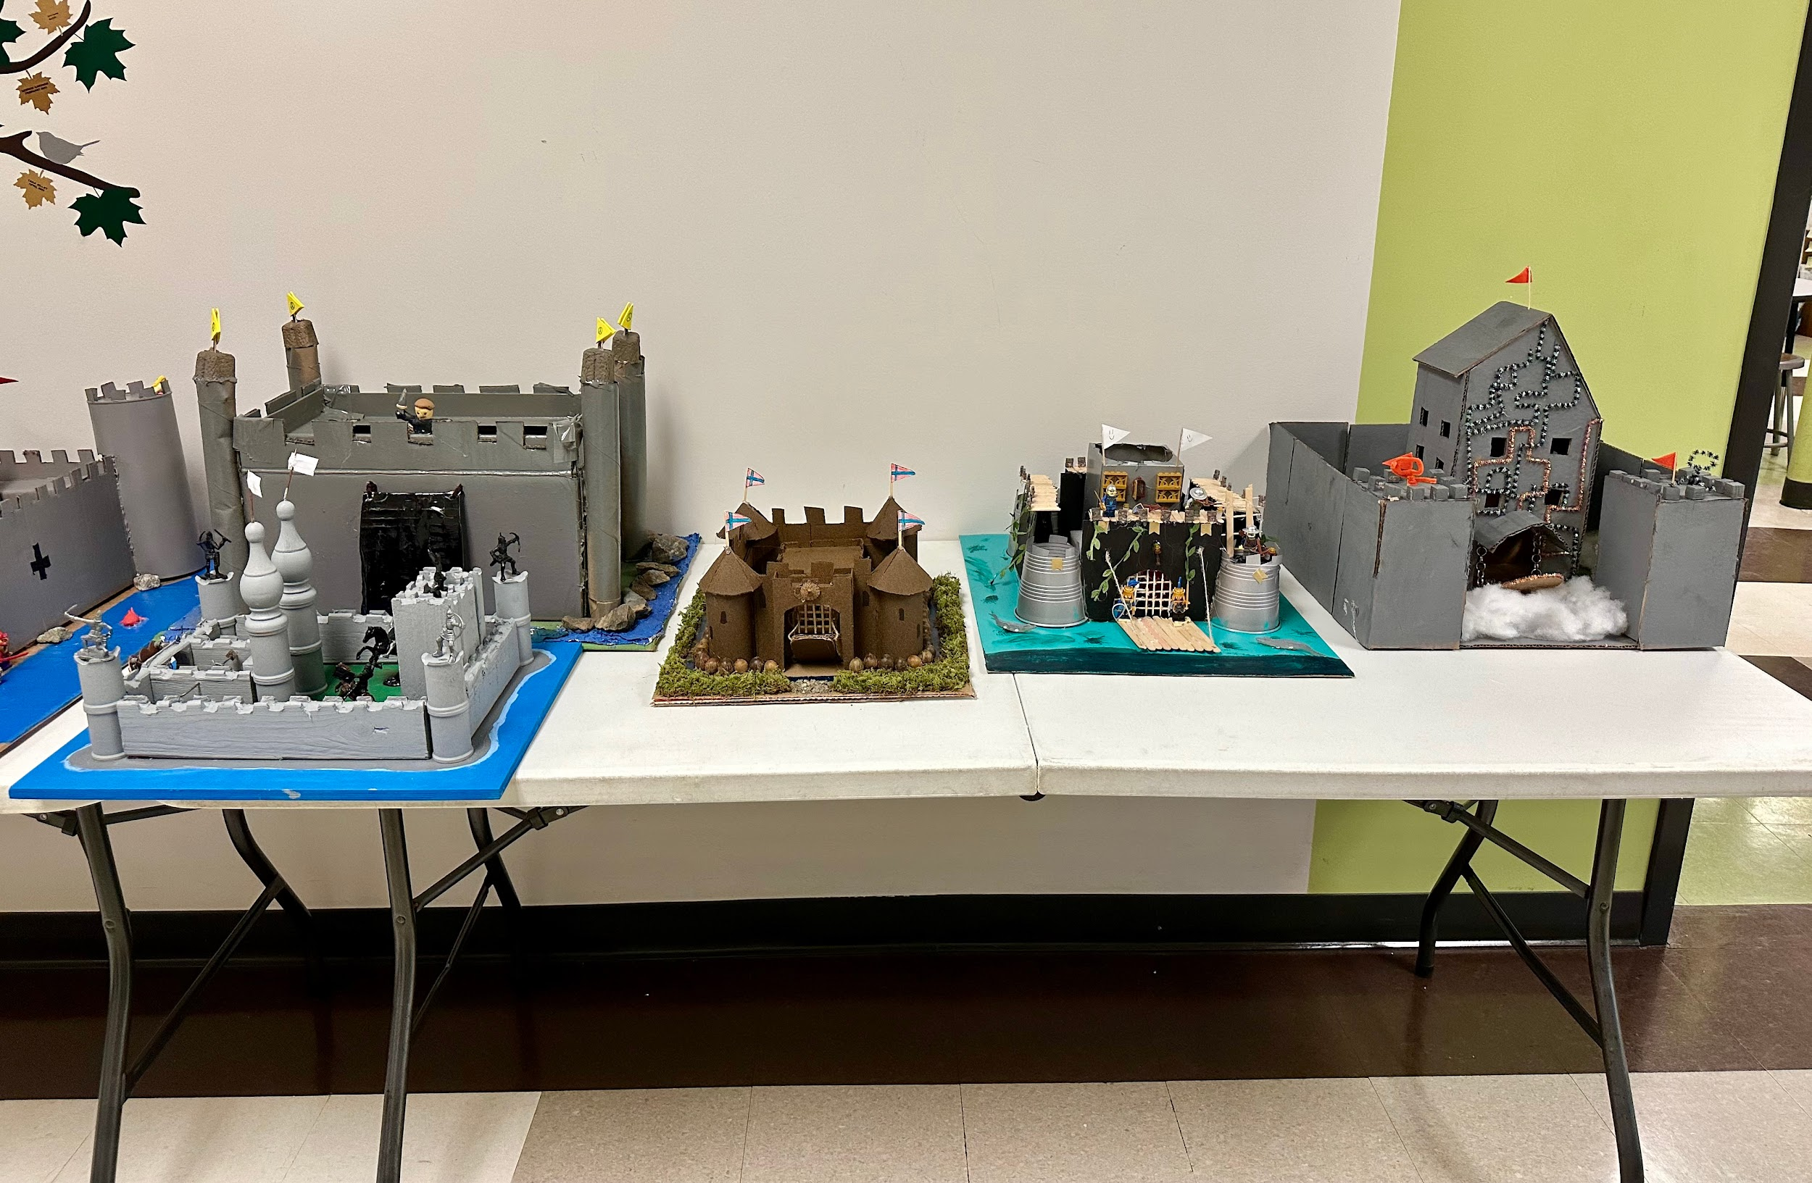
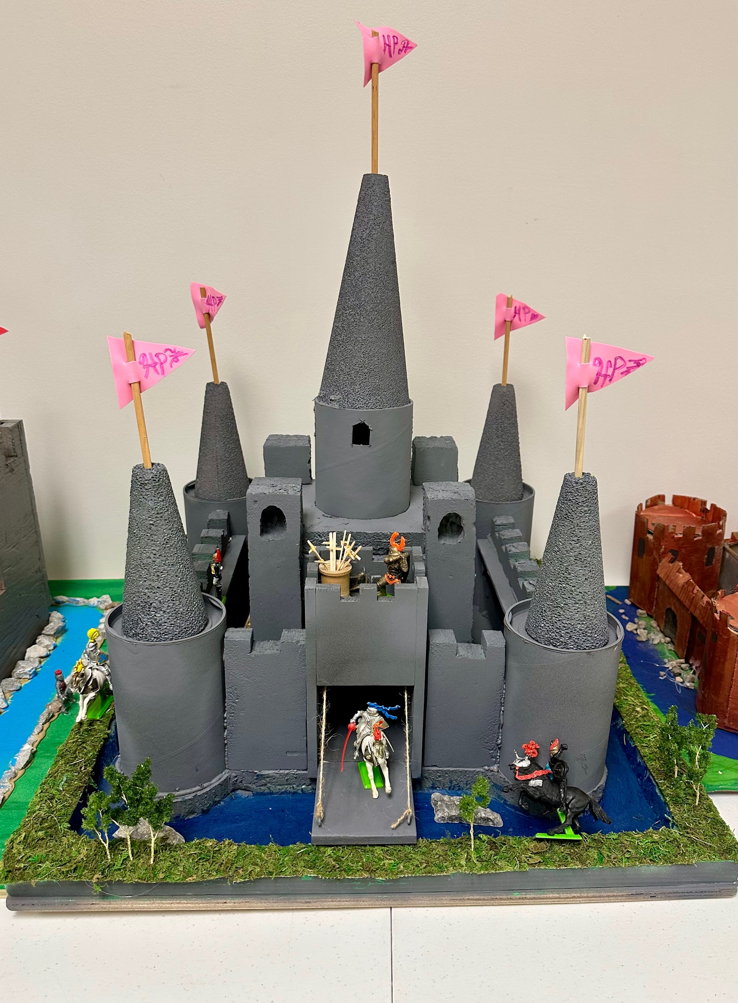
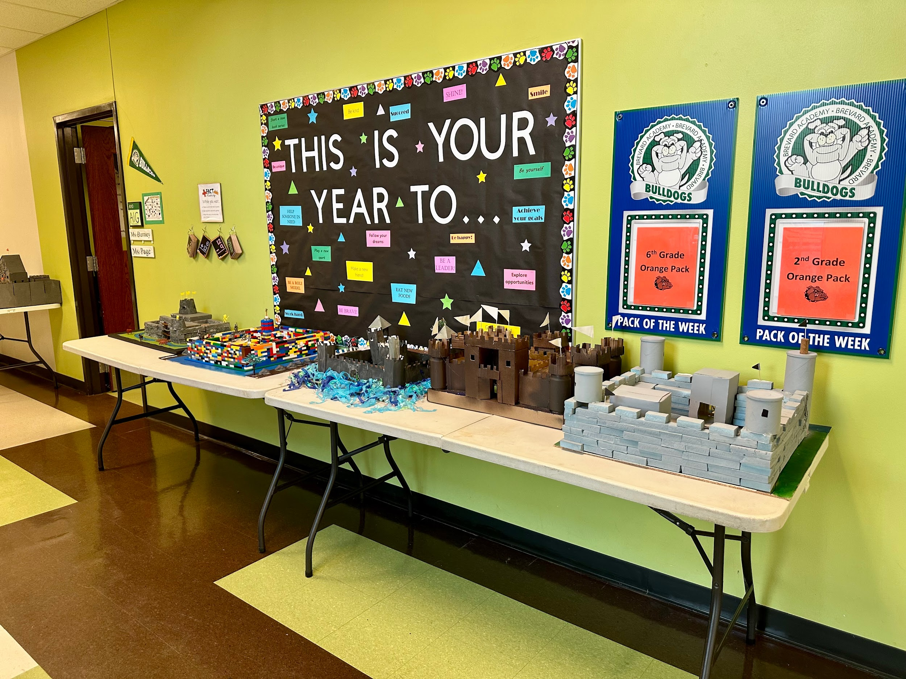
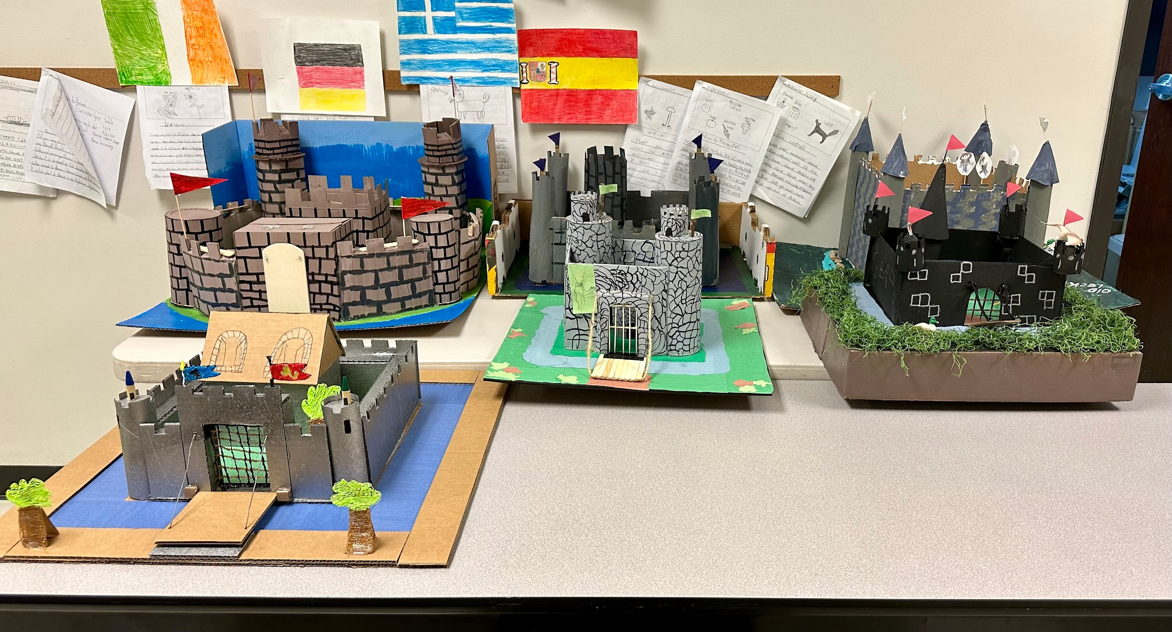

Slide 6
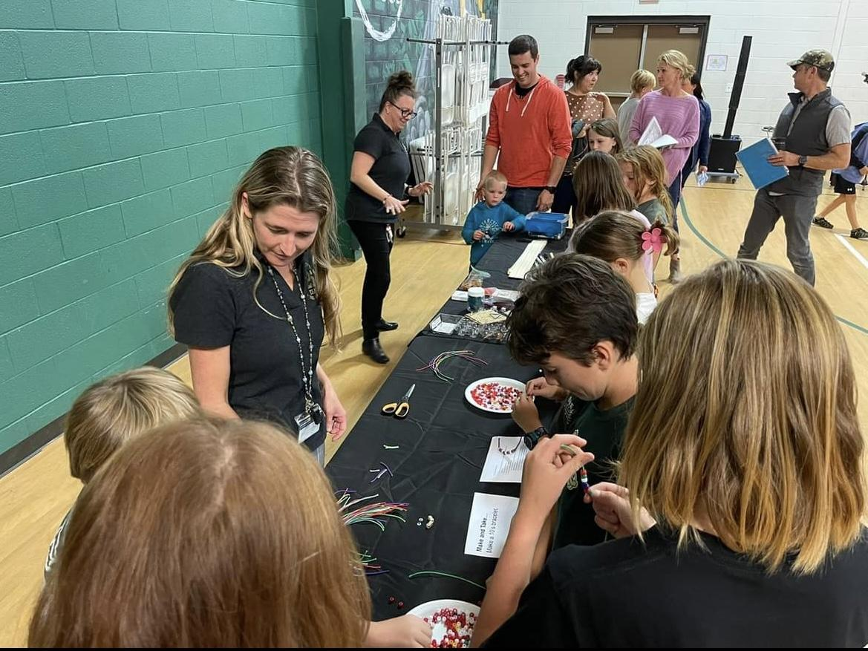
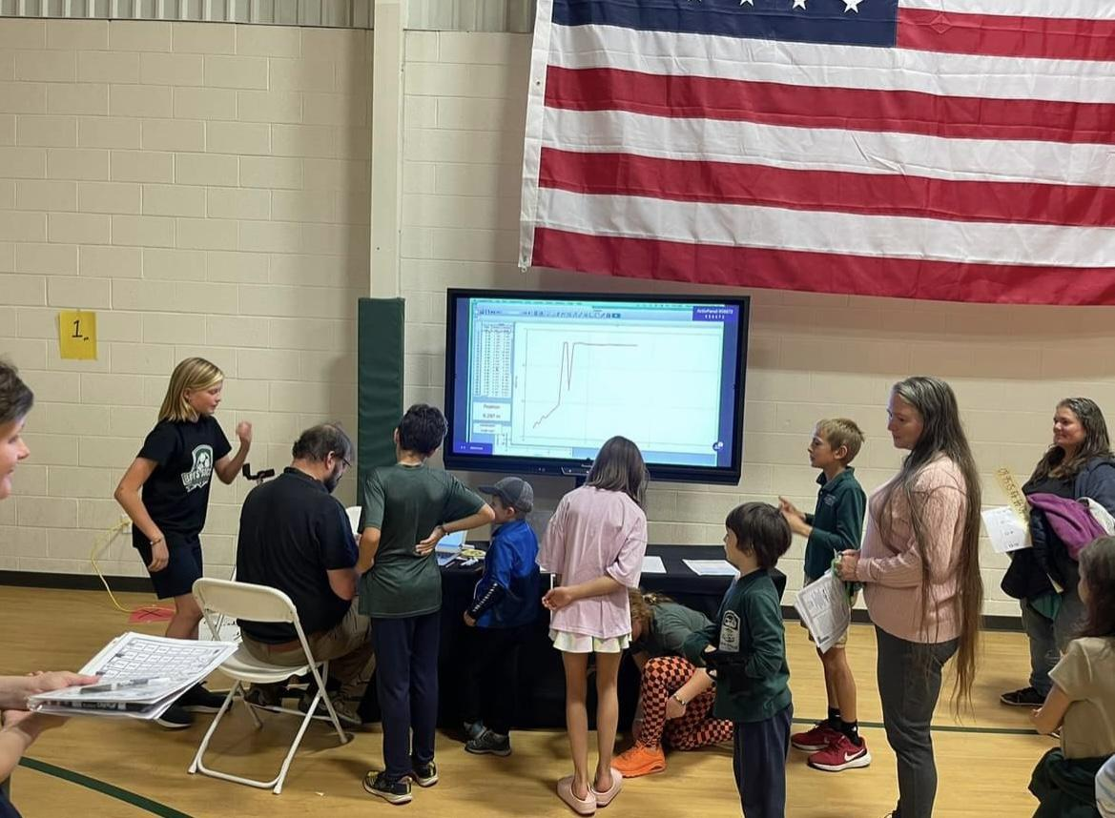

Slide 7
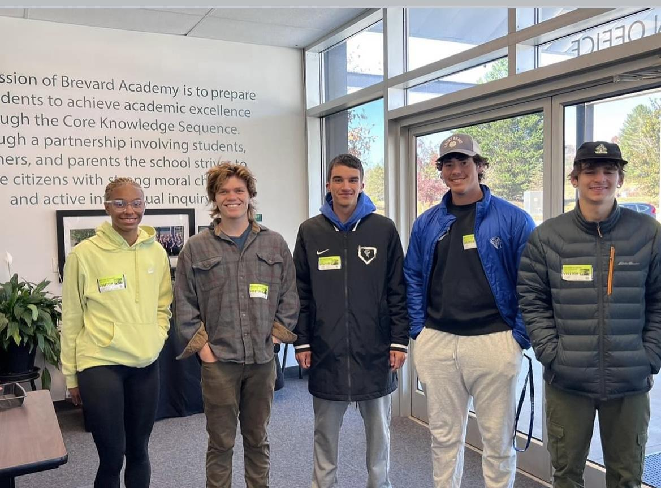
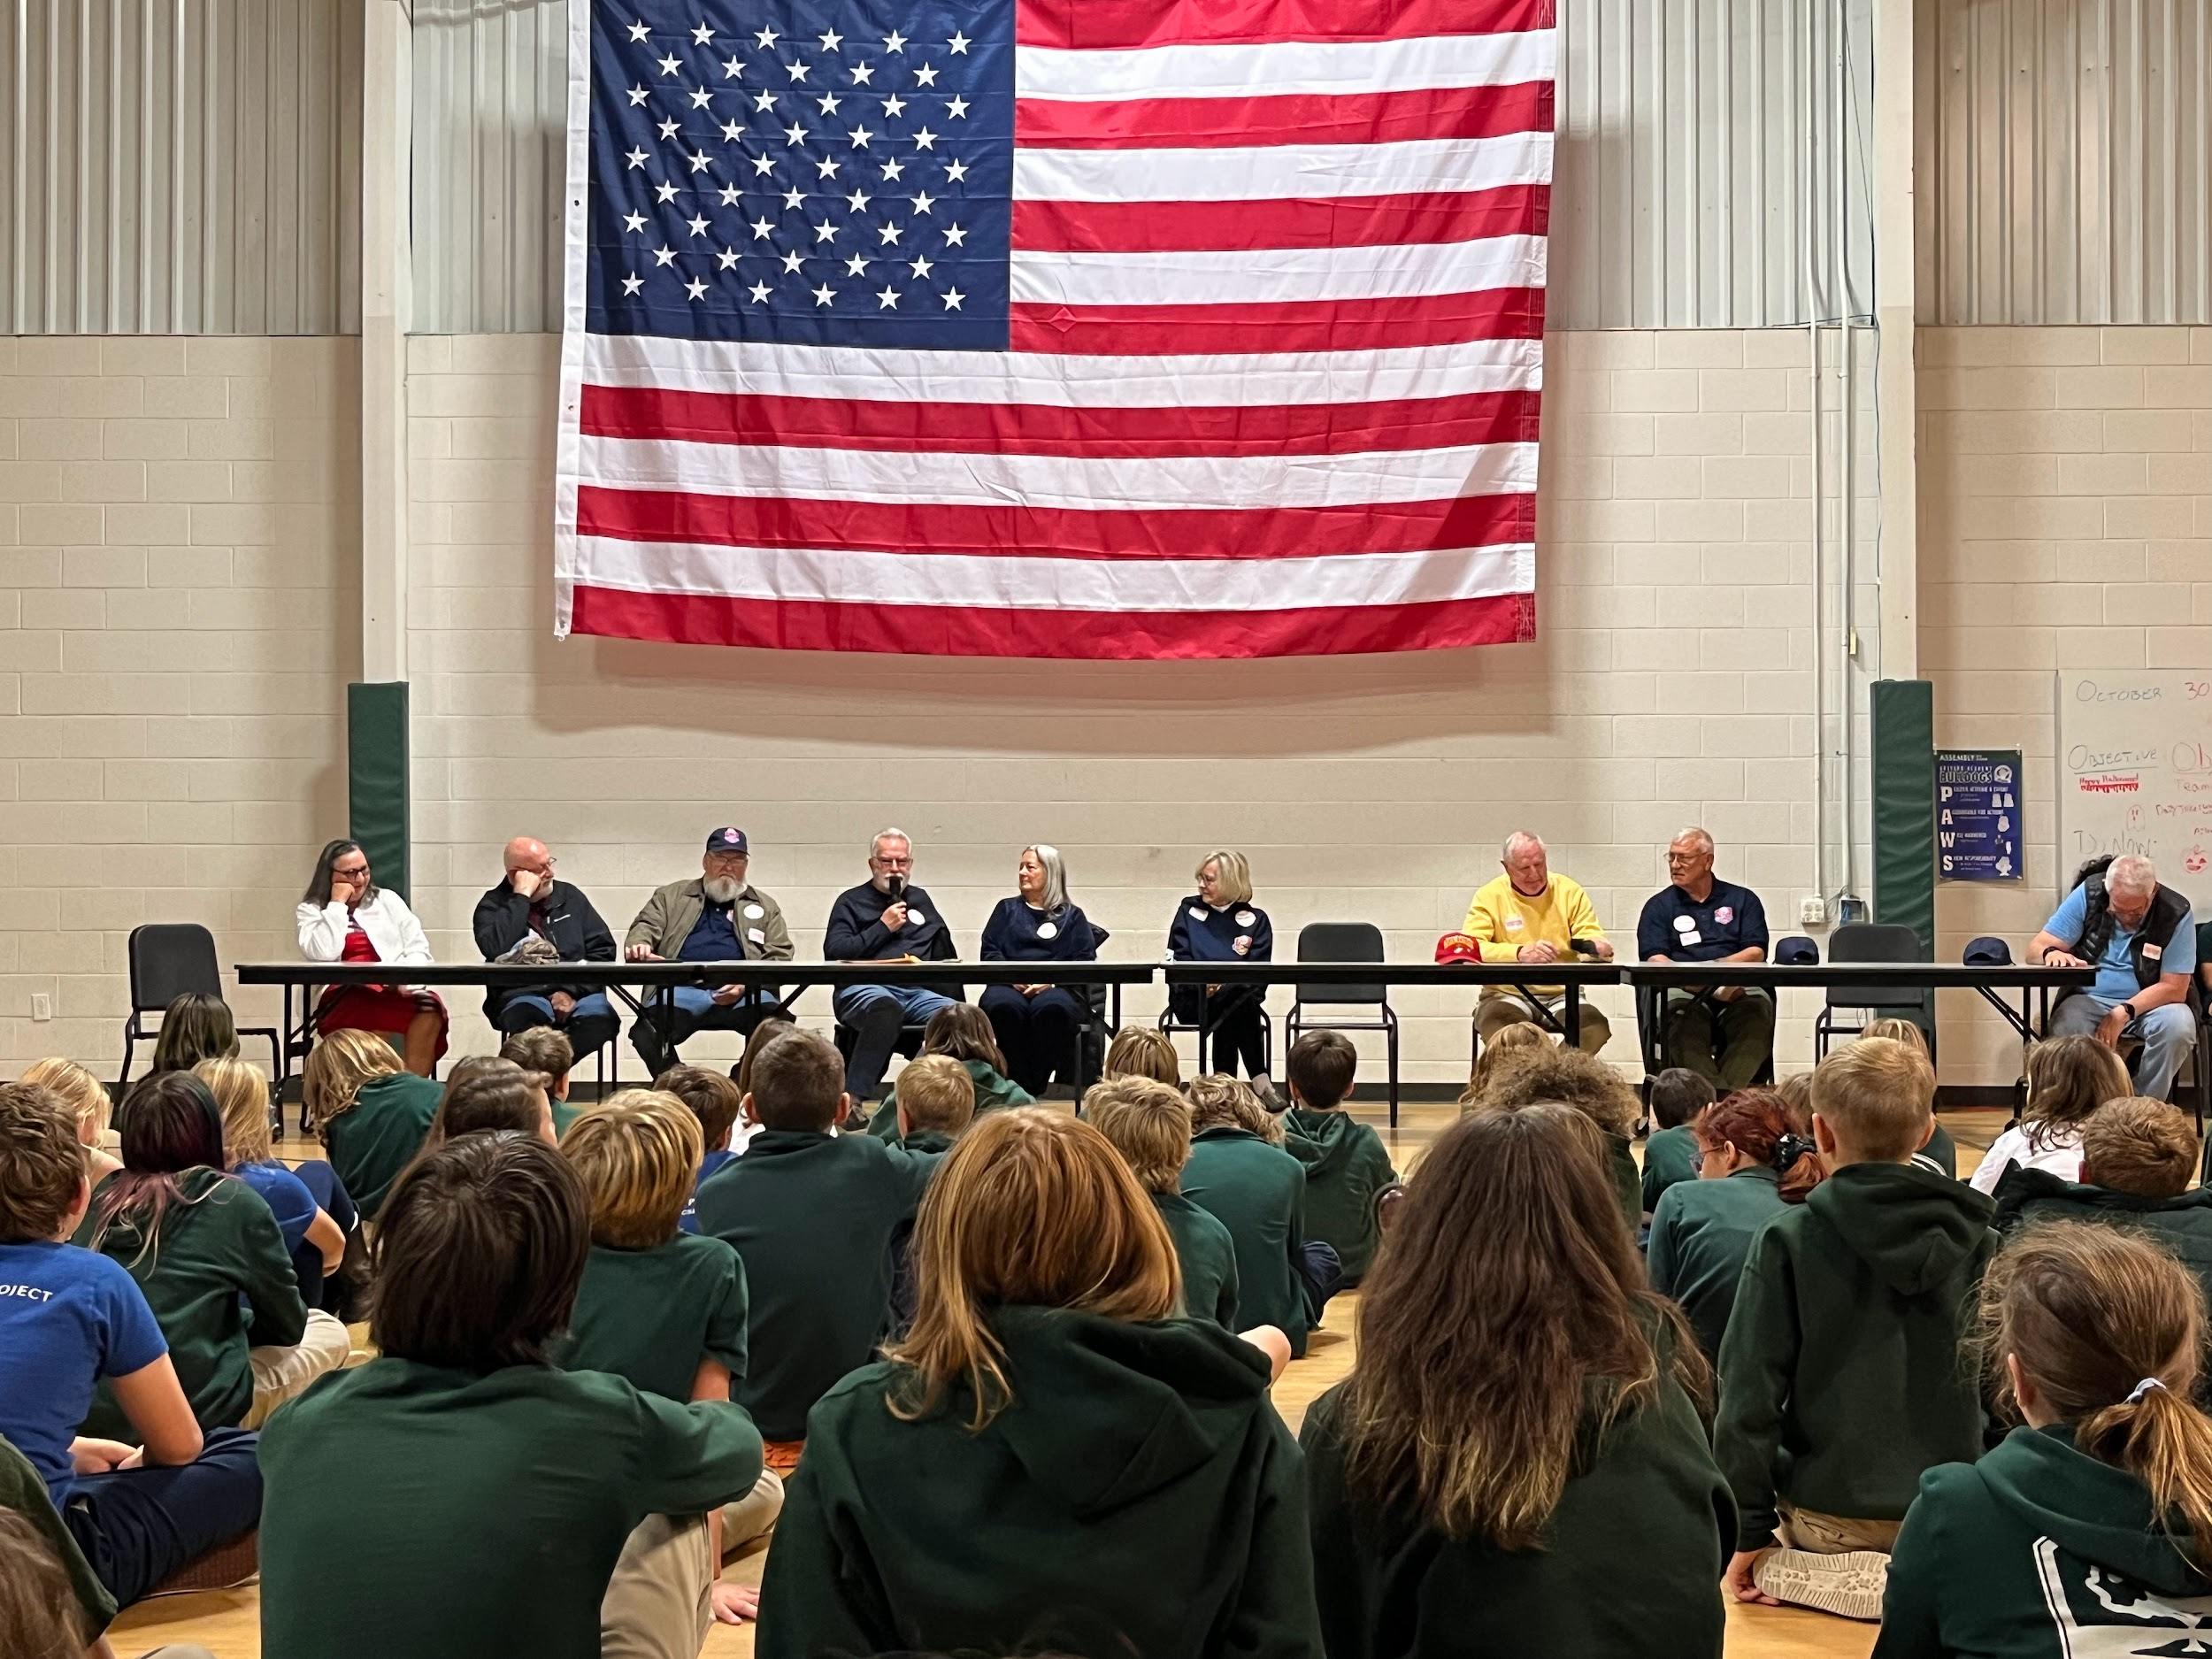

Slide 8
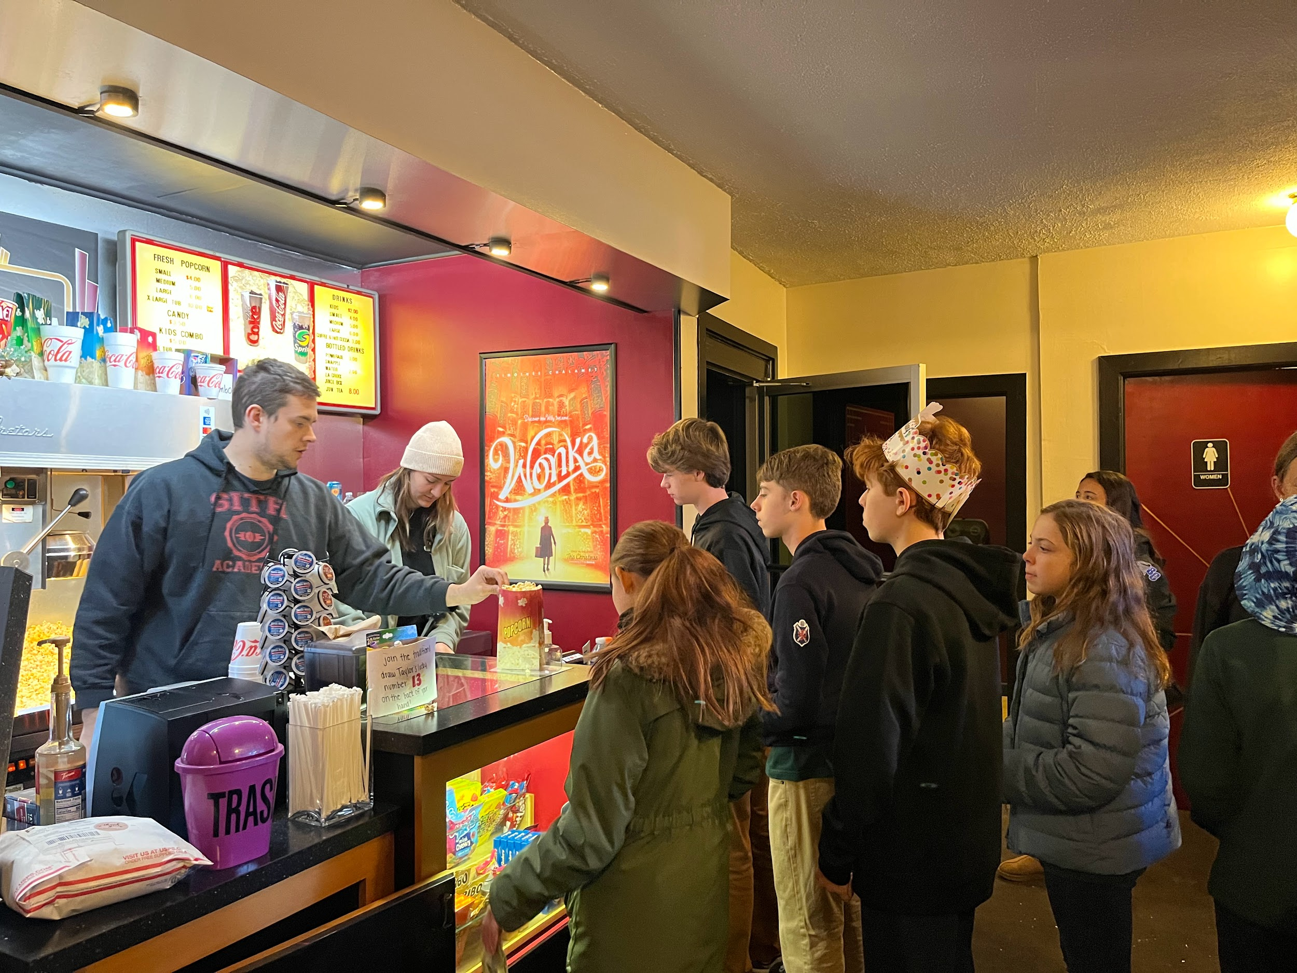
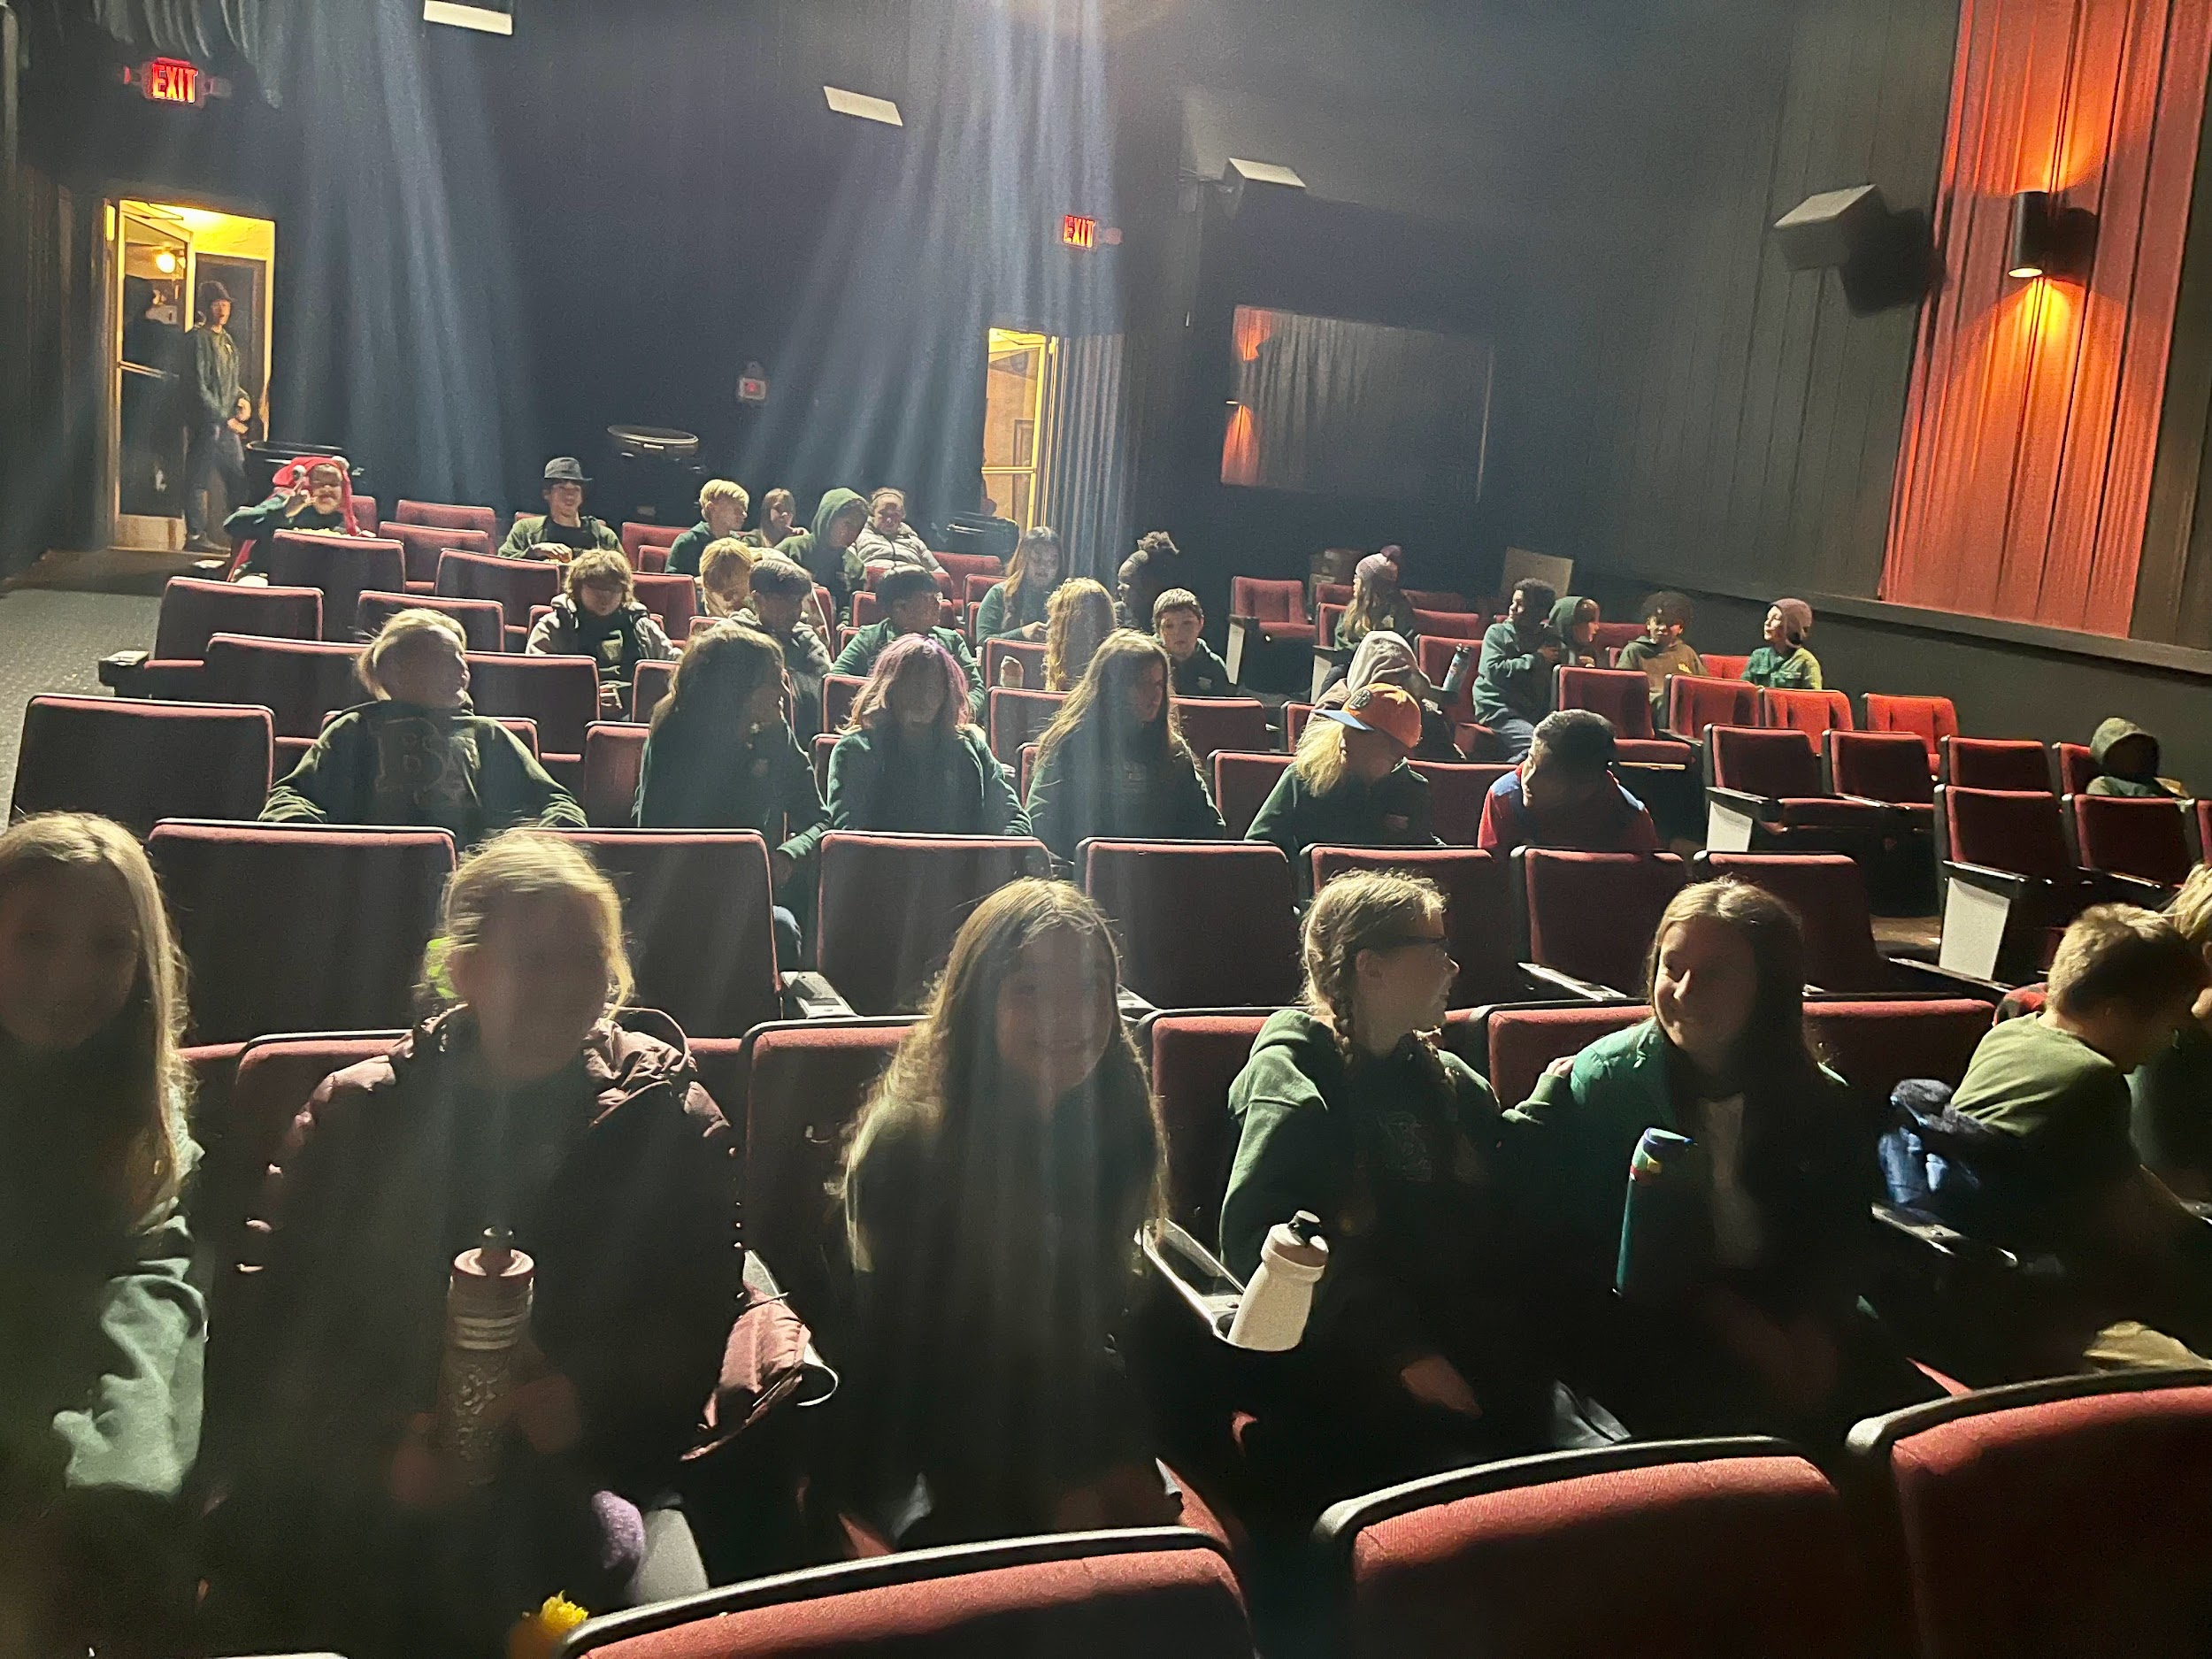

Slide 9
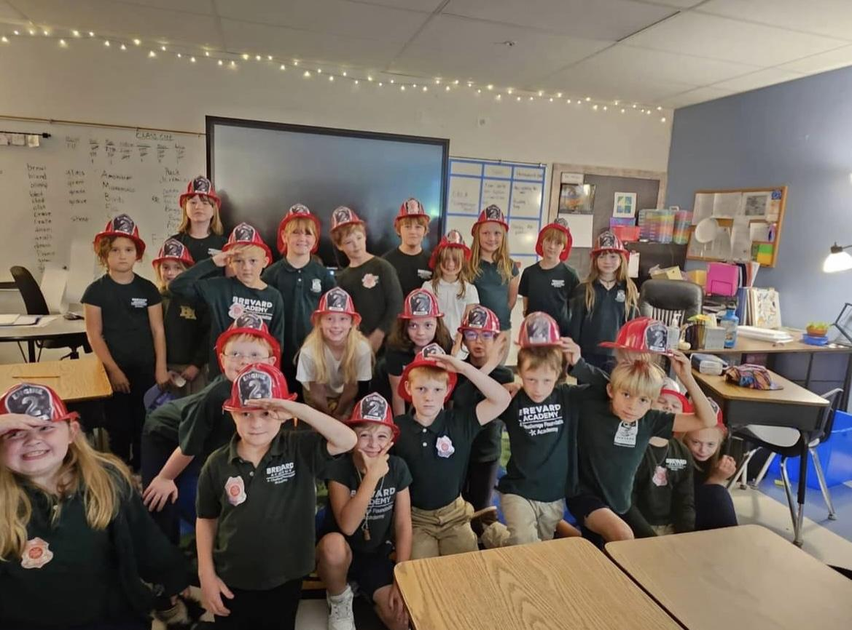
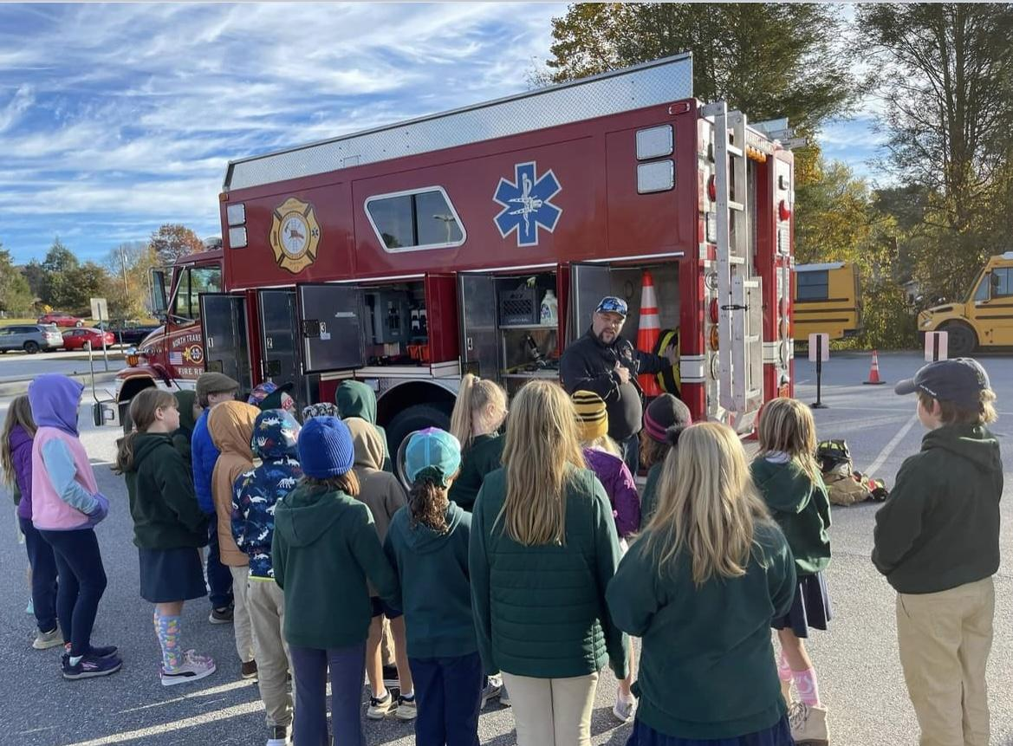
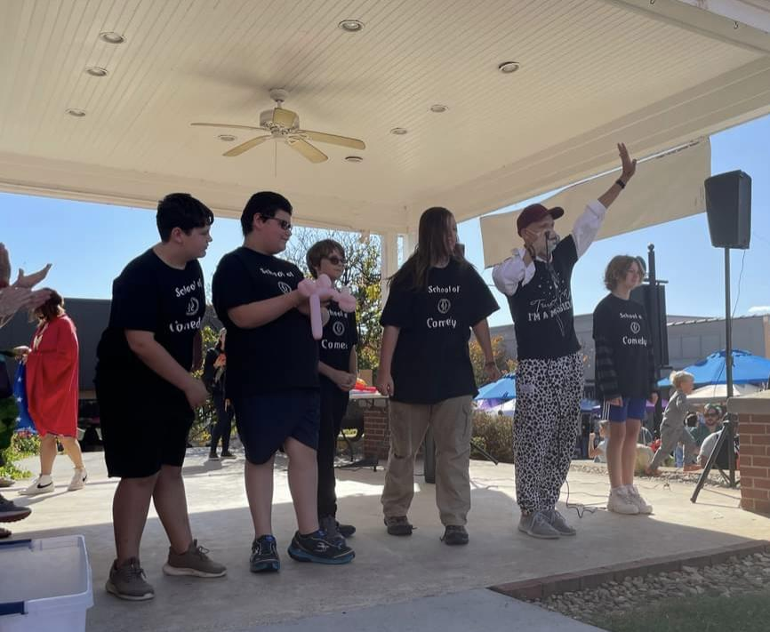
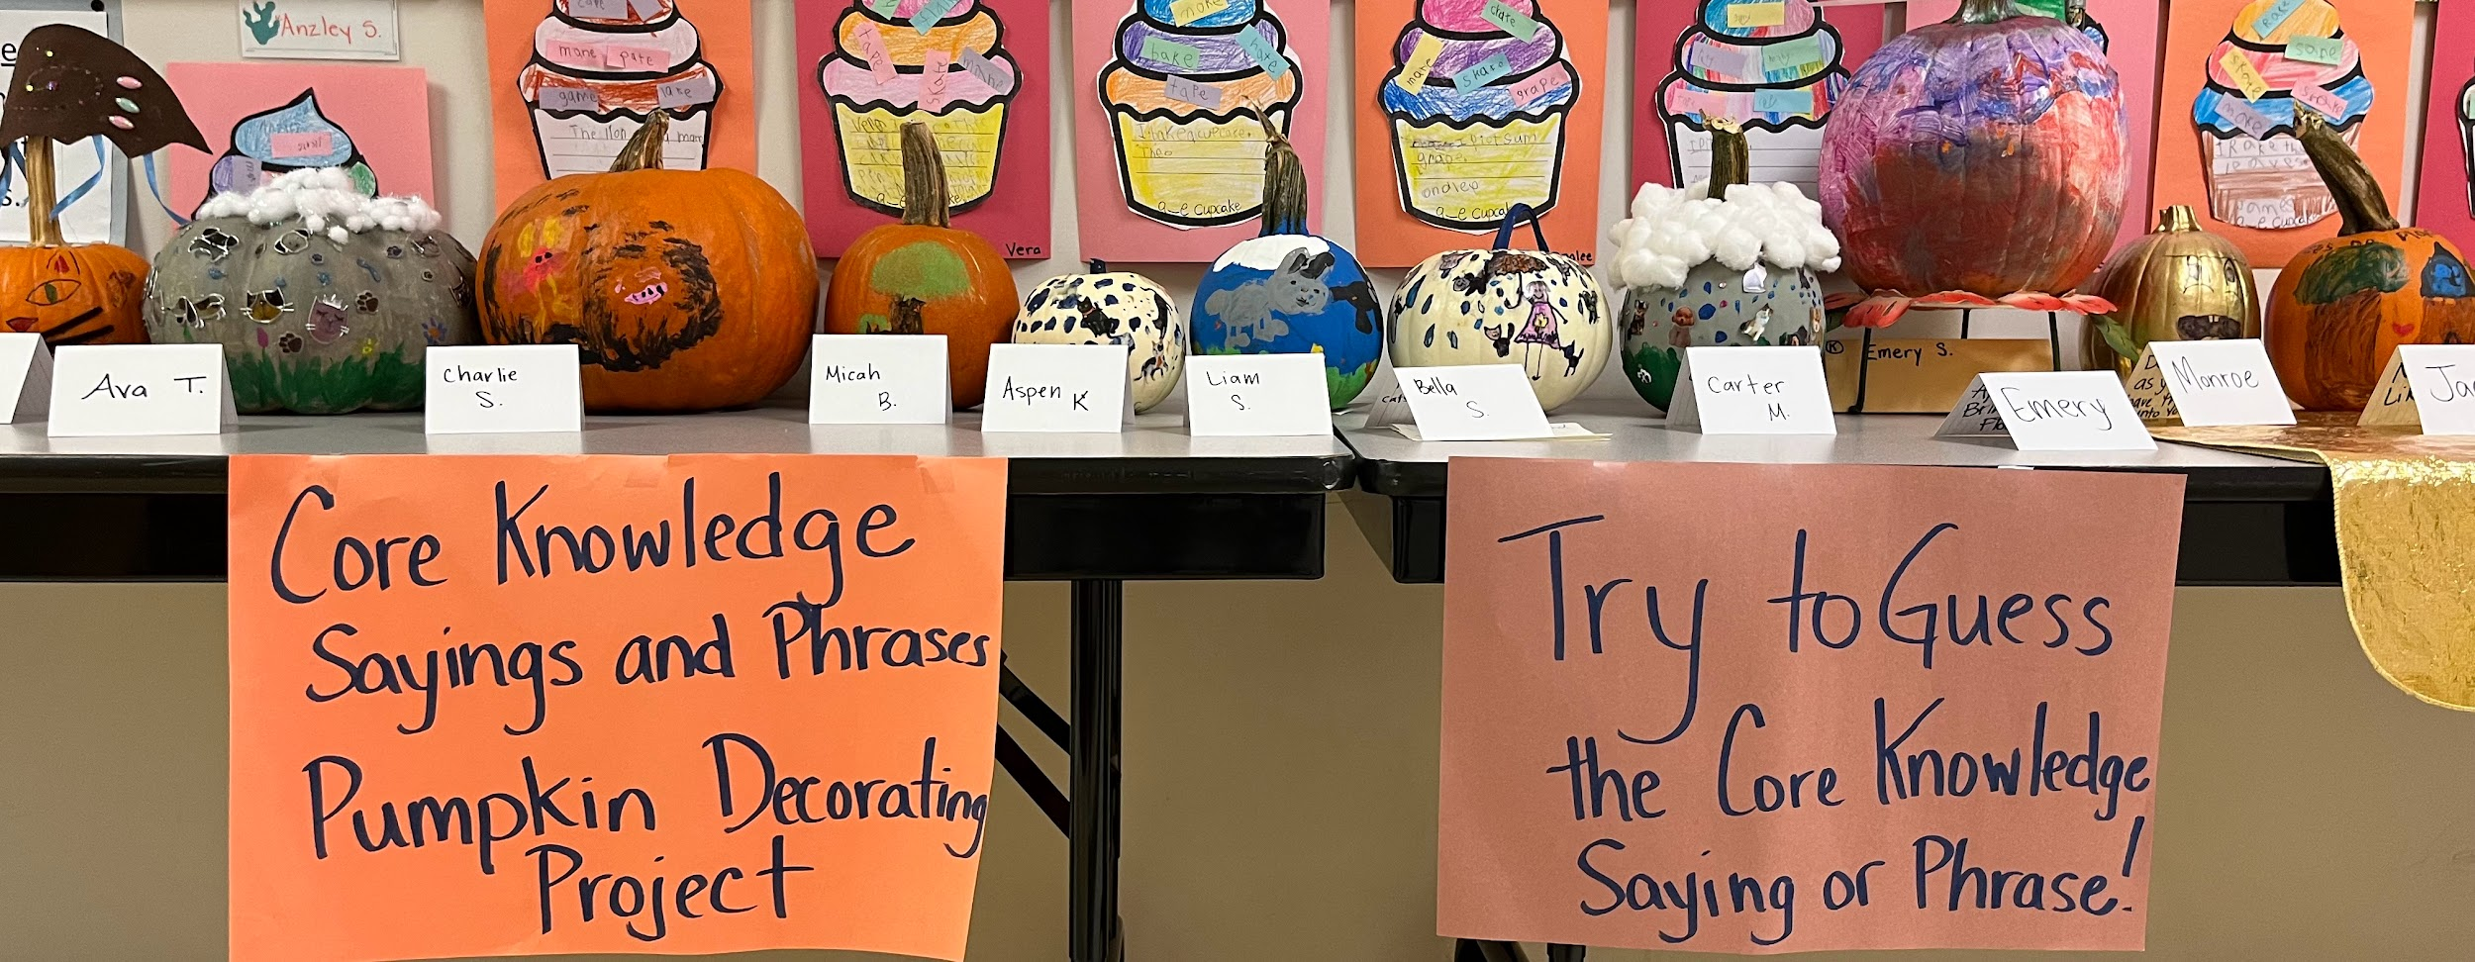
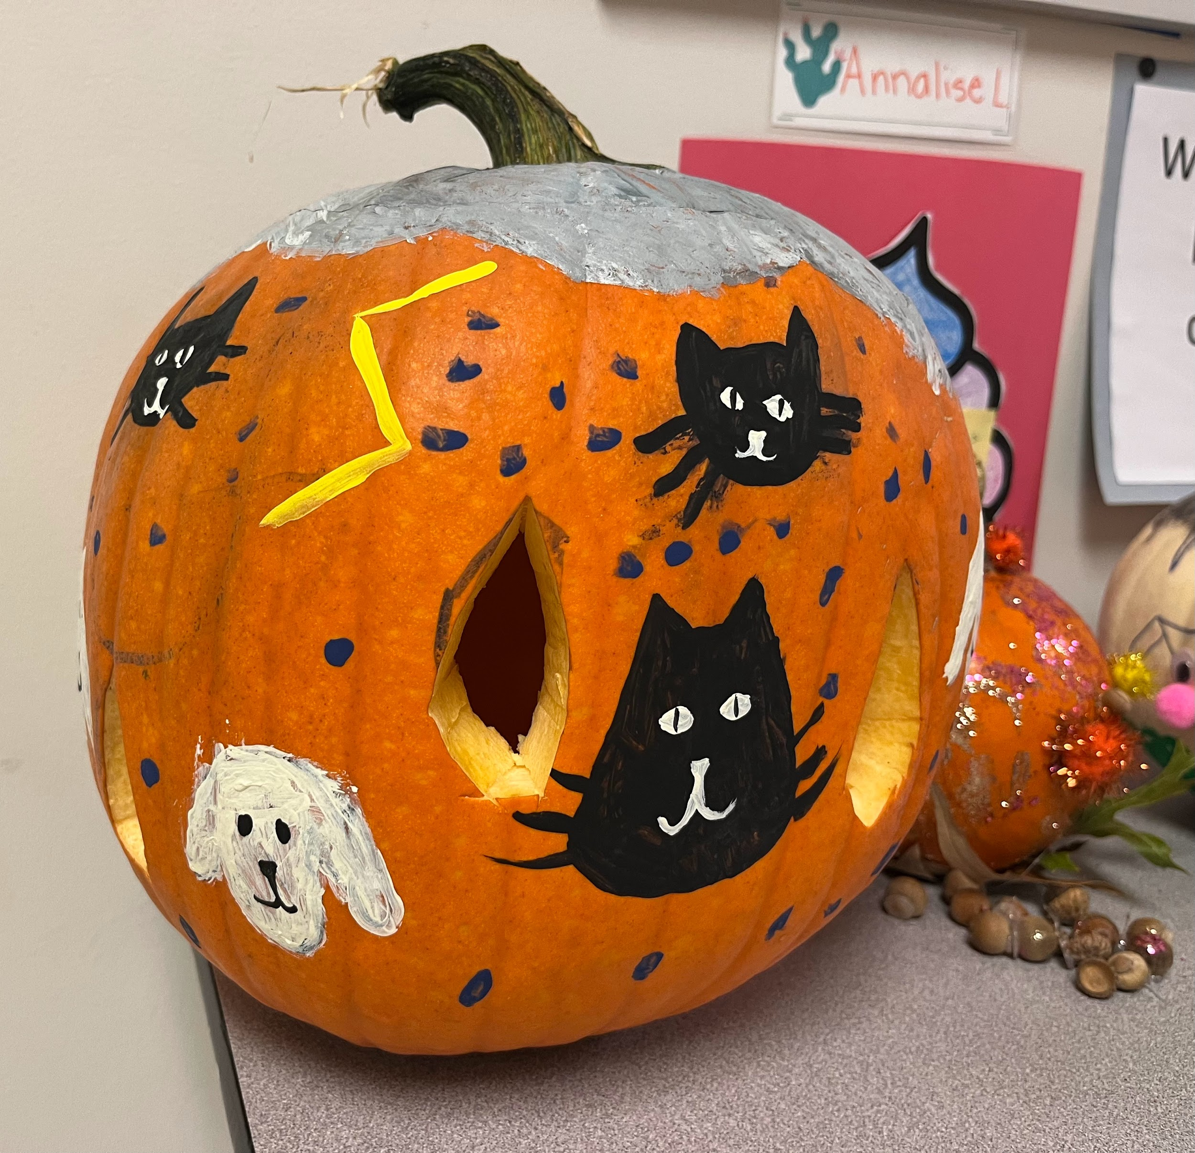
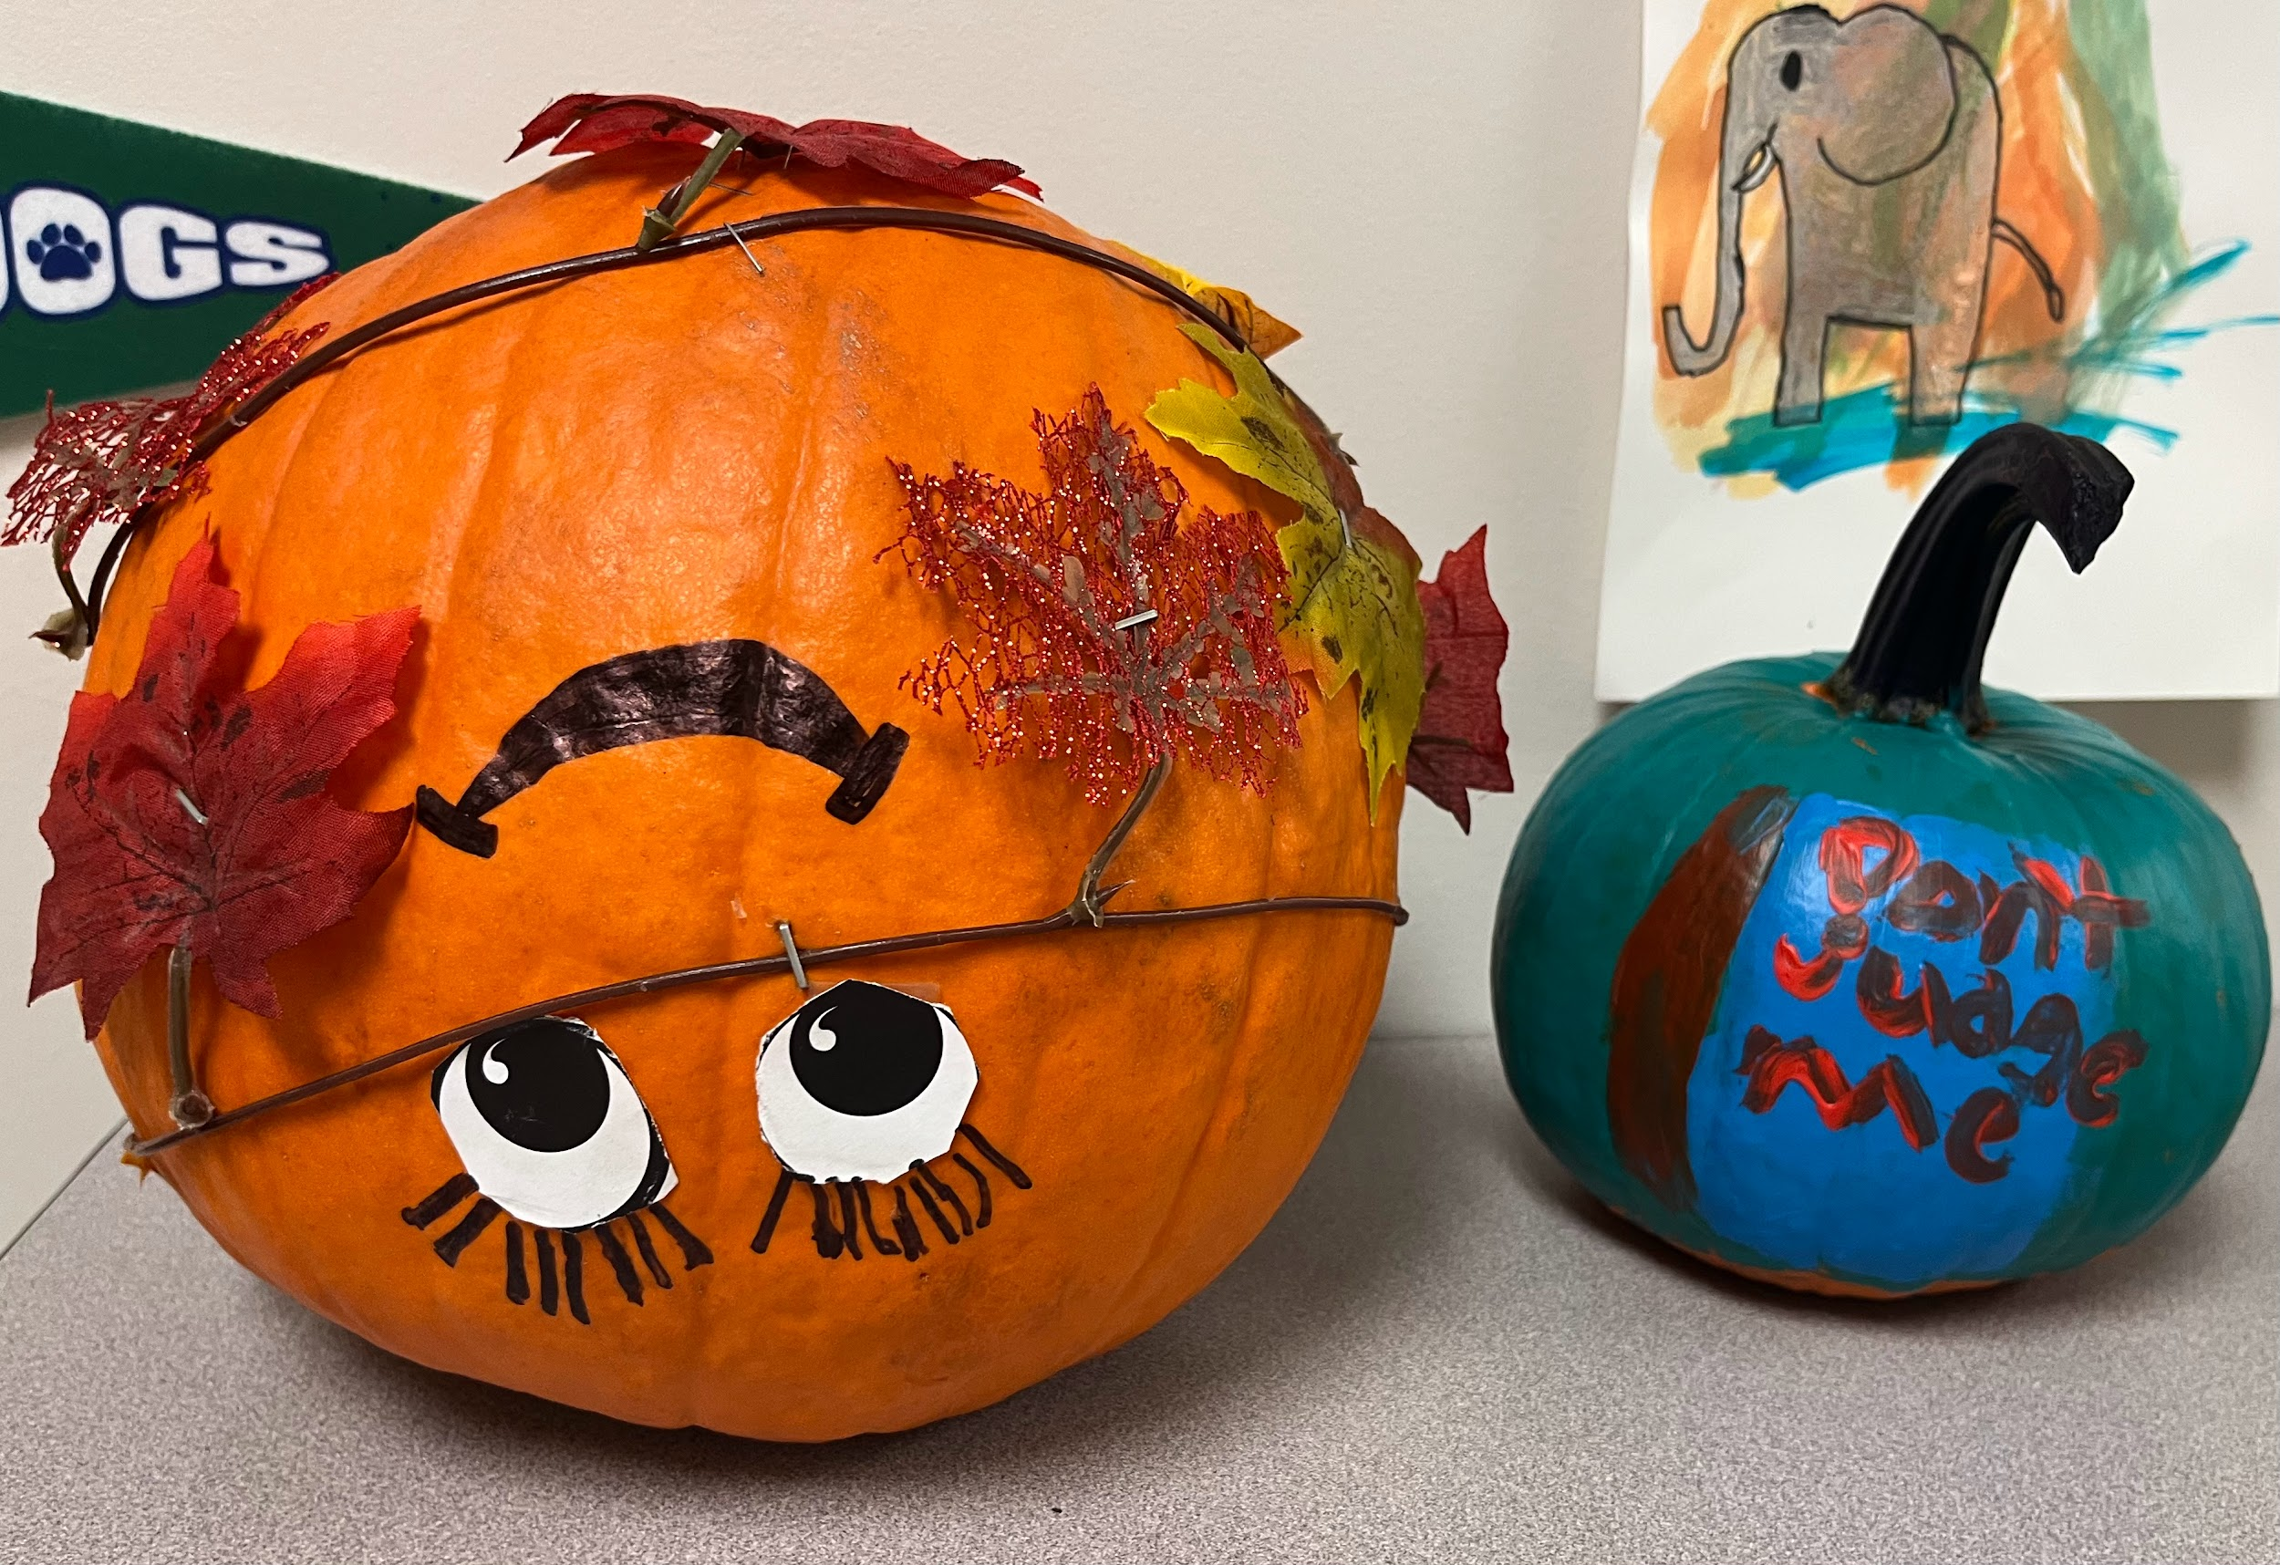
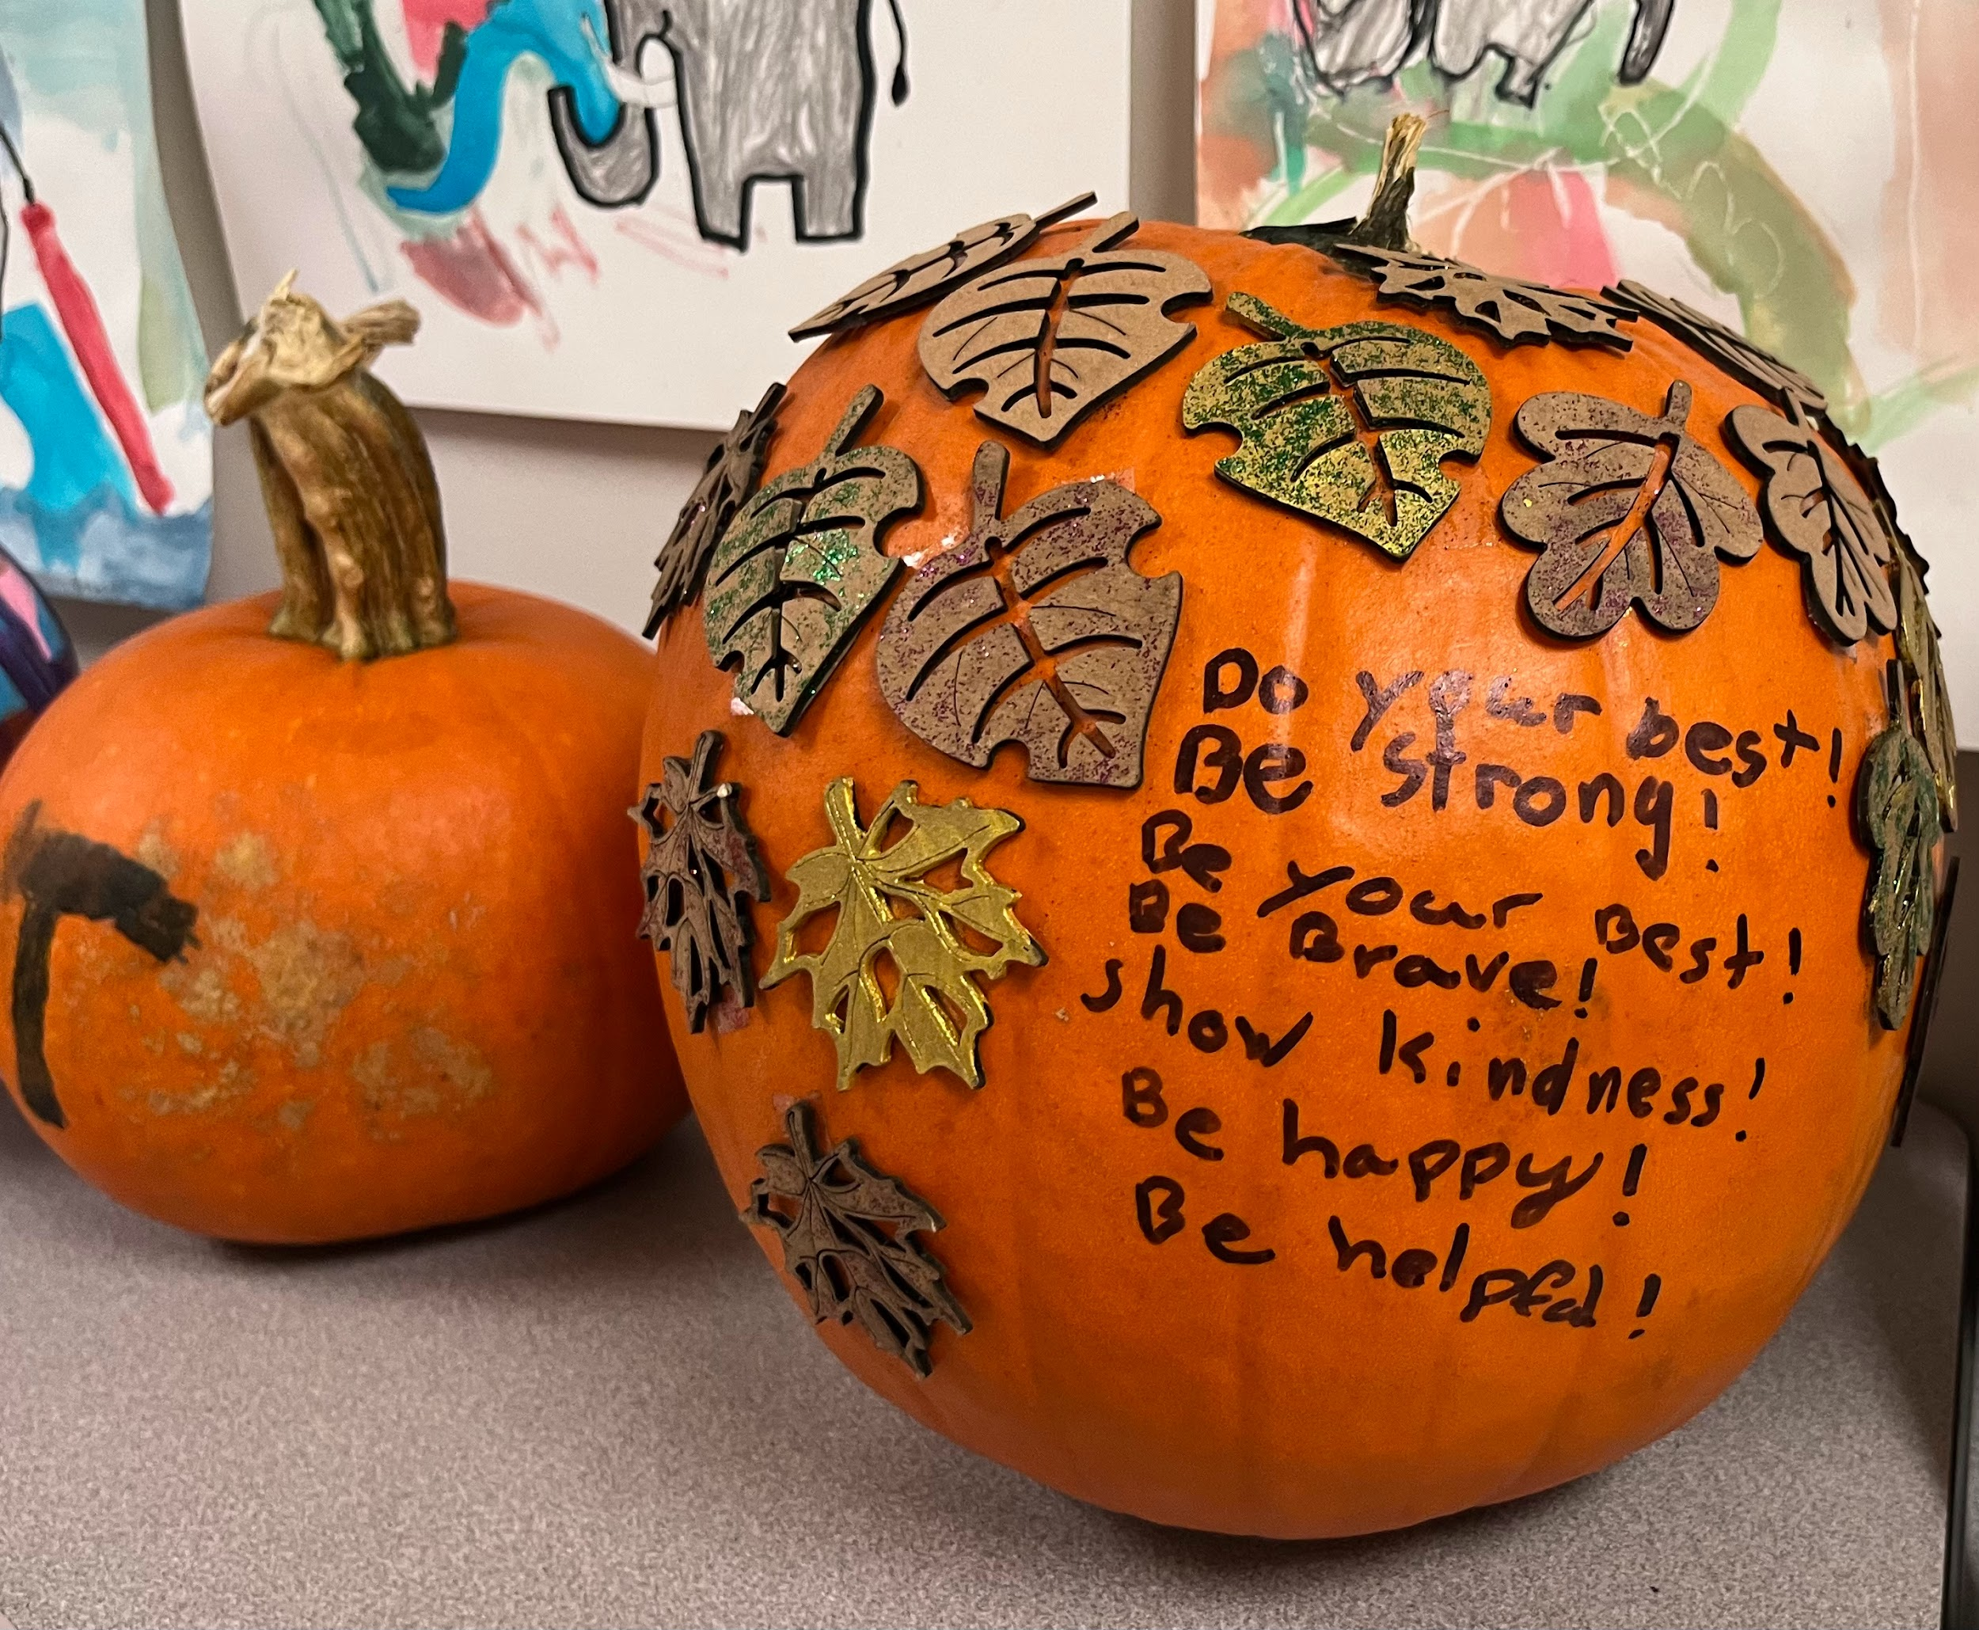

Slide 10
Thank You!
25 years and going strong!

