Slide 1
Encore High School for the Arts Brown Act and Best Practices for Governing Boards

Slide 2
disclaimer
This training cannot substitute for personalized legal advice.
Our advice is based upon the latest available guidance which is subject to change in this ever-evolving landscape.
After the training there will be a Q&A.

Slide 3
Ym&c firm mission
We champion outstanding choices in education for all students.
We believe a quality public education is a civil right.
We work and fight alongside you to ensure student needs are always put first.

Slide 4
Jerry W. Simmons, esq.
PARTNER

Slide 5
Understanding the Brown Act

Slide 6
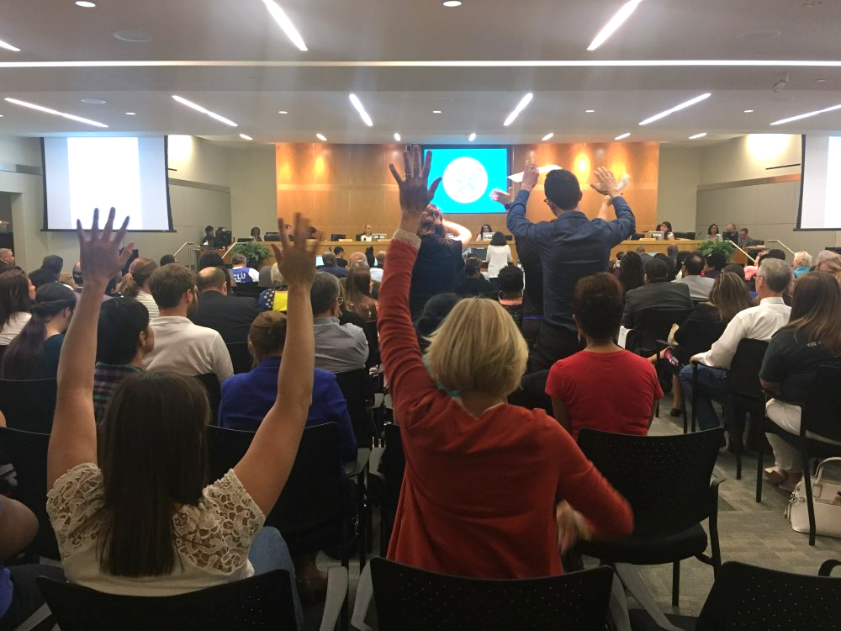
Purpose of The Brown Act
What Is the Purpose of the Brown Act?
To Foster Broad Public Access
“. . . The people of this State do not yield their sovereignty to the agencies which serve them. The people, in delegating authority, do not give their public servants the right to decide what is good for the people to know and what is not good for them to know. The people insist on remaining informed so that they may retain control over the instruments they have created.”

Slide 7
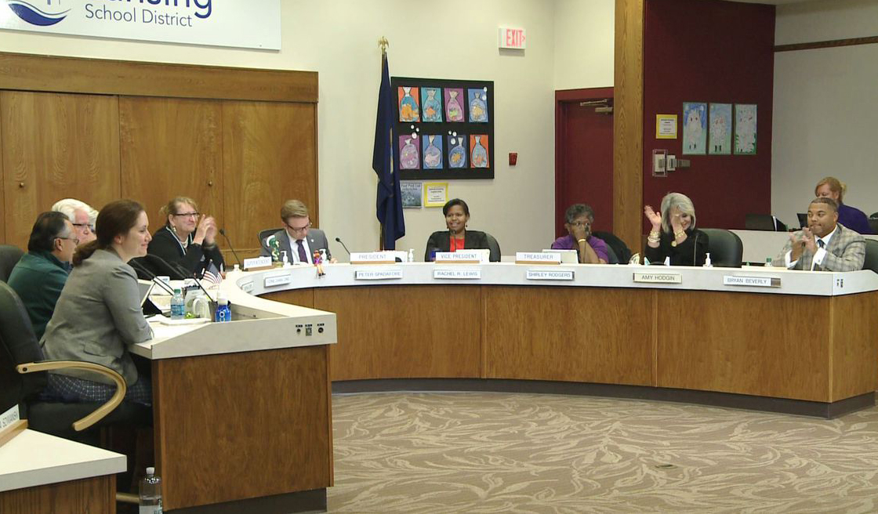
Meetings
Brown Act Applies to Meetings of the Board
When any congregation of a majority of the members of the body meet to hear, discuss, deliberate, or take action on any item of Charter School business

Slide 8
Meetings
Board Committees: Nearly all Committees Must Comply with the Brown Act
Exception Applies Only if All of the Following:
Advisory Committee (not decision making)
Composed of only Board members
Less than a quorum of the Board
Must not be a standing committee

Slide 9
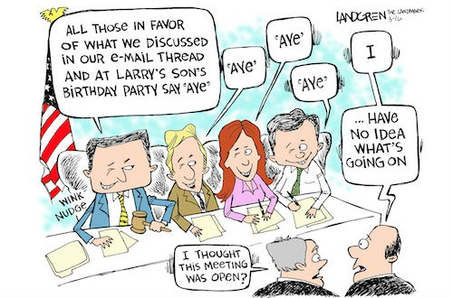
Meetings
Serial Meetings
Serial Meetings Are Prohibited
Majority of Board members
Engaging in a series of communications
Outside Board meeting
Through direct communications or intermediaries or technology
To discuss, deliberate, or take action on any item of business (including relaying comments or position of other Board members)

Slide 10
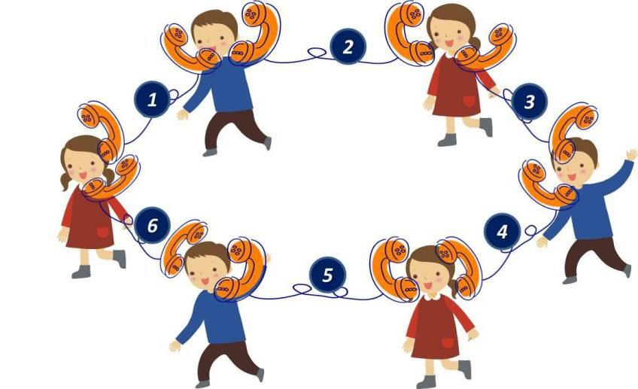
Meetings
Serial Meetings
Hub or Chain prohibited
Technology may result in meetings at times you might not expect
E-mails
Text messages
Social media
Website postings
Online forums
Telephone calls
Faxes

Slide 11
Meetings
Teleconference Meetings (Normal rules)
Six Additional Requirements:
Agenda must be posted at all teleconference locations.
2. Each teleconference location must be identified in the notice and agenda of the meeting.

Slide 12
Meetings
Teleconference Meetings (cont’d)
3. All votes taken must be by roll call.
4. Each teleconference location must be accessible to the public. (ADA-compliance required.)
5. Members of the public must be able to hear and must have the right to address the Board directly from each teleconference location.
6. A quorum of the Board must participate from within the Charter School’s “jurisdiction.”

Slide 13
New Law! AB 2449
Signed by the Governor on September 13, 2022; effective on January 1, 2023
Amends the Brown Act teleconferencing rules to allow relaxed teleconferencing requirements for members’ personal emergencies and for just cause
Allows teleconferencing without any obligation to
Identify the teleconferencing location on the agenda
Allow public access to the teleconferencing location
Member must participate through both audio and visual technology

Slide 14
New Law! AB 2449
Teleconferencing is available under these rules where one of the following circumstances applies:
The member notifies the governing board at the earliest opportunity possible, up to the start of a regular meeting, for just cause up to twice per calendar year
The member requests to participate in the meeting remotely due to emergency circumstances and the governing board takes action to approve the request.
A general description of an item generally need not exceed 20 words (no need to disclose medical diagnosis or disability, or any personal medical information that is already exempt under existing law)

Slide 15
New Law! AB 2449
“Emergency circumstances” means a physical or family medical emergency that prevents a member from attending in person.
“Just cause” means any of the following:
A childcare or caregiving need of a child, parent, grandparent, grandchild, sibling, spouse, or domestic partner that requires them to participate remotely.
A contagious illness that prevents a member from attending in person.
A need related to a physical or mental disability as defined in law and not otherwise accommodated
Travel while on official business of the governing board or another state or local agency.

Slide 16
New Law! AB 2449
Teleconferencing based on an emergency requires that:
The member shall make a request to participate remotely as soon as possible.
The member must make a separate request for each meeting in which they seek to participate remotely.
If the request does not allow sufficient time to place proposed action on such a request on the posted agenda for the meeting for which the request is made, the legislative body may take action at the beginning of the meeting.

Slide 17
New Law! AB 2449
Under no circumstances can a member participate in meetings solely by teleconference from a remote location for a period of more than:
three consecutive months;
20 percent of the regular meetings within a calendar year; or
more than two meetings if the legislative body regularly meets fewer than 10 times per calendar year.

Slide 18
New Law! AB 2449
Other requirements:
At least a quorum of members must participate in person from a singular physical location clearly identified on the agenda and which is open to the public and situated within the local agency's jurisdiction.
Members of the public must be provided a means to “remotely hear and visually observe the meeting, and remotely address” the governing board, ” i.e., a two-way audiovisual platform or a two-way telephonic service and a live webcasting of the meeting.
Agenda must provide notice of how members of the public can access the meeting and provide public comment.
If the broadcast is disrupted, the board may not take action until remote access to the meeting is restored
Board cannot require public comments to be submitted in advance

Slide 19
New Law! AB 2449
The member shall publicly disclose before any action is taken, if any individuals 18 years of age or older are present in the room at the remote location, and the general nature of the member’s relationship with any such individuals.

Slide 20
Notice Requirements
Notice and Agendas
General Rule: The agenda shall be posted properly in advance of a meeting and must include a brief description of items to be transacted or discussed.
With a few exceptions, if an item is not on the agenda, the Board cannot discuss it.

Slide 21
Notice Requirements
When?
Regular meetings – 72 hours notice
Special meetings – 24 hours notice
Emergency meetings – 1 hour notice (rare)
Where to Post?
Physically at a publicly accessible location within the jurisdiction during the entire posting period
On the website – homepage with a prominent, direct link

Slide 22
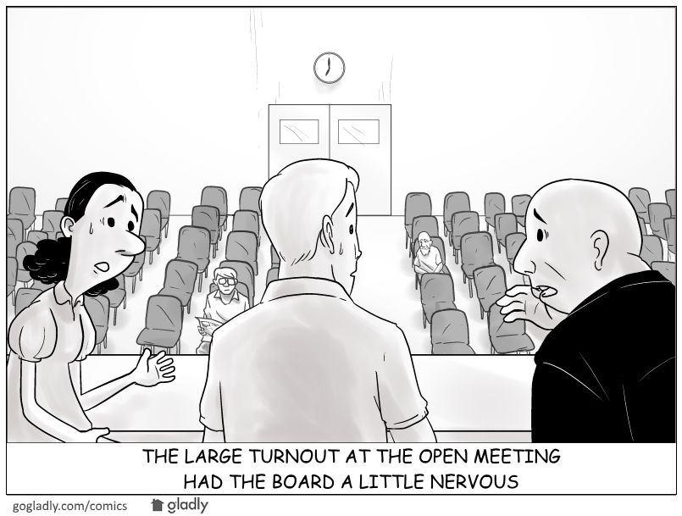
Rights of the Public
Rights to Enable Access and Participation
Give oral testimony at meeting
Time limits
Addressing disruptive speakers
Virtual meetings and best practices (stay in control of your meeting!)
Audio record and broadcast

Slide 23
Rights of the Public
Rights to Enable Access and Participation (cont.)
No conditions of public attendance
Non-discriminatory facilities (reasonable accommodations under ADA)
Copies of agendas and other public writings

Slide 24
New Law! SB 1100
Signed by the Governor on August 22,2022; effective on January 1, 2023
Adds a new section to the Brown Act authorizing the presiding member of the governing board conducting a meeting or their designee to remove, or cause the removal of, an individual for disrupting the meeting.

Slide 25
New Law! SB 1100
“Disrupting” means engaging in behavior during a meeting of a legislative body that actually disrupts, disturbs, impedes, or renders infeasible the orderly conduct of the meeting and includes, but is not limited to, one of the following:
(A) A failure to comply with reasonable and lawful regulations or policies adopted by a legislative body related to public comment, or any other law.
(B) Engaging in behavior that constitutes use of force or a true threat of force.

Slide 26
New Law! SB 1100
Before removing an individual, the presiding member or their designee must warn the individual that their behavior is
1. disrupting the meeting and
2. that their failure to cease their behavior may result in their removal.
The presiding member or their designee may then remove the individual if they do not promptly cease their disruptive behavior.

Slide 27
New Law! SB 1100
The warning requirement does not apply to behavior constituting a “true threat of force.”
A “true threat of force” means “a threat that has sufficient indicia of intent and seriousness, that a reasonable observer would perceive it to be an actual threat to use force by the person making the threat.”

Slide 28
Closed Sessions
What Are the Permissible Closed Sessions?
Pending/Anticipated Litigation (conference with legal counsel)
Personnel (appointment, employment, evaluation, discipline, dismissal)
Caveat: 24-hour written notice to employee is required if Board will hear complaints and/or charges

Slide 29
Closed Sessions
What Are the Permissible Closed Sessions? (cont.)
Conference with Real Estate Negotiator
Conference with Labor Negotiator
Public Security
Pupil Discipline (Education Code)

Slide 30
Closed Session
Requirements
Use “Safe Harbor” agenda language (GC 54954.5)
Prior to Closed Session:
Board Must Make a Public Announcement of Reasons for Closed Session Prior to Closed Session
Public Must Have an Opportunity to Comment
After Closed Session:
Board Must Make a Public Report of Action Taken in Closed Session and Vote or Abstention of Every Board Member
Only necessary personnel may attend
Confidentiality is required

Slide 31
Executive Compensation
Executive Compensation
Approval of CEO/Executive Director’s compensation (and some others) must occur at a regular meeting
Govt. Code 54953: Prior to final action, Board must orally report a summary of the recommendation for final action, including the salary, salary schedule, and fringe benefits, during the open meeting where final action will be taken.
Final action in open session

Slide 32
Enforcement
Complaints and Challenges
Notice of Concern
Often brought by Charter Authorizer
Short turnaround to respond
Seek advice from legal counsel on response
Notice and Demand for Cure or Cease and Desist
Can be brought by DA or member of the public
Board must cure/respond within 30 days
Seek advice from legal counsel on response

Slide 33
Understanding Conflict of Interest Laws

Slide 34
Conflicts of Interest
Broad Definition
A conflict of interest arises when an individual who has a private financial interest in the outcome of a corporate contract or a public decision, participates in the decision-making process or influences or attempts to influence others making the contract or decision.
In short, a conflict of interest is a clash between an individual’s duty to his or her office and his or her personal interests.

Slide 35
Financial Interests
Common Types of Financial Interests Regulated by Conflict Laws
Ownership or investment in business entity
Investment in real property
Source of income
Source of gifts
Effect on personal finances
Financial interests of immediate family members of Board Members and employees typically are covered.

Slide 36
Government Code Section 1090
Elements
Public official (officer, board member, or employee)
Making a public contract (for sale or purchase)
Public official has a financial interest in the contract

Slide 37
Government Code Section 1090
What you need to know about Section 1090
If board member has financial interest, the entire board is prohibited from entering into the contract; even if it is with the best vendor at the best price and the interested board member abstains. (Unless an exception applies.)
Making a public contract is defined very broadly! Applies to earliest discussions, planning, solicitation for bids, etc., not just vote.
Thus, this statute is, in most respects, the toughest standard to meet.
Violation of GC 1090 is a felony and the contract void!

Slide 38
Political Reform Act

Slide 39
Political Reform Act
Big Picture
Public official
Participating in or attempting to influence a governmental decision
Public official has qualifying financial interest (Includes spouse and children)
Financial interest is material
The Official Must Recuse Him or Herself from
All Parts of the Decision-Making Process
Lots of very detailed regulations have also been adopted by FPPC.

Slide 40
COI Code
Conflict of Interest Code
States who must file the Form 700
Assigns disclosure categories

Slide 41
Form 700
Form 700
Statement of Economic Interests
When it must be filed:
Assuming or reappointment to office or position (within 30 days)
Once annually (by April 1st)
Leaving office or position (within 30 days)
Penalties for failure to file:
Criminal charges by Atty General or District Atty for deliberate failure to file
Civil or administrative action by FPPC or private citizen

Slide 42
Form 700
Gifts
General rule is that you cannot accept more than $500 from one source in a calendar year.
General rule is that gifts worth more than $50 must be reported (one gift or aggregate gifts from same source in a calendar year).
Many exceptions to both general rules, the most common being:
Special Occasions – Birthdays, Holidays:
Can be gifts from anyone (other than lobbyists) if the gift giving and taking is proportional.
Inheritance

Slide 43
Form 700
Gift (cont.)
Family Members:
Spouse (or former spouse), child, parent, grandparent, great grandparent, grandchild, brother, sister, current or former parent-in-law, brother-in-law, sister-in-law, aunt, great aunt, uncle, great uncle, niece, great niece, nephew, great nephew, first cousin, or first cousin once removed, or the spouse of any such person. (other than a lobbyist)
“BFF’s”- Long-term friendships:
Friends for a “period of time” and gift giving and taking must be proportional. (other than a lobbyist)
Dating – “bona fide” relationship (other than a lobbyist)
Returning or Donating Gifts vs. Reporting

Slide 44
Common Law on Conflicts-of-Interest
Prohibition Against Conflicts of Interest
Public official engaging in transaction or influencing decision.
Creating an appearance of impropriety (financial interest not necessarily required)
Doctrine of Incompatible Offices
Public official holding two public offices simultaneously
Offices are incompatible with each other (creating divided loyalties); overlapping jurisdictions

Slide 45
New Law! AB 2158
Signed by the Governor on September 13, 2022, effective January 1, 2023; subject to a ramp up period for full compliance by January 1, 2026
Existing law has required members and certain employees of cities and counties to engage in two hours of ethics training “relevant” to their public service” every two years
AB 2158 adds charter schools to the list of local agencies subject to the biennial training requirement and extends the training obligation to members of charter school boards

Slide 46
New Law! AB 2158
“Ethics laws” include, but are not limited to, the following:
(1) Laws relating to personal financial gain by public servants, including, but not limited to, laws prohibiting bribery and conflict-of-interest laws.
(2) Laws relating to claiming perquisites of office, including, but not limited to, gift and travel restrictions, prohibitions against the use of public resources for personal or political purposes, prohibitions against gifts of public funds, mass mailing restrictions, and prohibitions against acceptance of free or discounted transportation by transportation companies.

Slide 47
New Law! AB 2158
Requirements
The Fair Political Practices Committee and the Attorney General must be “consulted” in connection with the development of course materials
Charter schools must provide their officials with information on how they can meet the training requirements at least once annually
Charter schools must maintain records for at least five years after the training was provided indicating
The dates that officials satisfied the training requirements
The entit(ies) that provided the training

Slide 48
New Law! AB 2158
Applicability
Not applicable to board members whose terms will expire before January 1, 2026
All other board members seated as of January 1, 2025 must receive the required training by January 1, 2026 and retrain at least once every two years thereafter

Slide 49
New Law! AB 2158
Applicability
What about charter school employees?
Are they an “[a]n employee designated by a local agency governing body to receive the training specified under this article?”
What about training requirements in charters and MOUs?
Does this training count towards the new “ethics training” requirement?

Slide 50
NEXT LEVEL GOVERNANCE
Next level governance is about so much more than legal compliance. Most boards get training in the Brown Act and conflict of interest laws, but now we are going to focus on some pro tips.

Slide 51
A BOARD'S BIG PICTURE POLICY AND VISION ROLE
The Board should be focused on academic and fiscal performance of the school.
The Board should be asking questions that ensure the school is operating in a legally compliant manner.
The Board should evaluate your Executive Director in a thoughtful manner that aligns with your vision.
The Board should develop a Governance Handbook that contains vision and mission, core values, strategic goals, and governance team practices and protocols.

Slide 52
CRITICAL FISCAL QUESTIONS FOR EVERY BOARD
How many students do we have?
Is our enrollment trend up or down?
What are the implications of these trends?
Do we need to make immediate budget or staffing reductions to make our budget balance?
Are any audit findings a repeat of prior years?
Are there related party transactions?

Slide 53
CRITICAL ACADEMIC PERFORMANCE QUESTIONS
What specific steps are we taking to ensure we are on the high track for renewal?
What additional steps can we allocate funds and personnel toward to maximize our chances of being on the high track?
What schools on the high track have you studied?
What did you learn from their approach to curriculum, teacher hiring, professional development, instructional materials, and use of computer-based instruction to improve student outcomes?
How certain are we that performance will be better next year?

Slide 54
RECRUITING BOARD MEMBERS
Check to see if there are minimum requirements in your charter.
Create an application form to flesh out key questions.
Find out if there is anything about their background that would create legal liability, a PR nightmare, or that might damage the relationship with your authorizing district.
What skills does your Board lack that it needs to get the school to the next level?
Do you need your Board members to be fundraisers?
Consider political connections.

Slide 55
EVALUATING YOUR EXECUTIVE DIRECTOR
Are you setting reasonable goals before the calendar year or academic year begins?
Are you putting these in writing, so everyone remembers what was said?
Have you communicated these to your Principal/Executive Director?
Have you designed an evaluation instrument to determine whether these goals were met?
Have you aligned future salary increases to successfully achieving goals that the board set?
Have you left room for unforeseen circumstances?

Slide 56
Board Norm Facilitation
Having Board norms ensures that the Board members have a common set of expectations around:
* How Board members will interact with each other at meetings
* How Board members will interact with staff at meetings
* How Board members will interact with parents/students at meetings
* What Board members are expected to do between meetings

Slide 57
Questions?
Thank you
Jerry Simmons, Esq.
jsimmons@ymclegal.com
ymclegal.com | 916.646.1400

