Slide 1
ENCORE JR. /SR. HIGH SCHOOL FOR THE VISUAL AND PERFORMING ARTS
EDUCATIONAL EQUITY AND EXCELLENCE REPORT
© 2023 National Center for Urban School Transformation. All Rights Reserved 9245 Sky Park Court Suite 120 San Diego, CA 92123

Slide 2
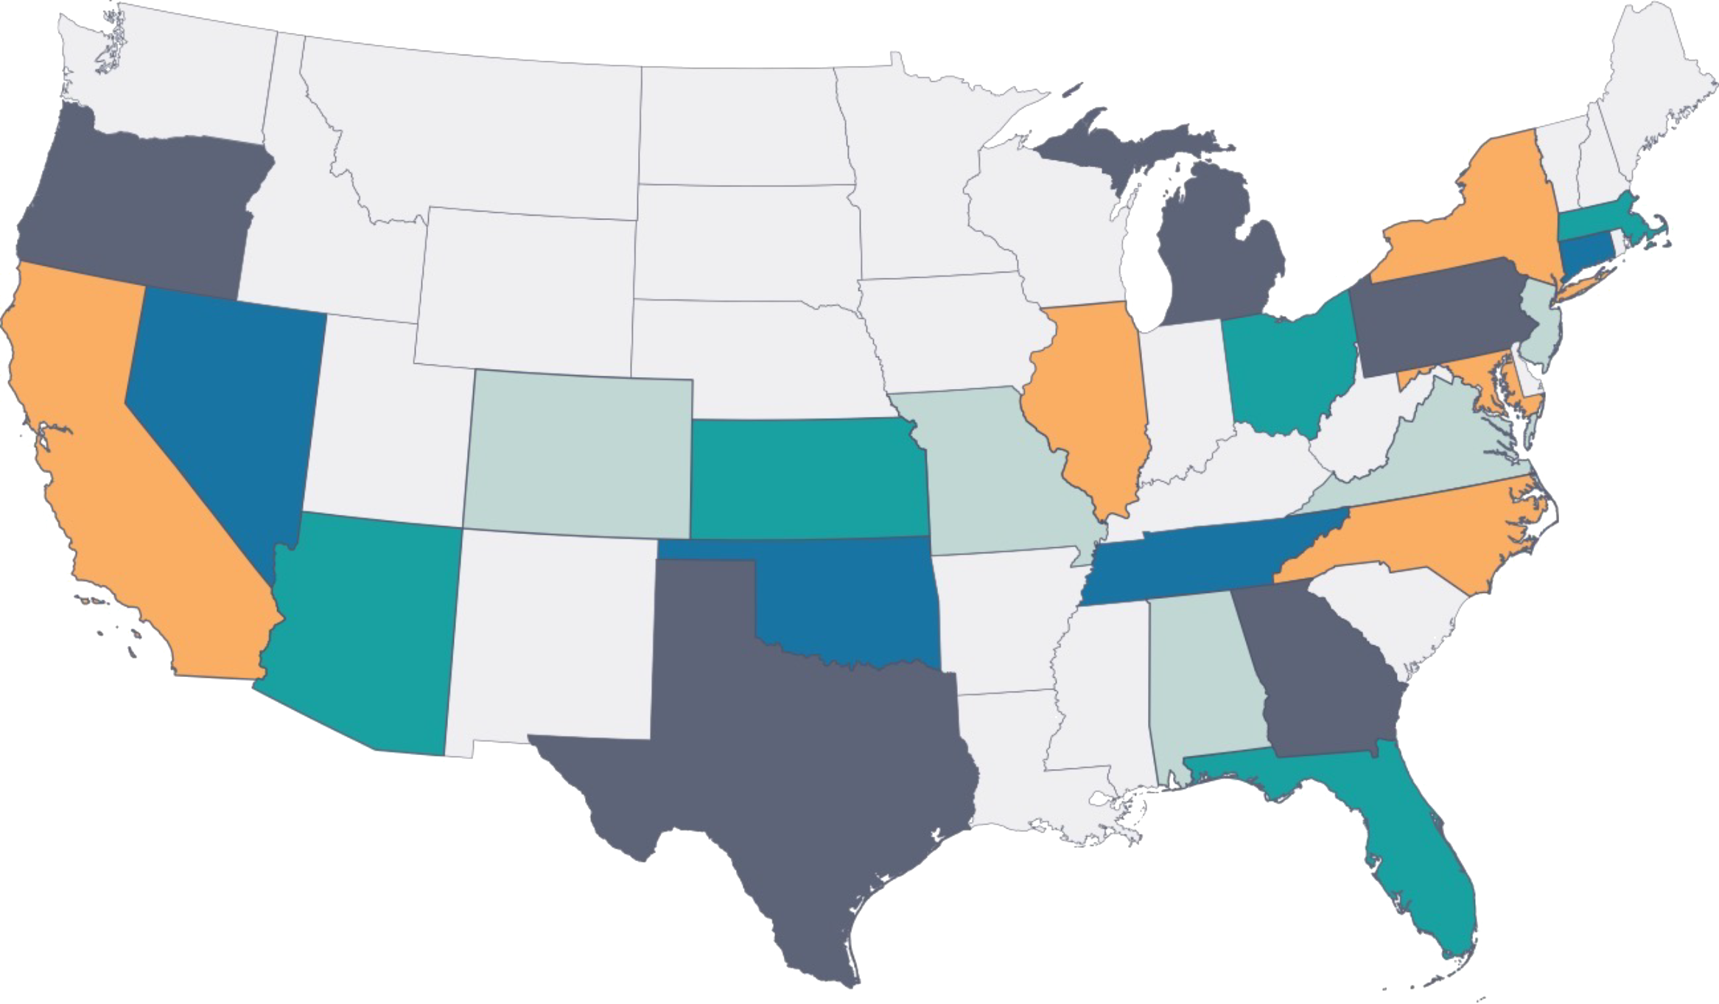
EQUITY AND EXCELLENCE REPORT
WHY THIS PARTNERSHIP?
Since 2005, NCUST has identified, awarded, and studied 175 schools in 25 states that:
Do not have selective admissions;
Manifest a wide array of evidence of educational equity and excellence; and
Each racial/ethnic and language group served outperforms overall statewide percentages
Visit our website for more information, including a list of schools we have recognized: www.ncust.com

Slide 3
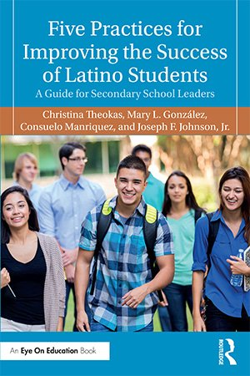
EDUCATIONAL EQUITY AND EXCELLENCE REPORT
KEY FINDINGS ARE DOCUMENTED IN THESE BOOKS

Slide 4
EDUCATIONAL EQUITY AND EXCELLENCE REPORT
BASIS FOR EQUITY REPORT

Slide 5
EDUCATIONAL EQUITY AND EXCELLENCE REPORT
FINDINGS: STRENGTHS
Warm, caring, and respectful environment for students
Performing arts opportunities are a plus for students
Evidence of strong relationships between staff and students and between students
Willingness amongst staff and administration to improve the learning experiences for all students
Students are supported and made to feel welcome and capable in the performing arts
Students expressed a strong sense of community and pride for their school
Positive, Transformational Culture

Slide 6
EDUCATIONAL EQUITY AND EXCELLENCE REPORT
FINDINGS: STRENGTHS
Teachers and classified staff shared that they enjoyed working at this school
The performing arts focus is a sense of pride for the staff
Supportive and encouraging new administrative team
Awareness and willingness of staff to improve
Positive, Transformational Culture

Slide 7
EDUCATIONAL EQUITY AND EXCELLENCE REPORT
FINDINGS: STRENGTHS
Teachers shared that they use their standards (performing arts and core) to plan for their lessons
Evidence of technology support for the curriculum and instruction
Students had access to individual resources to support their learning in the performing arts
Challenging Curricula

Slide 8
EDUCATIONAL EQUITY AND EXCELLENCE REPORT
FINDINGS: STRENGTHS
High engagement in most performing arts classrooms and some core classrooms
Targeted and individual feedback in most performing arts classrooms
In many classrooms, instruction was relevant to students
Many lessons were culturally and personally appropriate for learners
Effective, Engaging Instruction

Slide 9
EDUCATIONAL EQUITY AND EXCELLENCE REPORT
FINDINGS: NEXT STEPS
Agree upon and implement a strategy for leading students to perceive themselves as young scholars who are capable of learning challenging academic content.
Work together to identify a small number of critical academic standards (in mathematics, English language arts, and science) that will receive special attention and extra time.
Work together to identify two instructional practices that have the potential to accelerate learning, especially for students who, historically, have not experienced academic success.

Slide 10
EDUCATIONAL EQUITY AND EXCELLENCE REPORT
IMPLEMENTING RECOMMENDATIONS: ESSENTIAL CONSIDERATIONS

