Slide 1
With a full complement of diverse students at every grade level with a healthy waitlist because we are a model public Montessori program and we share our story broadly. [Rec: Finance]
Potential Metrics | Board Role
Enrollment #s Waitlist #s application # of outreach presentations # of in-person & virtual tours # of parents volunteering w/ tours # of local elected leaders that tour | Explore 3 y/o solution Organizing parents to talk/share at tours Recruit someone w/ marketing experience to board

Slide 2
Current Enrollment Data

Slide 3
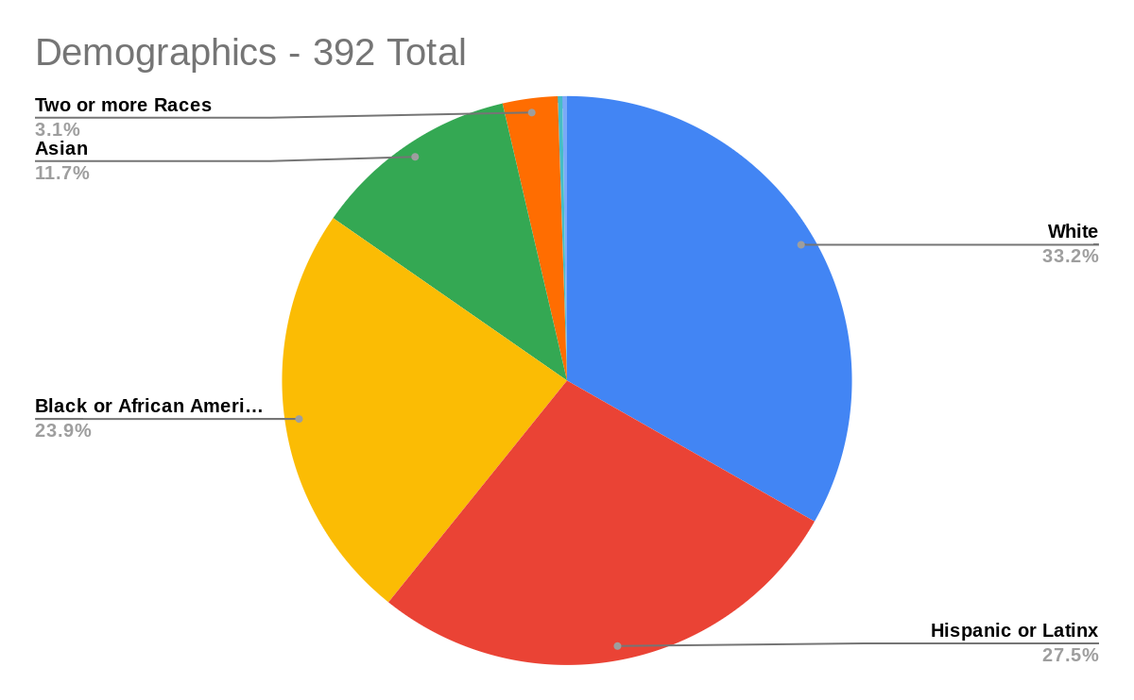
Student Demographics/Demografía - 330 total
Other
5.1%
Two or more
16.1%
31.5%
18.2%
29.1%

Slide 4
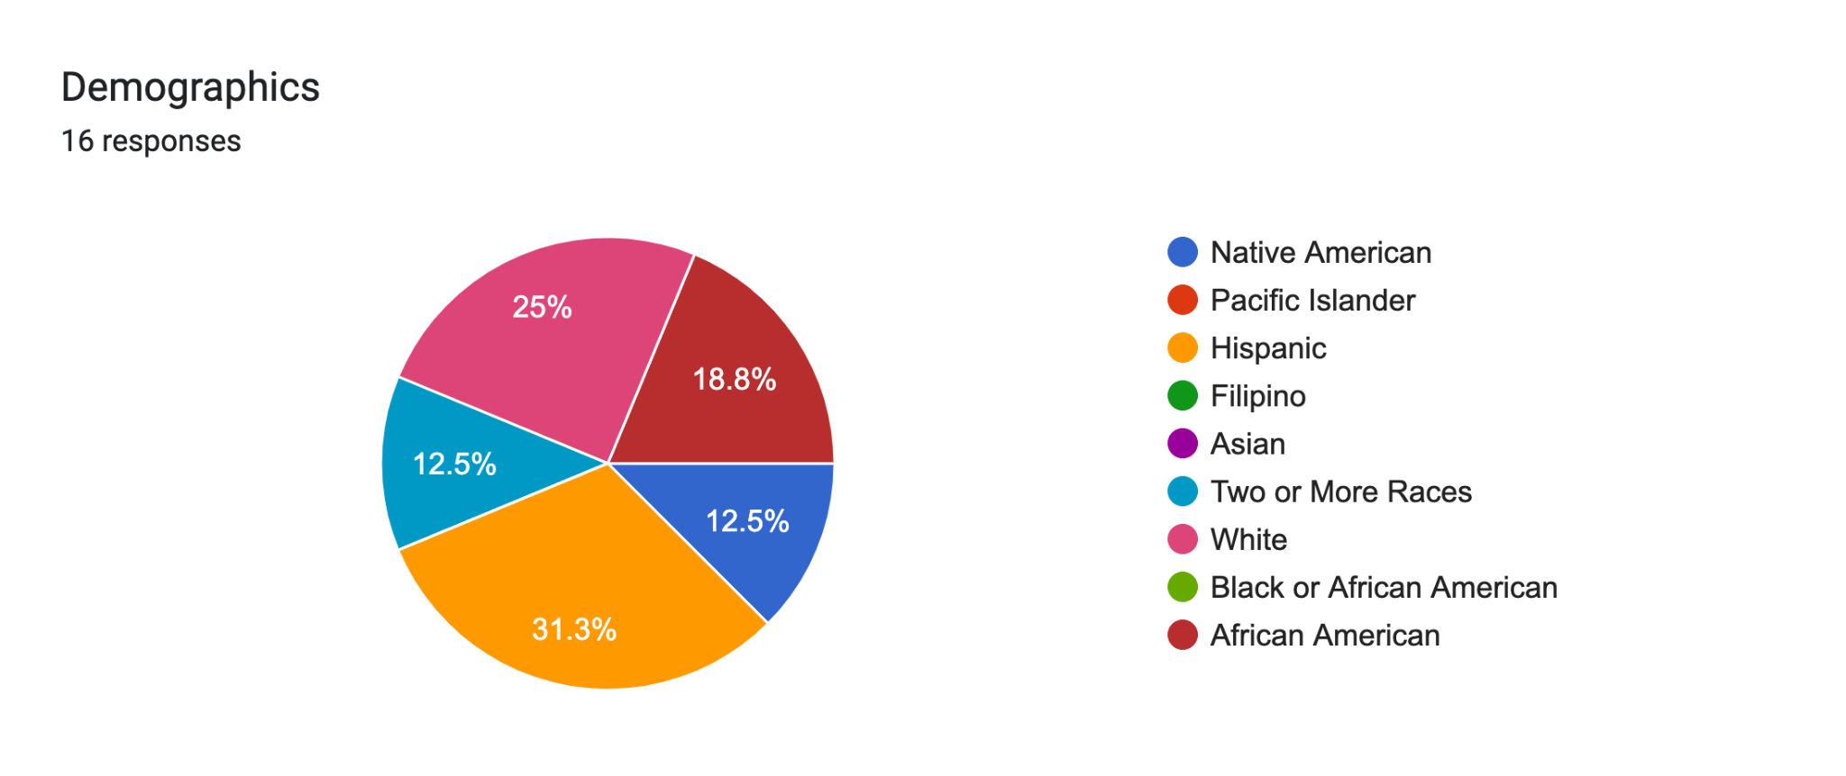
Diverse Teachers Annual Report
Lead Teacher Demographics - 2022/2023

