Slide 1
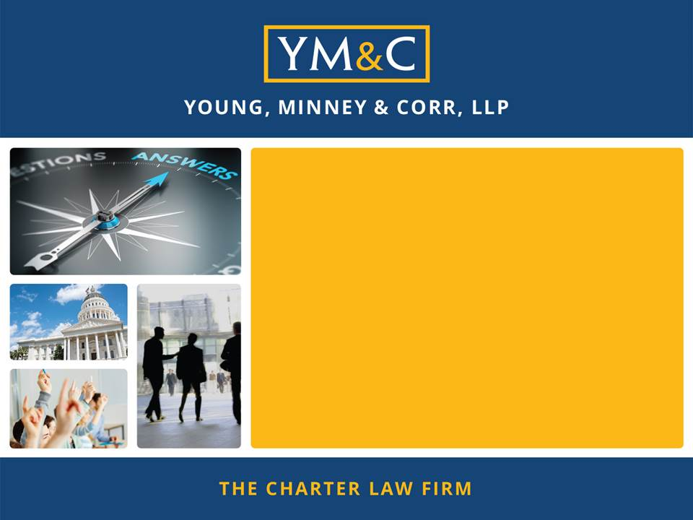
Encore Junior and Senior High School
Brown Act and Conflict of Interest Training
February 27, 2023
Presented by:
Jerry W. Simmons (jsimmons@mycharterlaw.com)
(916) 646-1400
1

Slide 2

Education Code 47604.1
Charter School Transparency Law
Effective January 1, 2020
Charter schools must comply with Public Records Act, Brown Act, Political Reform Act, and Government Code 1090.
Applicable to charter schools and entities managing/operating charter schools.

Slide 3

Understanding the
Brown Act

Slide 4

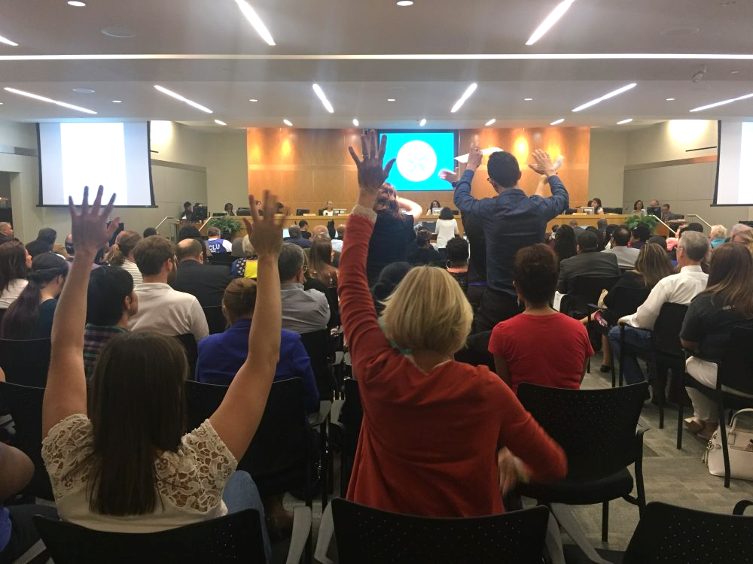
Purpose of The Brown Act
What Is the Purpose of the Brown Act?
To Foster Broad Public Access
“. . . The people of this State do not yield their sovereignty to the agencies which serve them. The people, in delegating authority, do not give their public servants the right to decide what is good for the people to know and what is not good for them to know. The people insist on remaining informed so that they may retain control over the instruments they have created.”

Slide 5

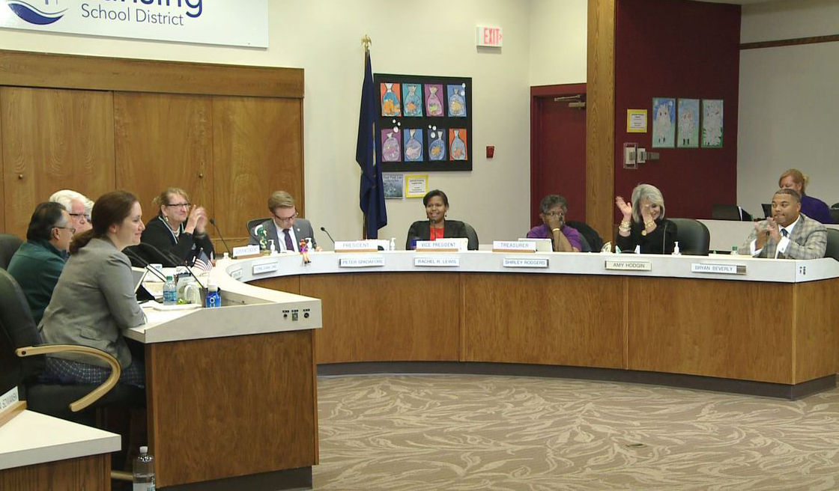
Meetings
Brown Act Applies to Meetings of the Board
Basic Definition
When any congregation of a majority of the members of the body meet to hear, discuss, deliberate, or take action on any item of Charter School business

Slide 6

Meetings
Board Committees: Nearly all Committees Must Comply with the Brown Act
Exception Applies Only if All of the Following:
Advisory Committee (not decision making)
Composed of only Board members
Less than a quorum of the Board
Must not be a standing committee

Slide 7

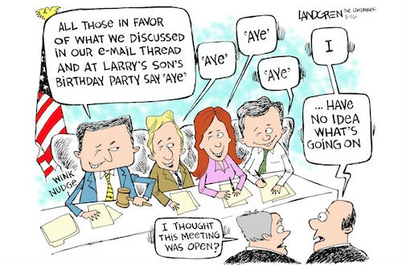
Meetings
Serial Meetings
Serial Meetings Are Prohibited
  Majority of Board members
  Engaging in a series of
  communications
  Outside Board meeting
  Through direct communications
  or intermediaries or technology
  To discuss, deliberate, or take action on any item of business (including relaying comments or position of other Board members)

Slide 8
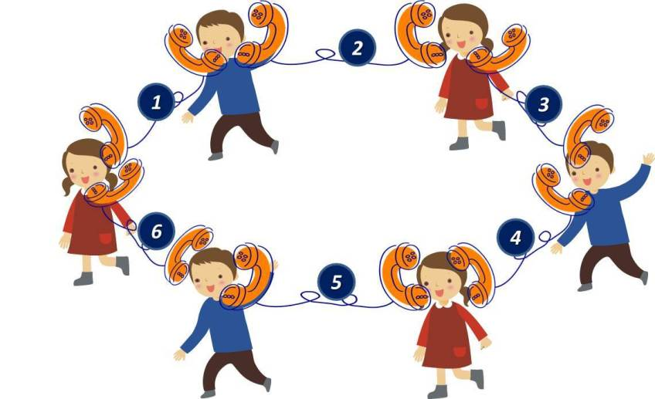
Meetings
Serial Meetings
Hub or Chain prohibited
Technology may result in meetings at times you might not expect
  E-mails
  Text messages
  Social media
  Website postings
  Online forums
  Telephone calls
  Faxes

Slide 9
Meetings
Serial Meeting & Limit on One-Way Communications
While an employee or official may engage in separate conversations or communications with other members of the Board in order to answer questions or provide information regarding a matter of Charter School business, that person may not communicate to members of the Board the comments or position of any other member or members of the Board.

Slide 10


Meetings
Teleconference Meetings (Normal rules)
Six Additional Requirements:
Agenda must be posted at all teleconference locations.
2. Each teleconference location must be identified in the notice and agenda of the meeting.

Slide 11
Meetings
Teleconference Meetings (cont’d)
3. All votes taken must be by roll call.
4. Each teleconference location must be accessible to the public. (ADA-compliance required.)
5. Members of the public must be able to hear and must have the right to address the Board directly from each teleconference location.
6. A quorum of the Board must participate from within the Charter School’s “jurisdiction.”

Slide 12

Assembly Bill 361
Pursuant to AB 361 (October 1, 2021), a charter school board may continue to hold teleconference meetings without adhering to some of the traditional requirements of the Brown Act. If certain conditions are met, a charter school board may continue to meet virtually with the following flexibilities:
  The agenda does not need to provide notice of each teleconference location nor do agendas need to be posted at each location;
  A quorum of board members do not need to be located within the Charter School’s jurisdiction; and
  Governing board members may participate in a teleconference meeting from places that are not publicly accessible.

Slide 13


Assembly Bill 361
A charter school board may continue to hold teleconference meetings without adhering to all of the traditional requirements of the Brown Act under the following circumstances:
    During a proclaimed state of emergency; and
    State or local officials have imposed or recommended measures to promote social distancing; or
    The charter school board determines that meeting in person would present imminent risks to the health or safety of attendees.

Slide 14
Assembly Bill 361
If meeting pursuant to AB 361, the board must:
  Protect the statutory and constitutional rights of the parties and public appearing before the board.
  Give notice and post agendas as otherwise required under the Brown Act.
  Allow members of the public to access the meeting (e.g., Zoom) and describe the manner in which the public can offer public comment.
  Not require members of the public to submit comments in advance of the meeting. The public must be able to participate in real time.
  Provide a timed or a reasonable period for public comment.
  If there is a technical disruption in the meeting broadcast, take no further action on items on the agenda until public access is restored.

Slide 15
Assembly Bill 361
In order to continue holding meetings pursuant to AB 361, the board must make the following findings by majority vote every 30 days:
  The charter school board has reconsidered the circumstances of the state of emergency.
  Any of the following circumstances exist:
    The state of emergency continues to directly impact the ability of the members to meet safely in person.
    State or local officials continue to impose or recommend measures to promote social distancing.

Slide 16
New Law! AB 2449
Signed by the Governor on September 13, 2022; effective on January 1, 2023
Amends the Brown Act teleconferencing rules to allow relaxed teleconferencing requirements for members’ personal emergencies and for just cause
Allows teleconferencing without any obligation to
  Identify the teleconferencing location on the agenda
  Allow public access to the teleconferencing location
Member must participate through both audio and visual technology
16

Slide 17
New Law! AB 2449
Teleconferencing is available under these rules where one of the following circumstances applies:
  The member notifies the governing board at the earliest opportunity possible, up to the start of a regular meeting, for just cause up to twice per calendar year
  The member requests to participate in the meeting remotely due to emergency circumstances and the governing board takes action to approve the request.
    A general description of an item generally need not exceed 20 words (no need to disclose medical diagnosis or disability, or any personal medical information that is already exempt under existing law)
17

Slide 18
New Law! AB 2449
“Emergency circumstances” means a physical or family medical emergency that prevents a member from attending in person.
“Just cause” means any of the following:
  A childcare or caregiving need of a child, parent, grandparent, grandchild, sibling, spouse, or domestic partner that requires them to participate remotely.
  A contagious illness that prevents a member from attending in person.
  A need related to a physical or mental disability as defined in law and not otherwise accommodated
  Travel while on official business of the governing board or another state or local agency.
18

Slide 19
New Law! AB 2449
Teleconferencing based on an emergency requires that:
  The member shall make a request to participate remotely as soon as possible.
  The member must make a separate request for each meeting in which they seek to participate remotely.
  If the request does not allow sufficient time to place proposed action on such a request on the posted agenda for the meeting for which the request is made, the legislative body may take action at the beginning of the meeting.
19

Slide 20
New Law! AB 2449
Under no circumstances can a member participate in meetings solely by teleconference from a remote location for a period of more than:
  three consecutive months;
  20 percent of the regular meetings within a calendar year; or
  more than two meetings if the legislative body regularly meets fewer than 10 times per calendar year.
20

Slide 21
New Law! AB 2449
Other requirements:
At least a quorum of members must participate in person from a singular physical location clearly identified on the agenda and which is open to the public and situated within the local agency's jurisdiction.
Members of the public must be provided a means to “remotely hear and visually observe the meeting, and remotely address” the governing board, ” i.e., a two-way audiovisual platform or a two-way telephonic service and a live webcasting of the meeting.
Agenda must provide notice of how members of the public can access the meeting and provide public comment. Cannot require public comments to be submitted in advance.
If the broadcast is disrupted, the board may not take action until remote access to the meeting is restored
Board cannot require public comments to be submitted in advance
21

Slide 22
New Law! AB 2449
The member shall publicly disclose before any action is taken, if any individuals 18 years of age or older are present in the room at the remote location, and the general nature of the member’s relationship with any such individuals.
22

Slide 23

Notice Requirements
Notice and Agendas
General Rule: The agenda shall be posted properly in advance of a meeting and must include a brief description of items to be transacted or discussed.
With a few exceptions,
if an item is not on the agenda,
the Board cannot discuss it.

Slide 24

Notice Requirements
Contents
Brief description = usually not more than 20 words
How to request disability-related accommodation
Location for inspection of docs distributed to Board

Slide 25
Notice Requirements
When?
Regular meetings – 72 hours notice
Special meetings – 24 hours notice
Emergency meetings – 1 hour notice (rare)
Where to Post?
Physically at a publicly accessible location within the jurisdiction during the entire posting period
On the website – homepage with a prominent, direct link

Slide 26
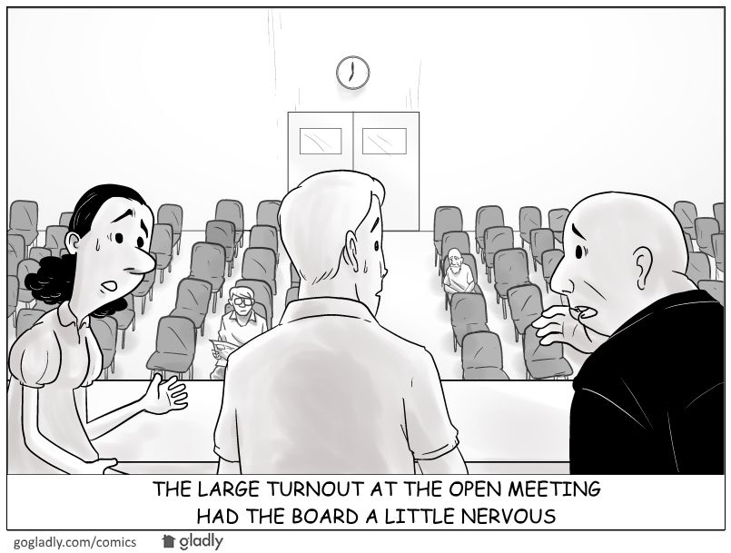
Rights of the Public
Rights to Enable Access and Participation
Give oral testimony at meeting
  Time limits
  Addressing disruptive
  speakers
Virtual meetings and best
practices (stay in control
of your meeting!)
Audio record and broadcast

Slide 27
Rights of the Public
Rights to Enable Access and Participation (cont.)
No conditions of public attendance
Non-discriminatory facilities (reasonable accommodations under ADA)
Copies of agendas and other public writings

Slide 28
New Law! SB 1100
Signed by the Governor on August 22,2022; effective on January 1, 2023
Adds a new section to the Brown Act authorizing the presiding member of the governing board conducting a meeting or their designee to remove, or cause the removal of, an individual for disrupting the meeting.
28

Slide 29
New Law! SB 1100
“Disrupting” means engaging in behavior during a meeting of a legislative body that actually disrupts, disturbs, impedes, or renders infeasible the orderly conduct of the meeting and includes, but is not limited to, one of the following:
  (A) A failure to comply with reasonable and lawful regulations or policies adopted by a legislative body related to public comment, or any other law.
  (B) Engaging in behavior that constitutes use of force or a true threat of force.
29

Slide 30
New Law! SB 1100
Before removing an individual, the presiding member or their designee must warn the individual that their behavior is
  1. disrupting the meeting and
  2. that their failure to cease their behavior may result in their removal.
The presiding member or their designee may then remove the individual if they do not promptly cease their disruptive behavior.
30

Slide 31
New Law! SB 1100
The warning requirement does not apply to behavior constituting a “true threat of force.”
A “true threat of force” means “a threat that has sufficient indicia of intent and seriousness, that a reasonable observer would perceive it to be an actual threat to use force by the person making the threat.”
31

Slide 32

Closed Sessions
What Are the Permissible Closed Sessions?
Pending/Anticipated Litigation (conference with legal counsel)
Personnel (appointment, employment, evaluation, discipline, dismissal)
  Caveat: 24-hour written notice to employee is required if Board will hear complaints and/or charges

Slide 33
Closed Sessions
What Are the Permissible Closed Sessions? (cont.)
Conference with Real Estate Negotiator
Conference with Labor Negotiator
Public Security
Pupil Discipline (Education Code)

Slide 34
Closed Session
Requirements
  Use “Safe Harbor” agenda language (GC 54954.5)
  Prior to Closed Session:
    Board Must Make a Public Announcement of Reasons for Closed Session Prior to Closed Session
    Public Must Have an Opportunity to Comment
  After Closed Session:
    Board Must Make a Public Report of Action Taken in Closed Session and Vote or Abstention of Every Board Member
  Only necessary personnel may attend
  Confidentiality is required

Slide 35

Executive Compensation
Executive Compensation
Approval of CEO/Executive Director’s compensation (and some others) must occur at a regular meeting
Govt. Code 54953: Prior to final action, Board must orally report a summary of the recommendation for final action, including the salary, salary schedule, and fringe benefits, during the open meeting where final action will be taken.
Final action in open session

Slide 36
Enforcement
Complaints and Challenges
  Notice of Concern
    Often brought by Charter Authorizer
    Short turnaround to respond
    Seek advice from legal counsel on response
  Notice and Demand for Cure or Cease and Desist
    Can be brought by DA or member of the public
    Board must cure/respond within 30 days
    Seek advice from legal counsel on response

Slide 37
Understanding Conflict of Interest Laws

Slide 38
Conflicts of Interest
Broad Definition
A conflict of interest arises when an individual who has a private financial interest in the outcome of a corporate contract or a public decision, participates in the decision-making process or influences or attempts to influence others making the contract or decision.
In short, a conflict of interest is a clash between an individual’s duty to his or her office and his or her personal interests.
38

Slide 39

Financial Interests
Common Types of Financial Interests Regulated by Conflict Laws
  Ownership or investment in business entity
  Investment in real property
  Source of income
  Source of gifts
  Effect on personal finances
Financial interests of immediate family members of Board Members and employees typically are covered.
39

Slide 40
Government Code
Section 1090
Elements
  Public official (officer, board member, or employee)
  Making a public contract (for sale or purchase)
  Public official has a financial interest in the contract
40

Slide 41
Government Code
Section 1090
What you need to know about Section 1090
If board member has financial interest, the entire board is prohibited from entering into the contract; even if it is with the best vendor at the best price and the interested board member abstains. (Unless an exception applies.)
Making a public contract is defined very broadly! Applies to earliest discussions, planning, solicitation for bids, etc., not just vote.
Thus, this statute is, in most respects, the toughest standard to meet.
Violation of GC 1090 is a felony and the contract void!
41

Slide 42


Political Reform Act

Slide 43
Political Reform Act
Big Picture
  Public official
  Participating in or attempting to influence a governmental decision
  Public official has qualifying financial interest (Includes spouse and children)
  Financial interest is material
The Official Must Recuse Him or Herself from
All Parts of the Decision-Making Process
Lots of very detailed regulations have also been adopted by FPPC.
43

Slide 44

COI Code
Conflict of Interest Code
States who must file the Form 700
Assigns disclosure categories
44

Slide 45
Form 700
Form 700
Statement of Economic Interests
When it must be filed:
  Assuming or reappointment to office or position (within 30 days)
  Once annually (by April 1st)
  Leaving office or position (within 30 days)
Penalties for failure to file:
  Criminal charges by Atty General or District Atty for deliberate failure to file
  Civil or administrative action by FPPC or private citizen
45

Slide 46

Political Reform Act
“Financial Interest” for Form 700
Investment in business entity of $2,000 or more
Real property investment of $2,000 or more
Income of $500 or more
Business position in entity
Gift of $50 or more

Slide 47
Form 700
Check the Conflict-of-Interest Code to Determine What You Must Report (Board members: broad disclosure).
  Typically, All Financial Interests
      Not Your Residence
      Not Income from a Public Agency
      Half of Your Spouse’s Income
      Financial Interest within Your Jurisdiction
          Property – within 2 miles of jurisdiction
          Investments/Business in jurisdiction
          Gifts – all gifts inside or outside of jurisdiction
47

Slide 48
Form 700
Gifts
General rule is that you cannot accept more than $500 from one source in a calendar year.
General rule is that gifts worth more than $50 must be reported (one gift or aggregate gifts from same source in a calendar year).
Many exceptions to both general rules, the most common being:
  Special Occasions – Birthdays, Holidays:
    Can be gifts from anyone (other than lobbyists) if the gift giving and taking is proportional.
Inheritance
48

Slide 49
Form 700
Gift (cont.)
  Family Members:
      Spouse (or former spouse), child, parent, grandparent, great grandparent, grandchild, brother, sister, current or former parent-in-law, brother-in-law, sister-in-law, aunt, great aunt, uncle, great uncle, niece, great niece, nephew, great nephew, first cousin, or first cousin once removed, or the spouse of any such person. (other than a lobbyist)
  “BFF’s”- Long-term friendships:
      Friends for a “period of time” and gift giving and taking must be proportional. (other than a lobbyist)
  Dating – “bona fide” relationship (other than a lobbyist)
  Returning or Donating Gifts vs. Reporting
49

Slide 50
Common Law on
Conflicts-of-Interest
Prohibition Against Conflicts of Interest
  Public official engaging in transaction or influencing decision.
  Creating an appearance of impropriety (financial interest not necessarily required)
Doctrine of Incompatible Offices
Public official holding two public offices simultaneously
Offices are incompatible with each other (creating divided loyalties); overlapping jurisdictions
50

Slide 51
New Law! AB 2158
Signed by the Governor on September 13, 2022, effective January 1, 2023; subject to a ramp up period for full compliance by January 1, 2026
Existing law has required members and certain employees of cities and counties to engage in two hours of ethics training “relevant” to their public service” every two years
AB 2158 adds charter schools to the list of local agencies subject to the biennial training requirement and extends the training obligation to members of charter school boards
51

Slide 52
New Law! AB 2158
“Ethics laws” include, but are not limited to, the following:
(1) Laws relating to personal financial gain by public servants, including, but not limited to, laws prohibiting bribery and conflict-of-interest laws.
(2) Laws relating to claiming perquisites of office, including, but not limited to, gift and travel restrictions, prohibitions against the use of public resources for personal or political purposes, prohibitions against gifts of public funds, mass mailing restrictions, and prohibitions against acceptance of free or discounted transportation by transportation companies.
52

Slide 53
New Law! AB 2158
“Ethics laws” include, but are not limited to, the following:
(3) Government transparency laws, including, but not limited to, financial interest disclosure requirements and open government laws.
(4) Laws relating to fair processes, including, but not limited to, common law bias prohibitions, due process requirements, incompatible offices, competitive bidding requirements for public contracts, and disqualification from participating in decisions affecting family members.
53

Slide 54
New Law! AB 2158
Requirements
The Fair Political Practices Committee and the Attorney General must be “consulted” in connection with the development of course materials
Charter schools must provide their officials with information on how they can meet the training requirements at least once annually
Charter schools must maintain records for at least five years after the training was provided indicating
  The dates that officials satisfied the training requirements
  The entit(ies) that provided the training
54

Slide 55
New Law! AB 2158
Applicability
Not applicable to board members whose terms will expire before January 1, 2026
All other board members seated as of January 1, 2025 must receive the required training by January 1, 2026 and retrain at least once every two years thereafter
55

Slide 56
New Law! AB 2158
Applicability
What about charter school employees?
  Are they an “[a]n employee designated by a local agency governing body to receive the training specified under this article?”
What about training requirements in charters and MOUs?
Does this training count towards the new “ethics training” requirement?
56

Slide 57
Public Records Act

Slide 58
Public Records Act
- Nearly all electronic and paper records held by the charter school are disclosable to members of the public and the media.
- Emails and text messages relating to school business are disclosable if a specific exemption does not apply
58

Slide 59

QUESTIONS AND RESPONSES
THANKS FOR ATTENDING TODAY!

