Slide 1
Fall 2022 Community Survey Results
Eno River Academy

Slide 2
Community Feedback and Engagement
324 total survey responses
402 individual free text comments

Slide 3
K-8 Survey

Slide 4
K-8
+2.1 from 2021 Survey

Slide 5
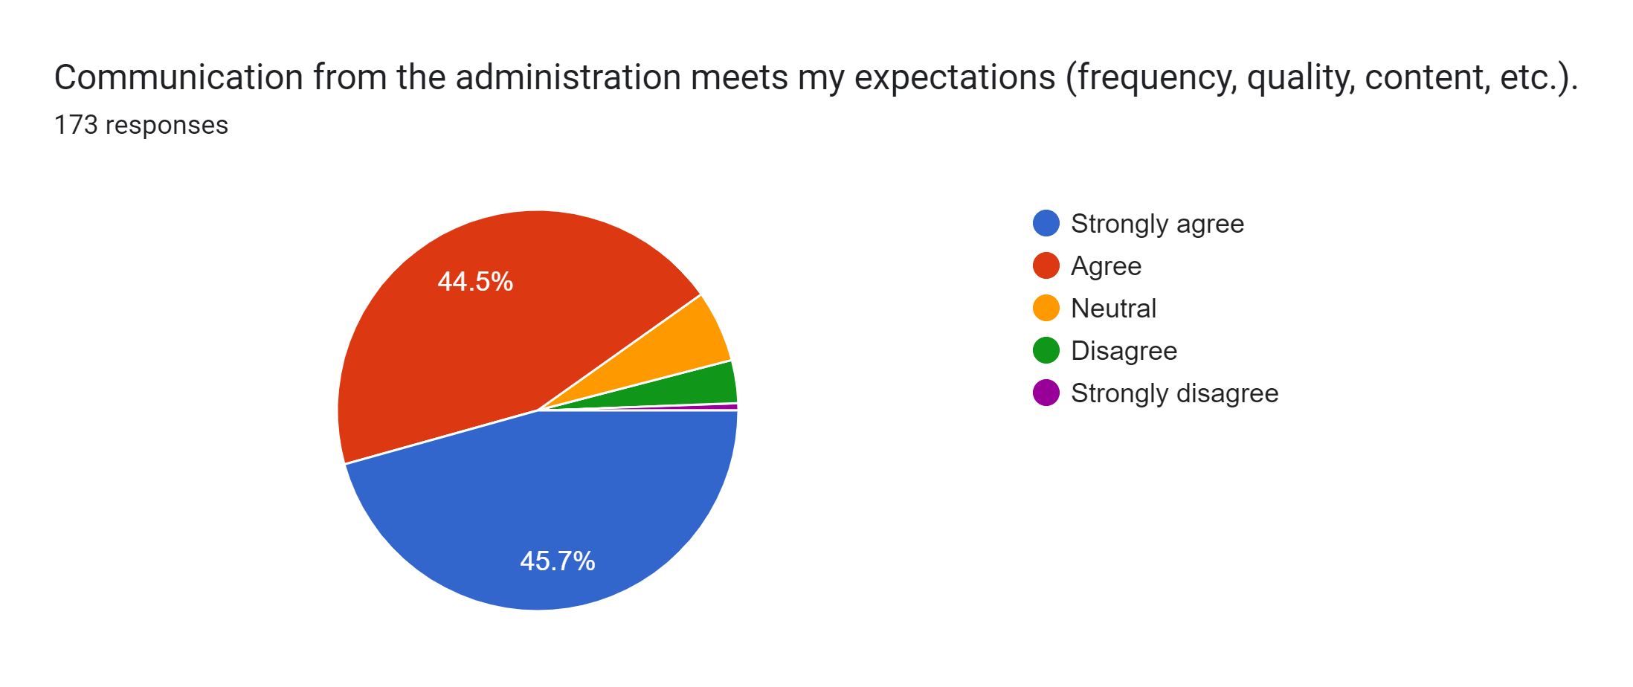
K-8
+1.4% from 2021 Survey

Slide 6
K-8
+18.5% from 2021 Survey

Slide 7
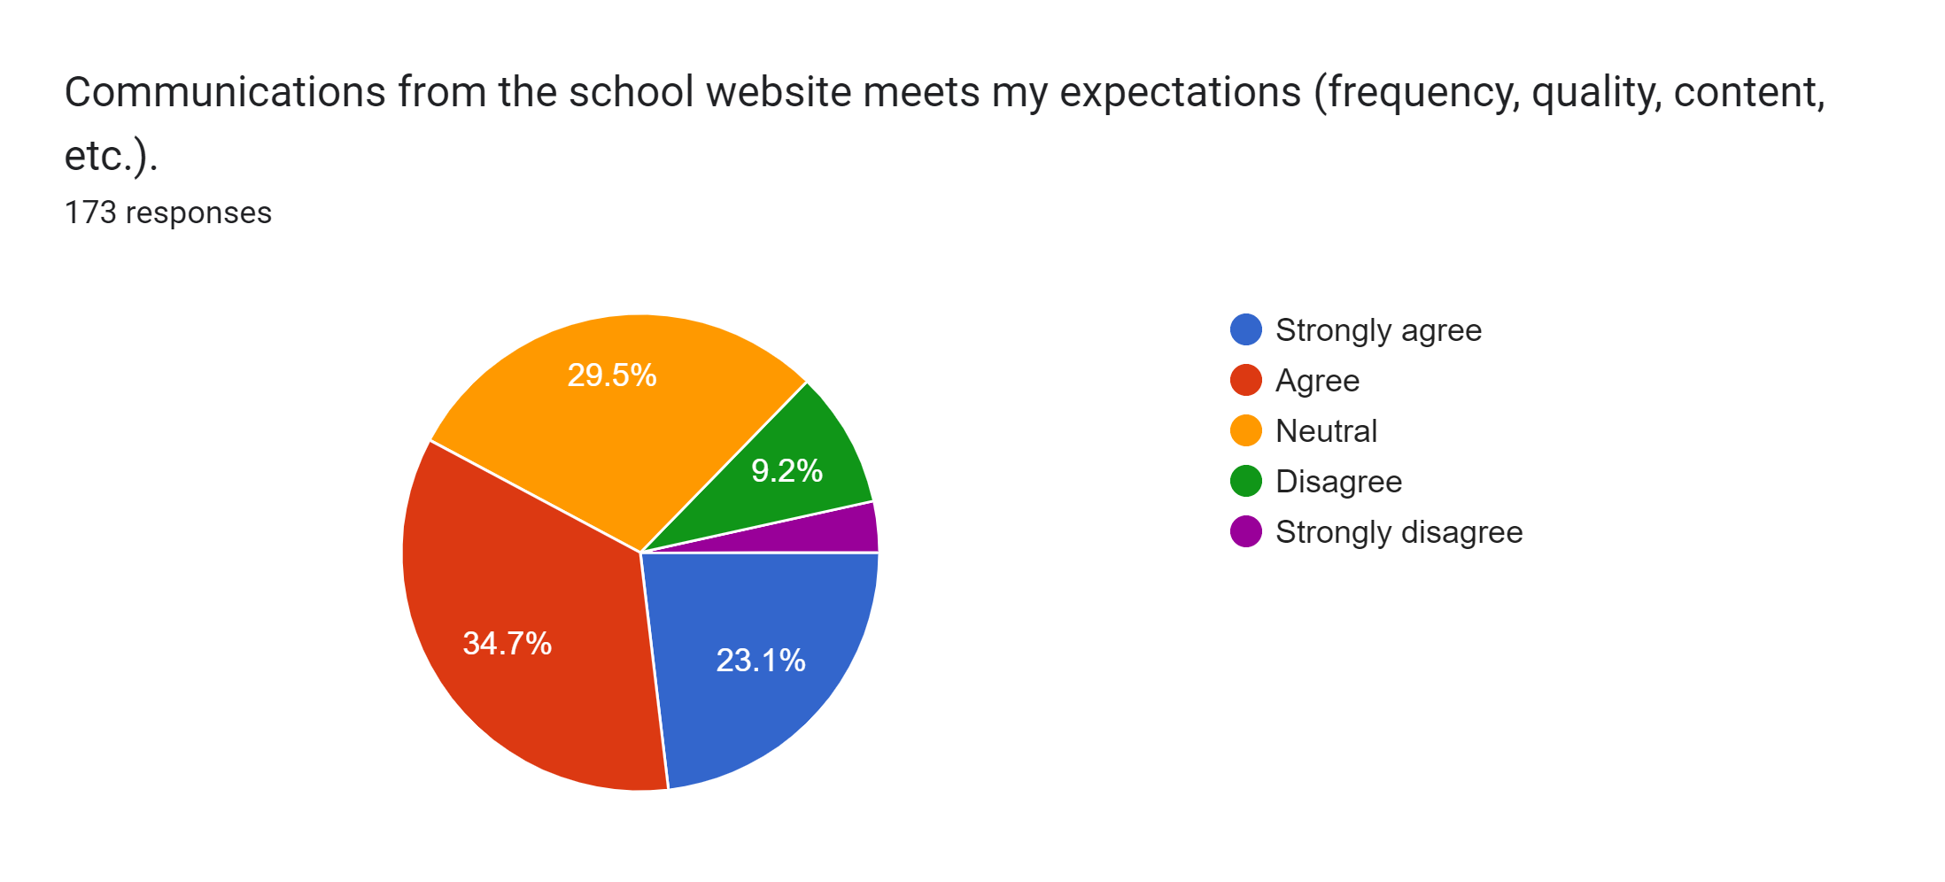
K-8
+1% from 2021 Survey

Slide 8
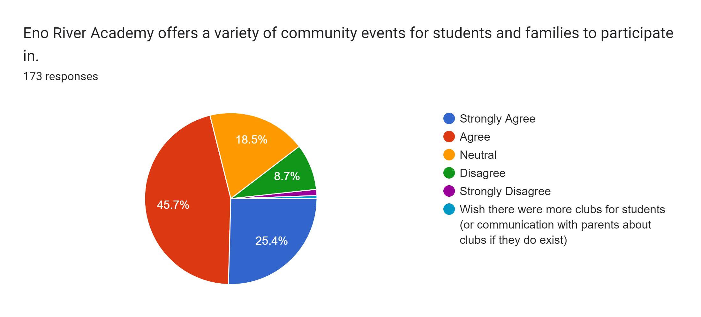
K-8
Question is new to 2022 survey

Slide 9
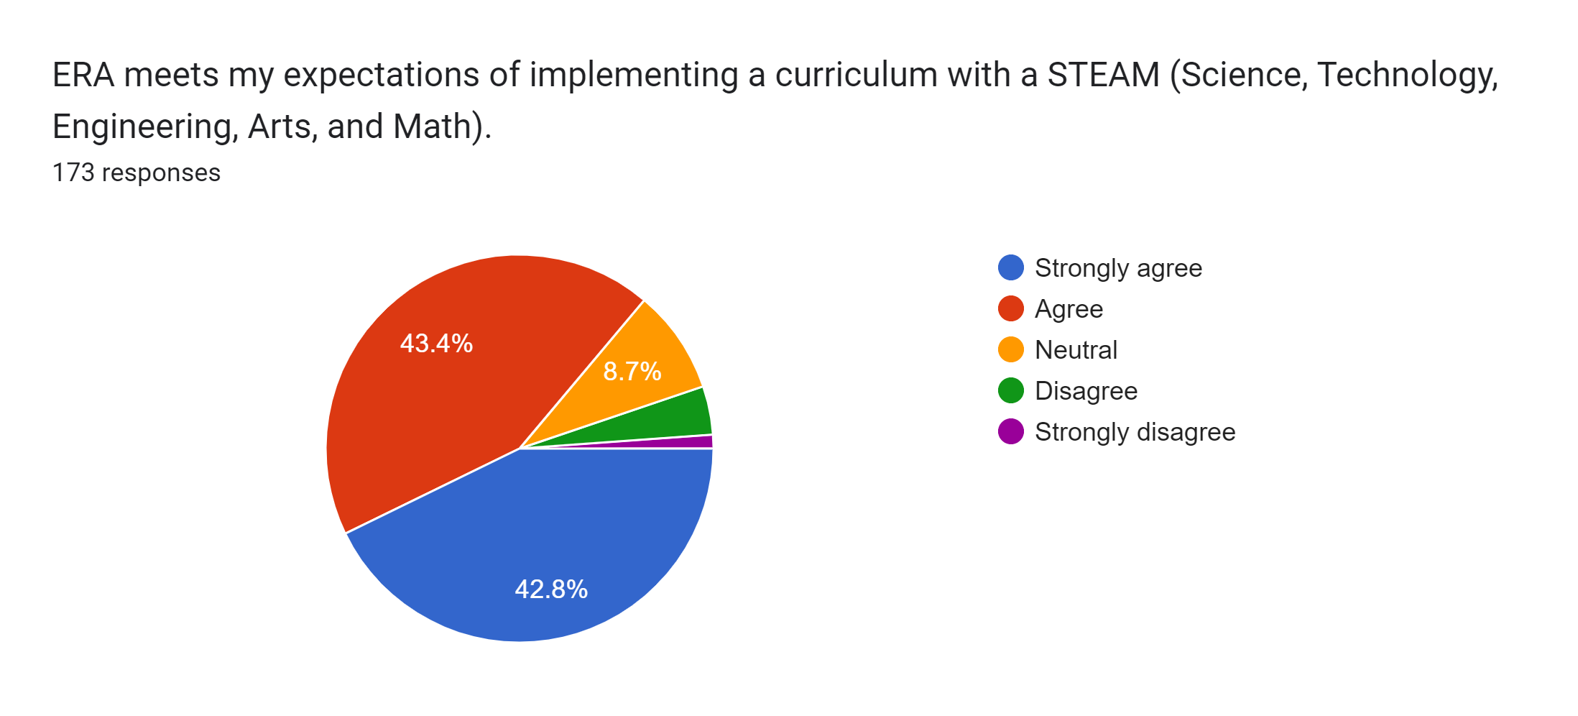
K-8
+1.9% from 2021 Survey

Slide 10
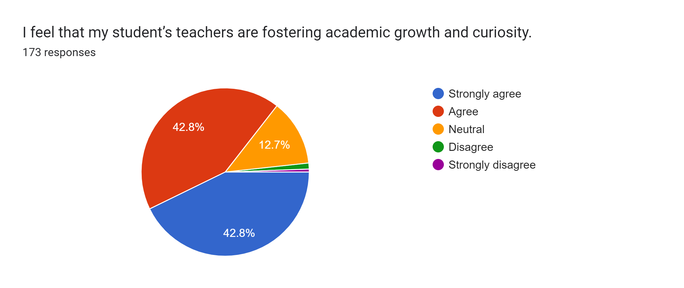
K-8
-3.1% from 2021 Survey

Slide 11
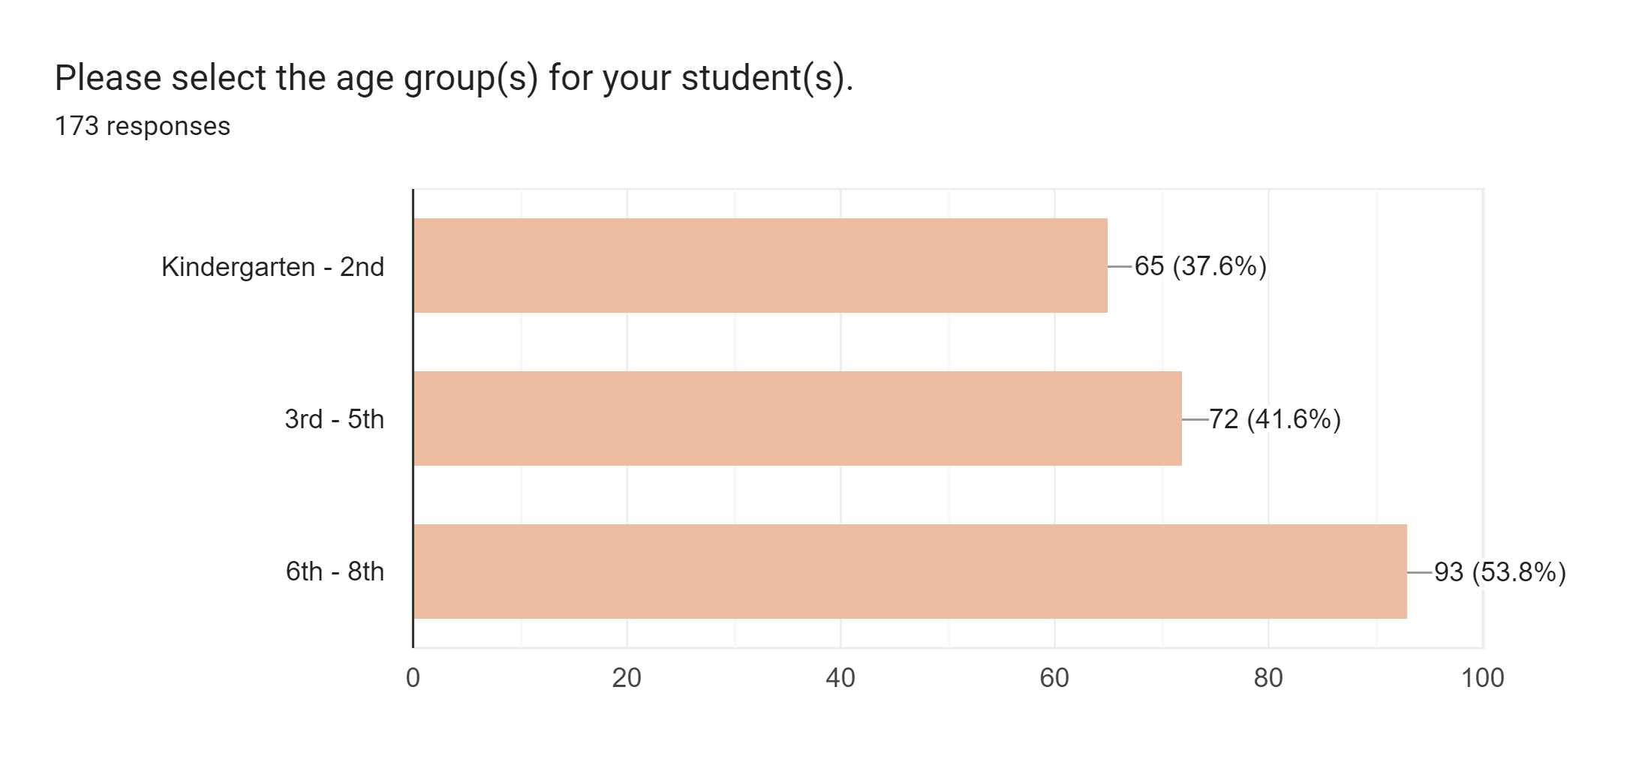
K-8

Slide 12
K-8
+13.3% from 2021 Survey

Slide 13
K-8
+13.5 from 2021 Survey

Slide 14
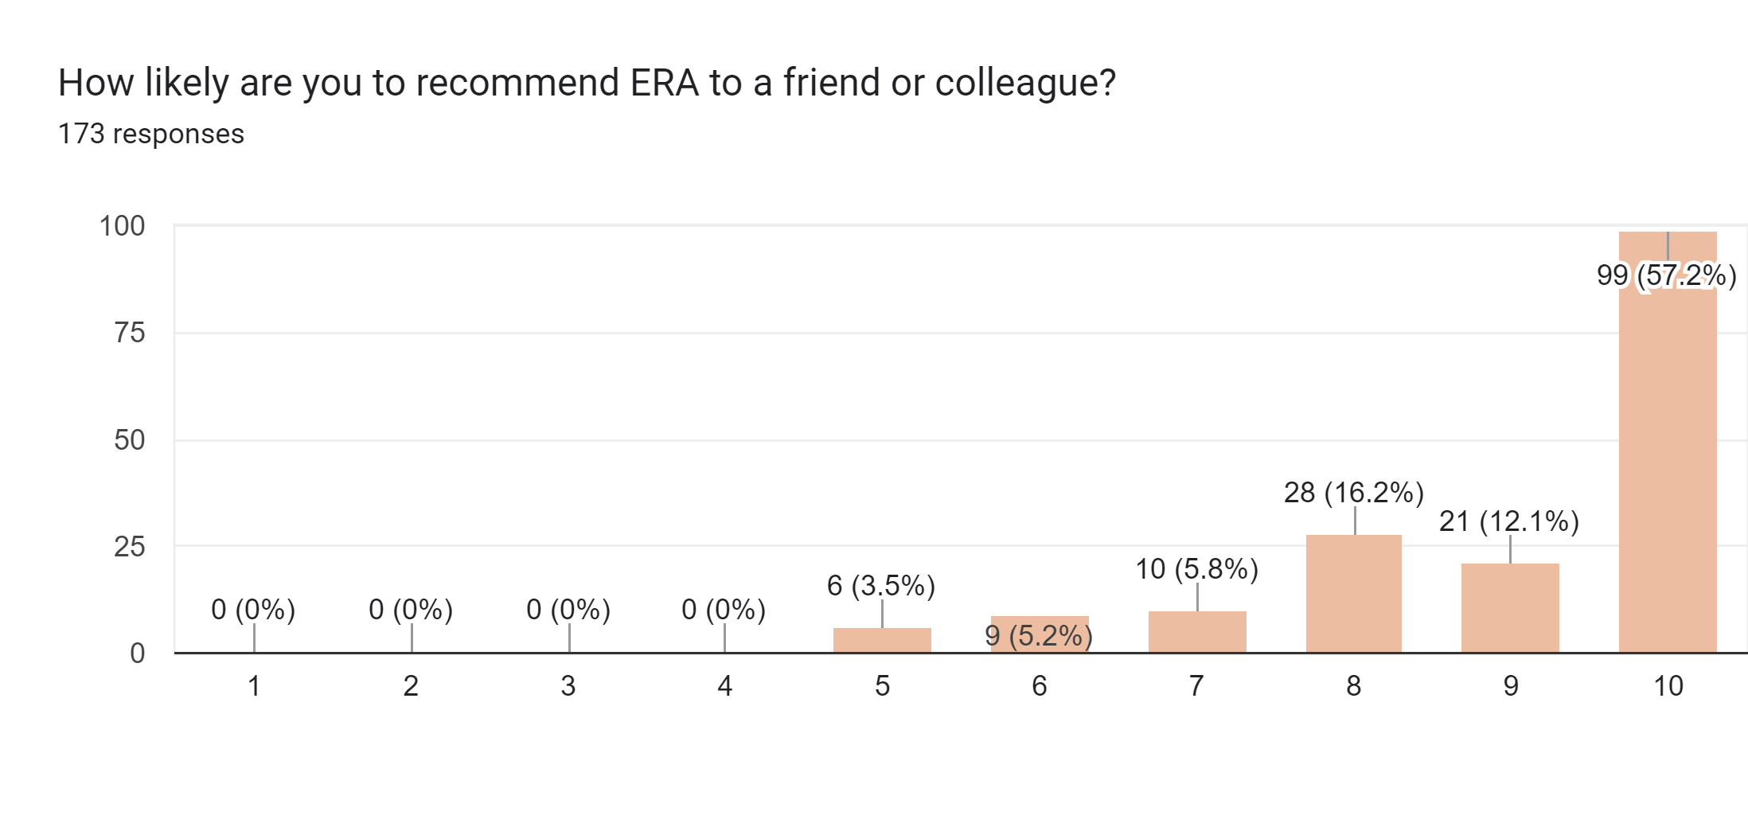
K-8
+4.4% ‘10s’ selected from 2021 Survey

Slide 15
K-8
+3.3% from 2021 Survey

Slide 16
High School

Slide 17
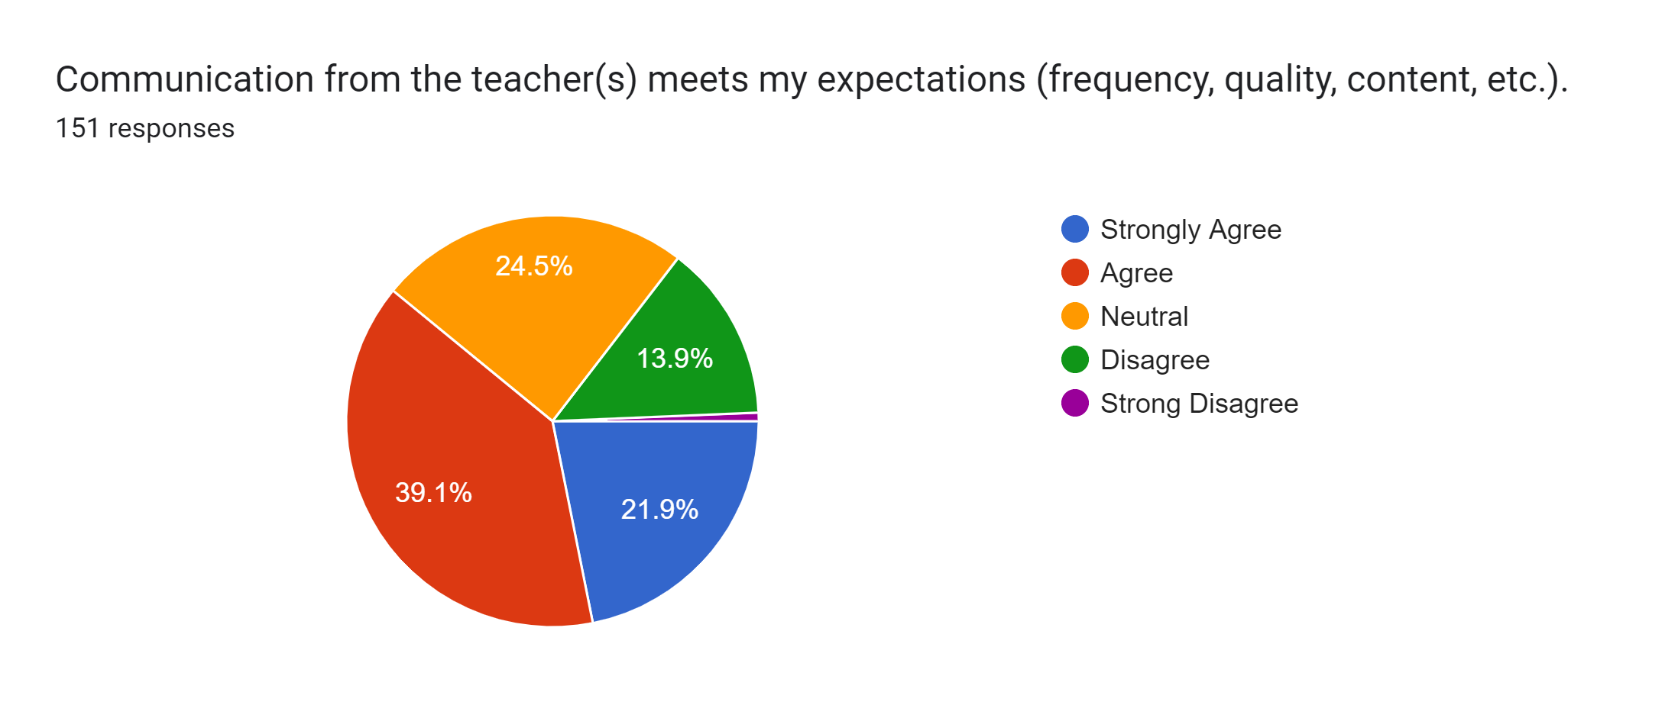
High School
+7% from 2021 Survey

Slide 18
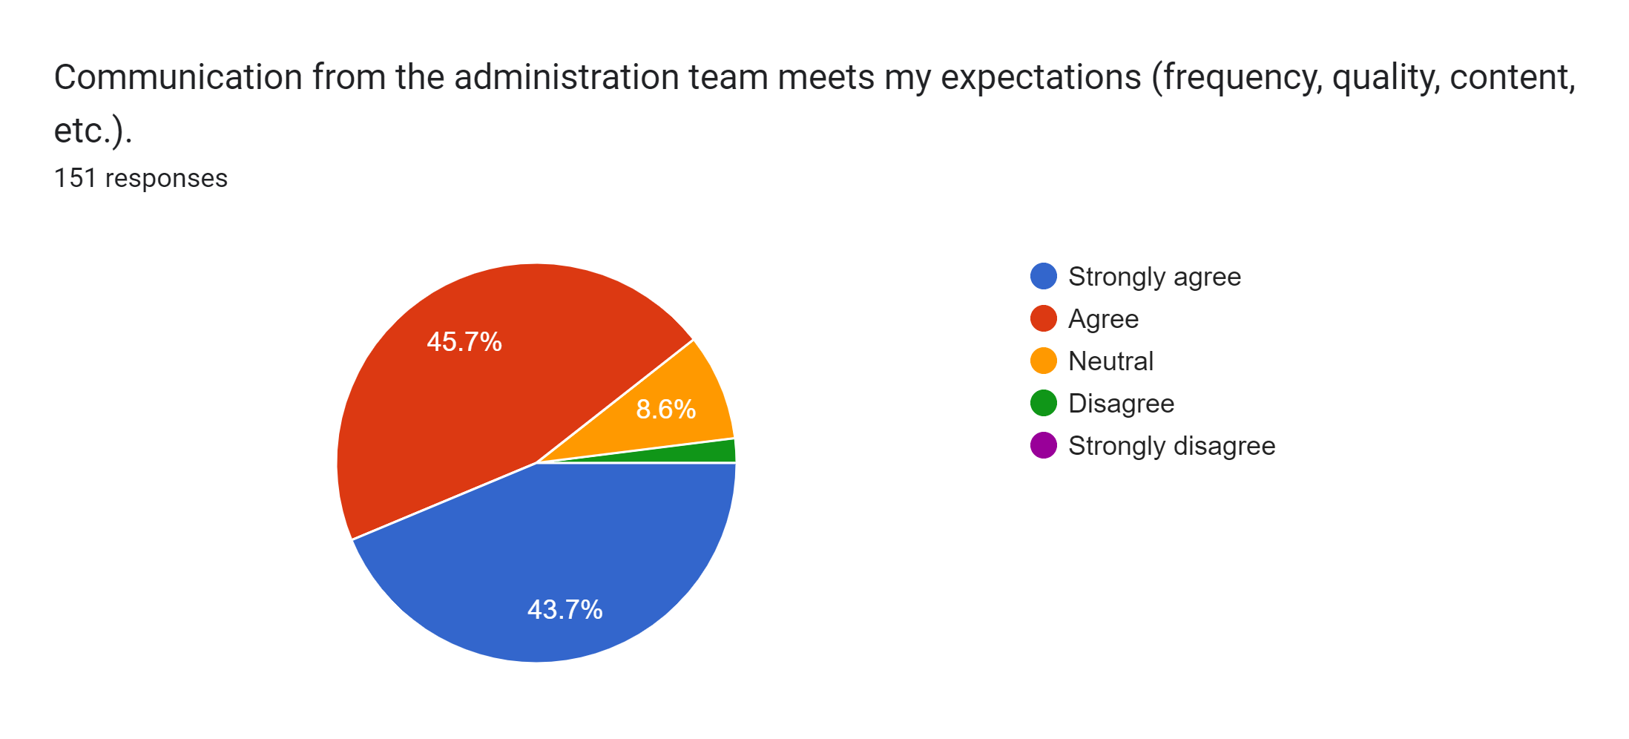
High School
+15.7% from 2021 Survey

Slide 19
High School
+15.6% from 2021 Surveyr

Slide 20
High School
+13.3% from 2021 Survey

Slide 21
High School
+14.9% from 2021 Survey

Slide 22
High School
+17.6% from 2021 Survey

Slide 23
High School
Question new to 2022 survey

Slide 24
High School
+7.8% from 2021 Survey

Slide 25
High School
+6.5% from 2021 Survey

Slide 26
High School
+13% from 2021 Survey

Slide 27
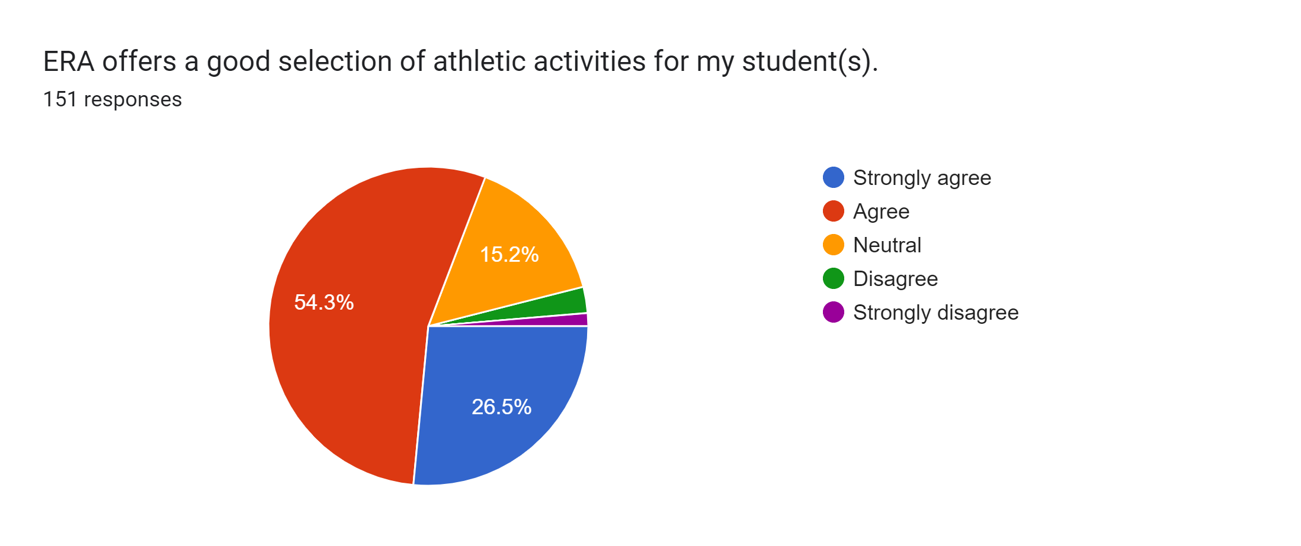
High School
+11.7% from 2021 Survey

Slide 28
High School
+10% ‘10s’ selected from 2021 survey

Slide 29
High School
+6.6% from 2021 Survey

