Slide 1
NWEA MAP Analysis
2021-22 Winter
For UMCS Board
February 2022
Notes:
Just finished testing. Initial analysis and will review in more detail at next academic committee meeting. Can discuss in more detail at March meeting too

Slide 2
NWEA MAP Background
NWEA MAP is computer adaptive assessment
Administer 2-3x per year in Math and Reading
2019-20 administered 2x/year due to COVID
Solid testing times (proxy for engagement), averaging 50-55 minutes
National norm-referenced assessment, not criterion-referenced
Norms changed in 2020-21 and applied retroactively to 2019-20 data
Students receive various scores
RIT score - tells teacher what student is ready to learn
Percentile rank - student’s national percentile rank based on subject, grade, and test period. 50th ptile is the median and proxy for being on grade-level/proficient; 41st is cutoff for Average
Met growth target - each student has a growth target (50th percentile) based on their subject, grade, and starting point. This indicates if their actual growth was greater than or equal to their growth target
Growth percentile rank - student’s national percentile rank for their growth (50th = median)

Slide 3
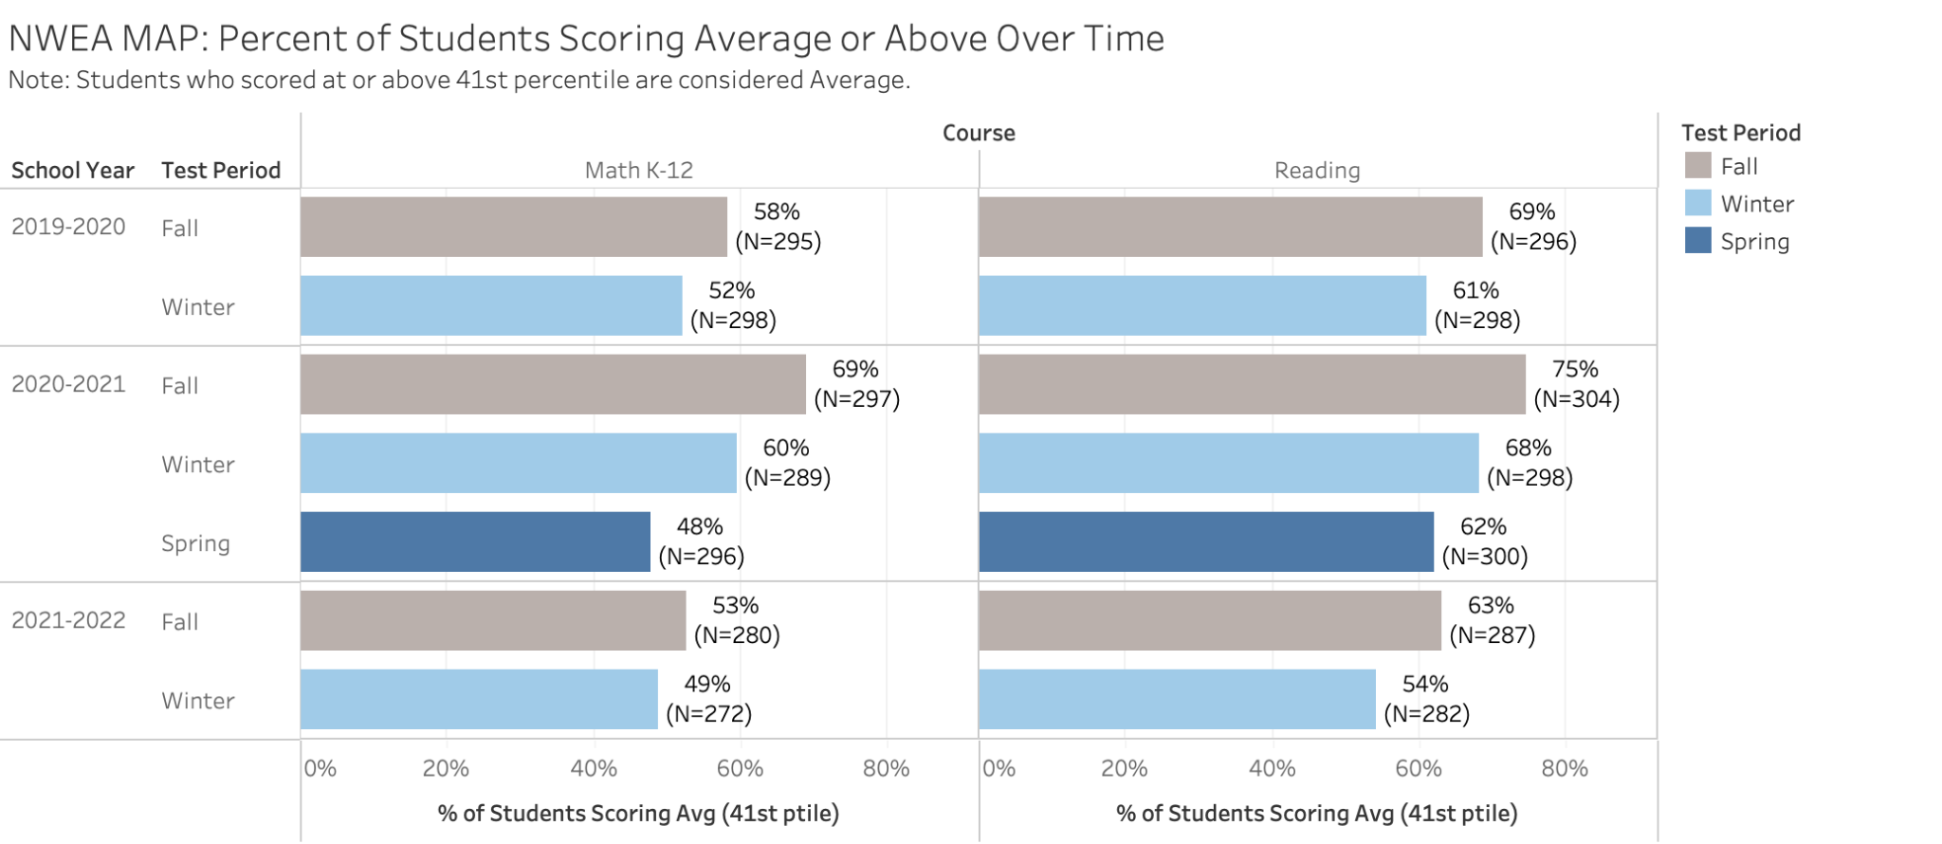
NWEA MAP Overall Results
49% of students scored Average or above on Math
54% of students scored Average or above on Reading

Slide 4
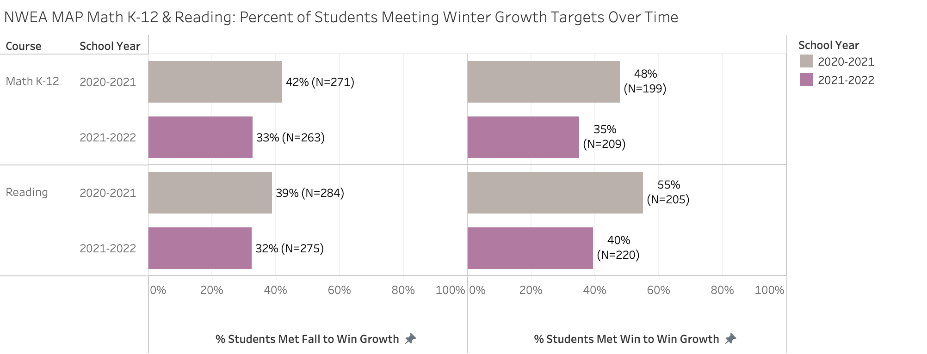
NWEA MAP Growth
Math: 35% of students achieved winter-to-winter growth targets
Reading: 40% of students achieved winter-to-winter growth
Notes:
Not as strong as hoped. Average is 50% of students meeting growth goals

Slide 5
Math Detail

Slide 6
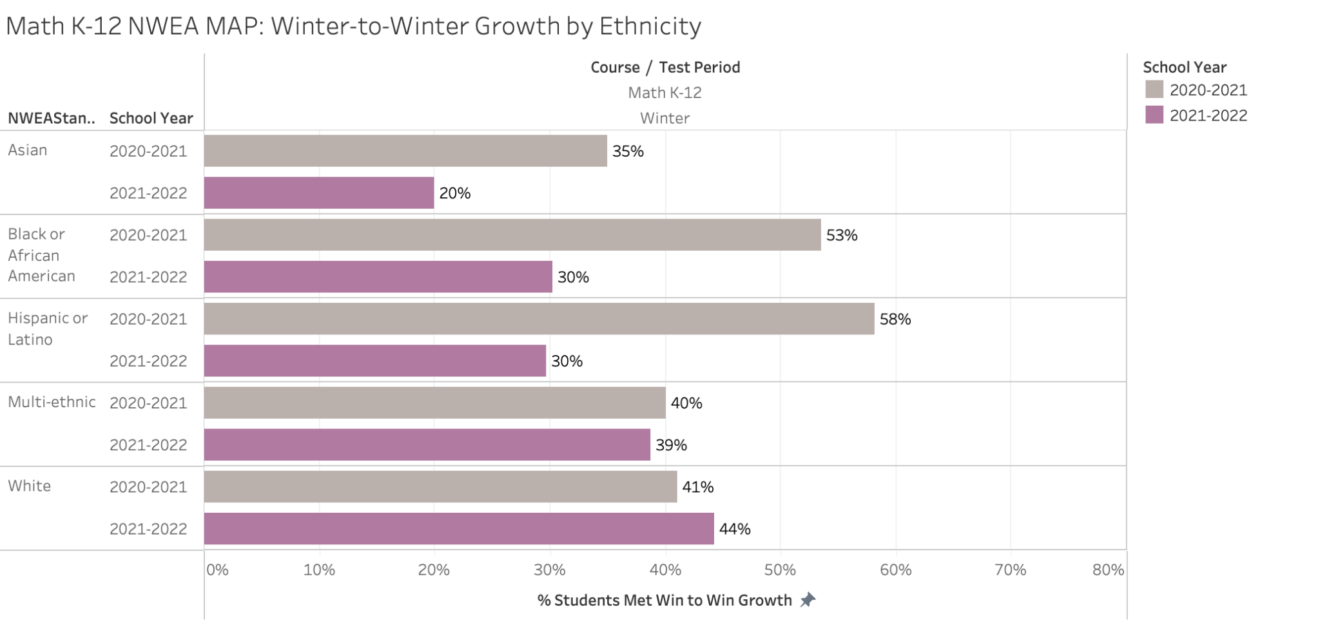
Math growth by ethnicity
Winter-to-winter math growth varies by race/ethnicity
Growth from multi-ethnic & White students is on-par or better than peers last year
More support needed for Asian, Black, Latinx students to achieve math growth targets

Slide 7
Math Results by Grade Band
More middle school students achieved growth targets this year than peers last year
Growth from lower and upper elementary students is lower than last year

Slide 8
Reading Detail

Slide 9
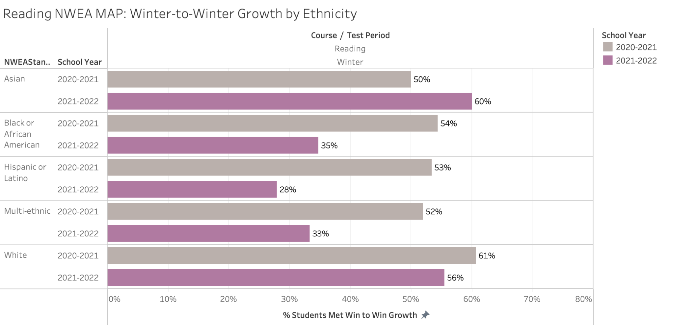
Reading growth by ethnicity
Winter-to-winter reading growth varies by race/ethnicity
Growth from Asian and White students is on-par or better than peers last year
More support needed for Black, Latinx, and multi-ethinic students to achieve reading growth targets

Slide 10
Reading Growth by Grade Band
More middle school students achieved growth targets this year than peers last year
Growth from lower and upper elementary students was similar and lower than last year
Notes:
Similar trends by grade level for reading as we saw in math

Slide 11
Next steps
Academic committee and administration to dig deeper into results
Reflect on what’s driving strong growth in some spaces/students, how to spread those practices, and what needs to change to accelerate growth
Review results with teachers to identify priority areas and students in need of additional support

