Slide 1
Summit Academy Charter School
Board Meeting Presentation
April 2021

Slide 2
Academic Excellence Principal’s Report
Hybrid Learning Model (April)
Data Dashboard
Summit Academy Professional Learning Institute (2020-2021)
DOE Authorizer Visit
ELA State Testing
Graduation Rates
Reentry Plan
CEI Academic Coaches

Slide 3
April In-Person Learning Stats
Date | Middle School | High School
4/12 | 9 | 8
4/13 | 11 | 8
4/14 | 12 | 7
4/15 | 10 | 7
4/16 | 8 | 4
4/26 | 10 | 7
4/27 | 63* | 5
4/28
4/29
4/30

Slide 4
Data Dashboard
https://docs.google.com/spreadsheets/d/13hrtJt-rpGBp87497n7Yts-82MTEnl-VyNqerdmQPTM/edit#gid=0

Slide 5
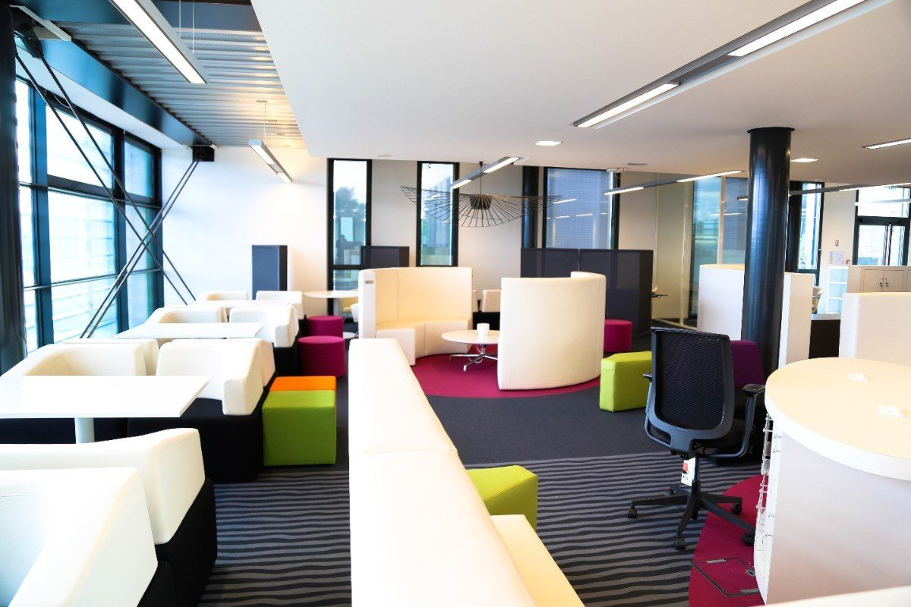
Professional Learning Institute
https://docs.google.com/document/d/1JTcSeEjENEPwaXMIwxto6M6WIhc5OwI-/edit

Slide 6
Doe authorizer visit April 14th
Note
Observation
Revisit evaluation plan
Not a high stakes visit
Used to support Summit in during the renewal
Visited Classrooms in both middle and high school
Liked the progress she saw-raised some concerns regarding teacher groupings and execution of the lesson’s objectives
Review the 5 year plan
Revise the leading and lagging indicators submitted year 1-due April 30th

Slide 7
ELA State Testing
Middle School Scholars:
91 scholars eligible to test
63 scholars showed up approximately 70% (Day 1)
Anticipate 25% for day 2 makeup

Slide 8
Graduation Rate (anticipated)
Middle School
39 Scholars
Must pass all classes
39/39= 100%
High School
48 potential graduates:
2015-1 scholar (0/1)=0%
2016- 4 scholars= (3/4)=75%
2017-36 scholars (25/36)= 70%
2018- 7 scholars (7/7)=100%
Anticipated Graduates: 35/48= 73%

Slide 9
Reentry Plan
Summer
SUMMER/FALL
Summer School Session
6 weeks July 5th –August 13th
List determined by the end of quarter 3 (April 15th )
Summer Institute for educators (August 2nd to 20th )
Middle School Orientation ( starts August 23rd )
High School Orientation (starts August 30th )
First day of school September 8th (anticipated)

Slide 10
CEI- Academic coaches
Second Session: April 5th –May 15th
This Photo by Unknown Author is licensed under CC BY-NC

