Slide 1
Development Committee Agenda
Thursday, 5/20 at 12 pm
Approve Meeting Minutes from 4/13/21
Fundraising Update
General Development Committee Priorities
Subcommittee Discussions
Discuss Committee Next Steps

Slide 2
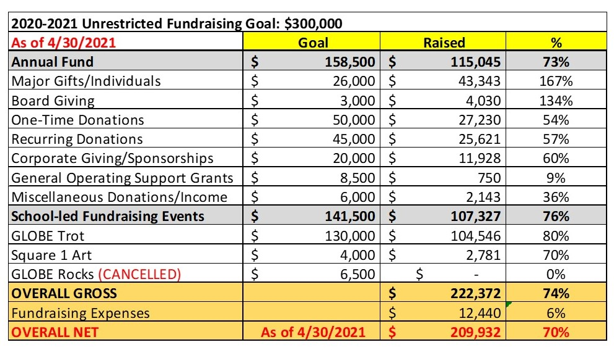
Fundraising Update

Slide 3
General Development Committee Priorities
Fund Development Plan – Meghann
Sponsorship Packet – Leigh
Bloomerang Donor Database – Meghann

Slide 4
Subcommittee Discussions
Leader/Reporting for Each Subcommittee
Fundraising Event Subcommittee
“Meet” with school staff who manage these events and set very rough dates – May 25 at 12pm
Start seeking sponsors for GLOBE Trot this summer
Research GiveButter.com and other potential platform vendors for in-person or virtual event
Grants Subcommittee
Update grant calendar and research new prospects
Apply for funding in the summer/fall for next school year
Work with other Board Committees (Facilities, DEI, Academic) and school staff to determine needs for restricted projects
Annual Fund Subcommittee
Develop more targeted strategies to appeal to major donors, recurring donors and sponsors
Create manageable process to keep up with donor acknowledgement and recognition tasks
Coordinate with PTCC’s calendar to strategically plan for Annual Fund appeals/giving opportunities throughout the year

Slide 5
Next Development Committee Meeting
Thursday, June 17, 2021 at 12 pm via Zoom
Next GLOBE Board Meeting
Monday, May 24, 2021 at 7:00 pm via Zoom
Development Committee Next Steps?

