Slide 1

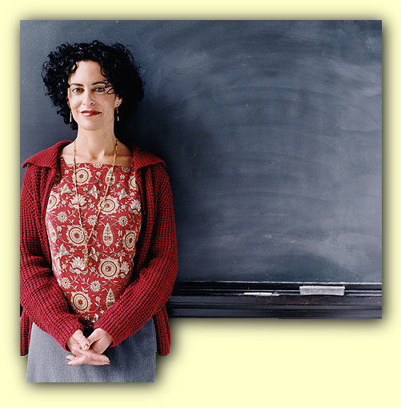

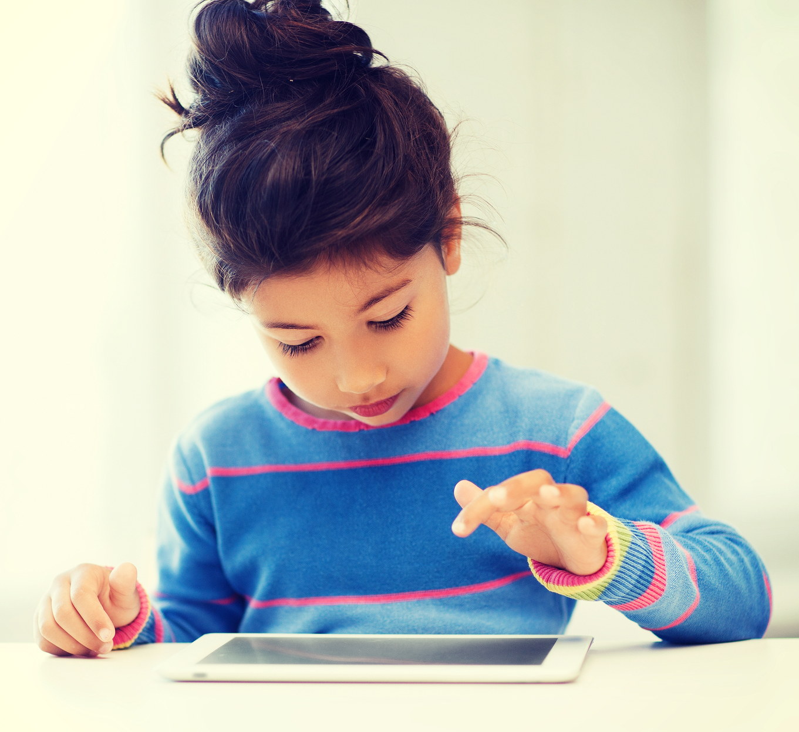



Slide 2
Core beliefs
CORE BELIEFS
All students can learn and reach his or her potential.
Effective teachers make the most difference in student academic performance.
We hold high expectations for students and ourselves.
We value parent engagement and community support.
We are accountable for clearly defined outcomes.
We value equity and commit to reducing inequities inherent in the education system.

Slide 3
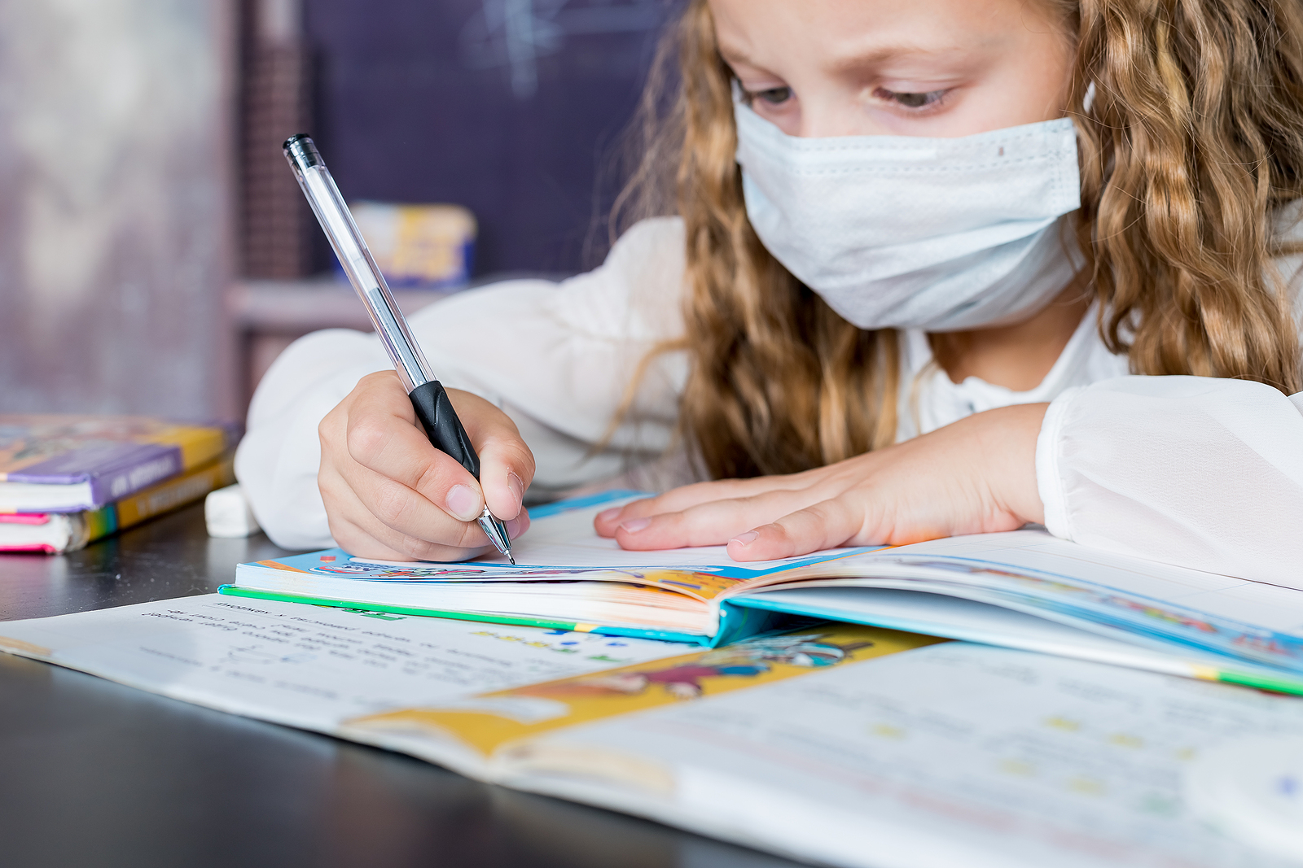
TFS 2020-2021 mid-year NWEA SCORES
4 jan 2021

Slide 4
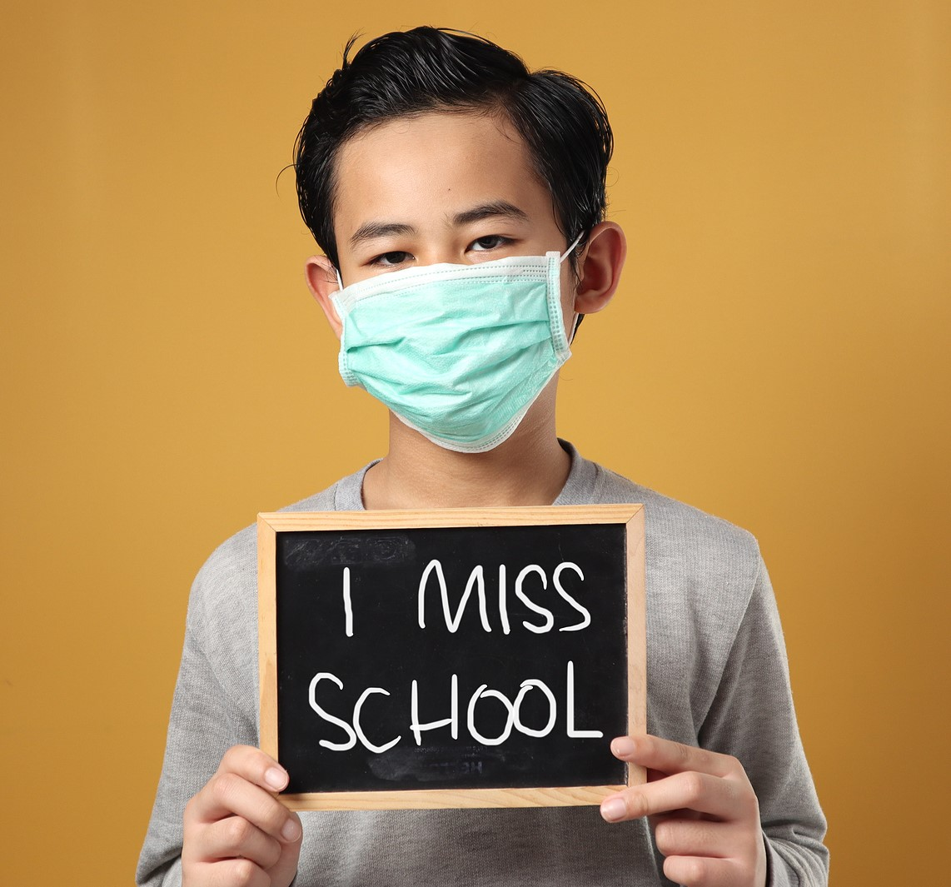

Slide 5
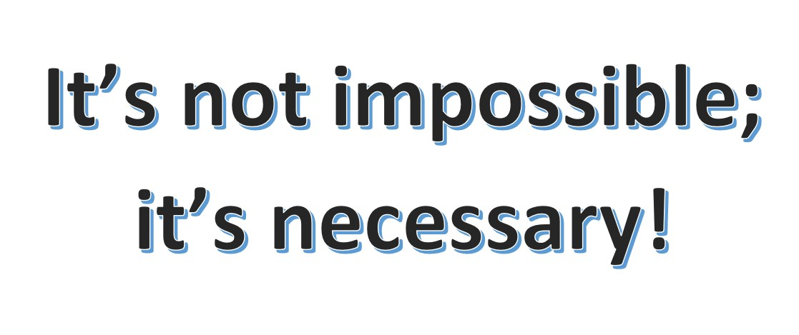

Slide 6
All Third Future Schools are on track to attain approx. 1.5 times the growth of the average student in the U.S. made prior to COVID.

Slide 7

We are demonstrating better than average academic growth even during the pandemic!

Slide 15

School slides
Dec 2020

